Slide 1

HEAT ILLNESS PREVENTION
For
ANR Employees and Volunteers
By

Slide 2
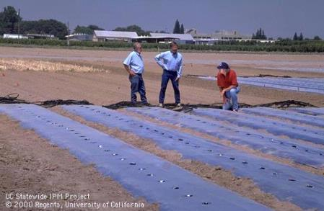


INTRODUCTION
Introduction
Objective
Compliance
Training
Risk Factors
Heat Index
Monitor
Heat Illness
Clothing
Comm.
Best Practice
Water
Shade & Rest
Work
Acclimate
Procedures
Plan
Responding
Summary
There were an average of 117 heat-caused fatalities in the US each year from 2000 to 2009.
About 25% of these fatalities occurred in outside locations.
This program provides information to reduce risks for experiencing heat illness and addresses heat training requirements given under California regulations.

Slide 3
OBJECTIVES
Introduction
Objective
Compliance
Training
Risk Factors
Heat Index
Monitor
Heat Illness
Clothing
Comm.
Best Practice
Water
Shade & Rest
Work
Acclimate
Procedures
Plan
Responding
Summary
After completing this training you will:
Understand regulations relating to heat illness.
Know risk factors, types of heat illness, and symptoms.
Know how to respond to onset of heat illness and when/how to summon emergency responders.
Be aware of additional information resources.
Supervisors should know their additional responsibilities to protect their employees who are at risk of heat illness

Slide 4
COMPLIANCE WITH HEAT ILLNESS REGULATIONS
Introduction
Objective
Compliance
Training
Risk Factors
Heat Index
Monitor
Heat Illness
Clothing
Comm.
Best Practice
Water
Shade & Rest
Work
Acclimate
Procedures
Plan
Responding
Summary
ANR has implemented training and procedures for meeting heat illness regulatory requirements:
Heat illness information available online at http://safety.ucanr.org/Programs/Heat_Illness_Prevention/
Heat Illness Prevention Plans developed as part of each location’s written Injury and Illness Prevention Program (Attachment H) or for individual research projects. See http://safety.ucanr.org/files/2859.pdf
Heat Illness Awareness Safety Note available online at http://safety.ucanr.org/files/1411.pdf
This Heat Illness Prevention training module

Slide 5

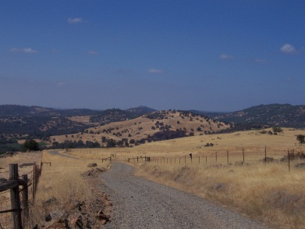
TRAINING
Introduction
Objective
Compliance
Training
Risk Factors
Heat Index
Monitor
Heat Illness
Clothing
Comm.
Best Practice
Water
Shade & Rest
Work
Acclimate
Procedures
Plan
Responding
Summary
No employee shall begin outdoor work where heat illness prevention measures are required unless they have received training that includes the following information:
The work site Heat Illness Prevention Plan; and
A description of risk factors, the types of heat illness, signs and symptoms, steps to prevent or treat
heat illness, and emergency response
procedures.

Slide 6
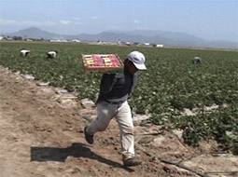
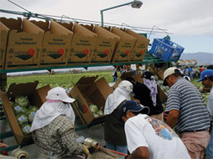
HEAT ILLNESS RISK FACTORS
Introduction
Objective
Compliance
Training
Risk Factors
Heat Index
Monitor
Heat Illness
Clothing
Comm.
Best Practice
Water
Shade & Rest
Work
Acclimate
Procedures
Plan
Responding
Summary
Personal or environmental factors may increase the risk for heat illness.
Environmental factors include temperature and humidity, wind and sun conditions, physical exertion associated with work tasks, and use of protective clothing and personal protective equipment.
Personal factors include consuming water, alcohol, caffeine, and soft drinks, degree of acclimatization, use of medications, age, and health.

Slide 7
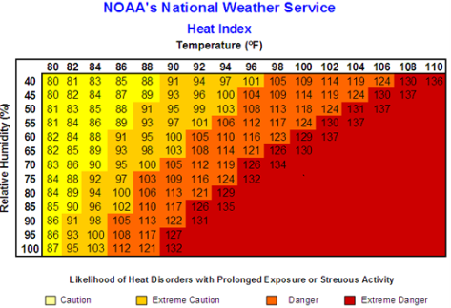
HEAT INDEX
Introduction
Objective
Compliance
Training
Risk Factors
Heat Index
Monitor
Heat Illness
Clothing
Comm.
Best Practice
Water
Shade & Rest
Work
Acclimate
Procedures
Plan
Responding
Summary
Measurement of how hot it feels in degrees Fahrenheit.
Heat index chart identifies heat illness danger zones.
Danger zones occur at lower temperatures when humidity is high and conversely, at higher temperatures when humidity is low.

Slide 8
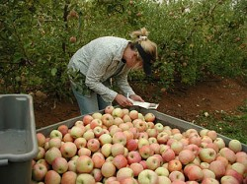
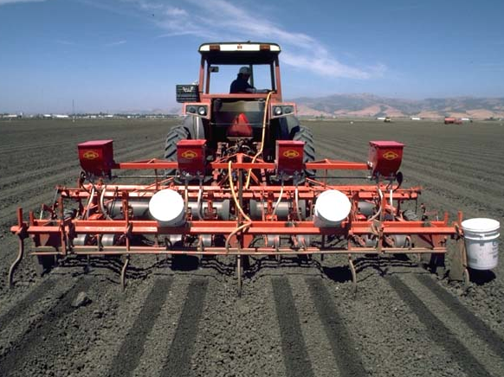
MONITOR THE WEATHER
Introduction
Objective
Compliance
Training
Risk Factors
Heat Index
Monitor
Heat Illness
Clothing
Comm.
Best Practice
Water
Shade & Rest
Work
Acclimate
Procedures
Plan
Responding
Summary
To determine predicted temperatures for the work location and develop plans to address potential heat illness risks.
Use a thermometer and/or access National Weather Service temperature and humidity information available online at: http://www.weather.gov

Slide 9



TYPES OF HEAT ILLNESS
Introduction
Objective
Compliance
Training
Risk Factors
Heat Index
Monitor
Heat Illness
Clothing
Comm.
Best Practice
Water
Shade & Rest
Work
Acclimate
Procedures
Plan
Responding
Summary
From most to least serious, heat illnesses include:
  Heat stroke
  Heat exhaustion
  Heat cramps
  Heat syncope
  Heat rash
Heat stroke is a life threatening condition that requires an immediate medical response.

Slide 10
HEAT ILLNESS SYMPTOMS
Introduction
Objective
Compliance
Training
Risk Factors
Heat Index
Monitor
Heat Illness
Clothing
Comm.
Best Practice
Water
Shade & Rest
Work
Acclimate
Procedures
Plan
Responding
Summary
Heat stroke: characterized by mental confusion, fainting, or seizures; hot dry skin usually reddish in color, high body temperature, rapid pulse, and shallow breathing.
Heat exhaustion: characterized by fatigue, dizziness, and nausea; profuse sweating, pale and moist skin, chills, fast pulse, and possibly slightly elevated temperature.
Heat cramps: characterized by muscle spasms in the arms, legs, and abdomen.
Heat syncope: characterized by fainting while standing still.
Heat rash: characterized by irritated/itchy skin with prickly feeling and small red bumps.
Any symptoms of heat illness must
be immediately reported

Slide 11
HEAT ILLNESS TREATMENTS
Introduction
Objective
Compliance
Training
Risk Factors
Heat Index
Monitor
Heat Illness
Clothing
Comm.
Best Practice
Water
Shade & Rest
Work
Acclimate
Procedures
Plan
Responding
Summary
Heat stroke: call 911 immediately, soak clothing with cool water, move to shaded and cool area, fan to increase body cooling.
Heat exhaustion: rest in shaded and cool place and drink fluids. Victim should not resume work.
Heat cramps: rest and drink non-caffeinated fluids. Usually rest and water is all that is needed.
Heat syncope: rest in a shaded and cool place, and drink fluids.
Heat rash: wash and dry skin, wear loose clothing and keep skin dry.

Slide 12
APPROPRIATE CLOTHING
Introduction
Objective
Compliance
Training
Risk Factors
Heat Index
Monitor
Heat Illness
Clothing
Comm.
Best Practice
Water
Shade & Rest
Work
Acclimate
Procedures
Plan
Responding
Summary
Wear long-sleeve shirts and long pants.
Wear loose fitting, light-weight and light-colored cotton clothes.
Wear sturdy, closed-toed shoes.
Wear a wide-brimmed hat or cap, and a bandana.

Slide 13
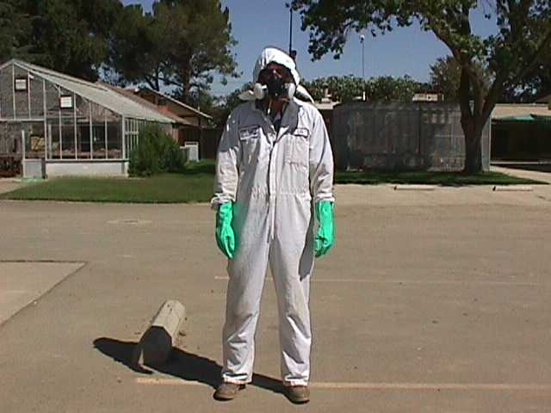
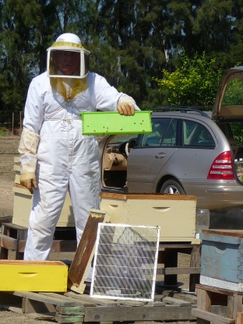
PERSONAL PROTECTIVE EQUIPMENT (PPE)
Introduction
Objective
Compliance
Training
Risk Factors
Heat Index
Monitor
Heat Illness
Clothing
Comm.
Best Practice
Water
Shade & Rest
Work
Acclimate
Procedures
Plan
Responding
Summary
Certain tasks require the use of PPE which may increase heat illness risk factors. PPE can restrict the rate and amount of heat exchange between the body and atmosphere. Extra precautions when wearing PPE may include:
Increasing the frequency and time of work breaks;
Consuming more water; and
Restricting the work time when PPE is required to be worn.

Slide 14
EFFECTIVE COMMUNICATION
Introduction
Objective
Compliance
Training
Risk Factors
Heat Index
Monitor
Heat Illness
Clothing
Comm.
Best Practice
Water
Shade & Rest
Work
Acclimate
Procedures
Plan
Responding
Summary
Communication is important to preventing heat illness, particularly if an emergency occurs or for periodically relaying information to supervisors about the location and physical status of workers.
Use person-to-person conversation or cell phones, walkie-talkies, two way radios, satellite phones, and other devices.
Employees shall be thoroughly trained on how and when to use the communication equipment.
Employees working alone shall communicate status reports to their supervisor according to a pre-arranged schedule.

Slide 15
BASIC PRACTICES
Introduction
Objective
Compliance
Training
Risk Factors
Heat Index
Monitor
Heat Illness
Clothing
Comm.
Best Practice
Water
Shade & Rest
Work
Acclimate
Procedures
Plan
Responding
Summary
Basic warm weather work practices include:
Pacing yourself.
Not working overtime or extra shifts.
Informing your supervisor of medical conditions or medications.
Never ignoring any heat illness symptom. Tell your supervisor about the symptoms.
Modifying how you work to address daily changes in temperature.

Slide 16

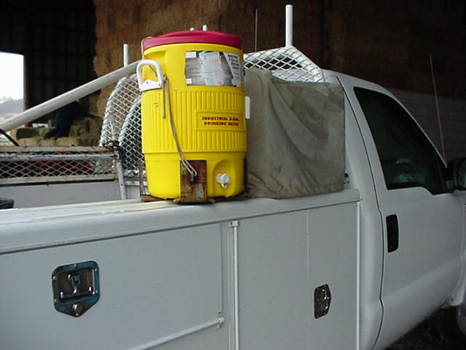
DRINK SUFFICIENT WATER
Introduction
Objective
Compliance
Training
Risk Factors
Heat Index
Monitor
Heat Illness
Clothing
Comm.
Best Practice
Water
Shade & Rest
Work
Acclimate
Procedures
Plan
Responding
Summary
The body requires sufficient intake of water to defend against heat illness.
Drink water even when you are not thirsty.
Drink water before and after work.
Drink small amounts of water frequently. For example: drink at least one cup (8 oz.) of water every 15 minutes
(or 1 quart per hour).

Slide 17
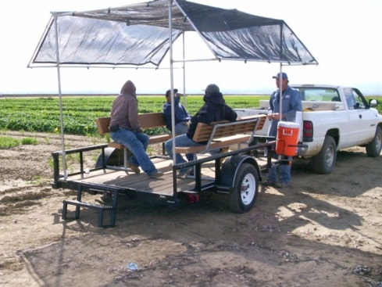

SHADE AND REST
Introduction
Objective
Compliance
Training
Risk Factors
Heat Index
Monitor
Heat Illness
Clothing
Comm.
Best Practice
Water
Shade & Rest
Work
Acclimate
Procedures
Plan
Responding
Summary
Take regularly scheduled rest breaks.
Whenever you feel you are becoming overheated, take a cool-down rest.
Shade may be provided by buildings, lean-tos, umbrellas, canopies, tarps, or other methods that block direct sunlight.
Shaded areas must be readily available and accommodate 25% of the employees in normal posture without touching each other.

Slide 18

SCHEDULING WORK
Introduction
Objective
Compliance
Training
Risk Factors
Heat Index
Monitor
Heat Illness
Clothing
Comm.
Best Practice
Water
Shade & Rest
Work
Acclimate
Procedures
Plan
Responding
Summary
When possible, schedule work/tasks at times when temperatures (and humidity) are at lower levels.
Strenuous work can be rescheduled or hours can be changed to work around the warmest part of the day
(11 am to 5 pm).
If necessary, work can be
stopped.

Slide 19
MONITORING FOR HEAT ILLNESS
Introduction
Objective
Compliance
Training
Risk Factors
Heat Index
Monitor
Heat Illness
Clothing
Comm.
Best Practice
Water
Shade & Rest
Work
Acclimate
Procedures
Plan
Responding
Summary
Always self-monitor for symptoms of heat illness.
Upon heat illness onset, immediately seek rest and begin consuming water. Notify others of your condition.
Use a buddy system to monitor for the signs of heat illness (disorientation, profuse sweating, fatigue, cramps, nausea, etc.).
If symptoms of heat illness are observed, then notify the supervisor and assist victim to seek rest in shade and obtain water.
If rest and water does not reduce heat illness symptoms, then seek further treatment at a medical facility.

Slide 20
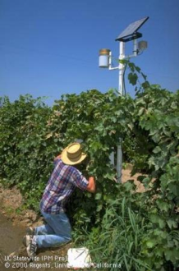
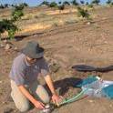
ACCLIMATIZATION
Introduction
Objective
Compliance
Training
Risk Factors
Heat Index
Monitor
Heat Illness
Clothing
Comm.
Best Practice
Water
Shade & Rest
Work
Acclimate
Procedures
Plan
Responding
Summary
Acclimatization is the body’s natural adaptation to temperature changes.
Acclimatization occurs over time.
Acclimatization decreases or disappears quickly.
Full-time, employees working outdoors typically acclimate as the weather gradually becomes warmer.
Supervisors must allow new employees time to acclimate.

Slide 21
HIGH HEAT PROCEDURES
Introduction
Objective
Compliance
Training
Risk Factors
Heat Index
Monitor
Heat Illness
Clothing
Comm.
Best Practice
Water
Shade & Rest
Work
Acclimate
Procedures
Plan
Responding
Summary
When the outdoor temperature exceeds 95° F, High Heat procedures must be implemented. Supervisors shall:
Assure effective communication is maintained;
Carefully observe workers for symptoms of heat illness;
Remind workers to drink water more frequently; and
Pay attention to new employees who may not be adequately acclimated.
Increasing the frequency/length of rest breaks and altering work schedules are also used during periods of high heat.

Slide 22
HEAT ILLNESS
PREVENTION PLAN
Introduction
Objective
Compliance
Training
Risk Factors
Heat Index
Monitor
Heat Illness
Clothing
Comm.
Best Practice
Water
Shade & Rest
Work
Acclimate
Procedures
Plan
Responding
Summary
Heat Illness Prevention Plans are developed as part of written Injury and Illness Prevention Program (Attachment H) or for research projects and other activities.
Heat Illness Prevention Plans describe heat illness symptoms, treatment, and prevention and responses to a heat illness, including instructions for contacting an emergency responder and providing directions to the work site or alternatively, transporting a victim to the nearest emergency care facility.
Supervisors, employees and volunteers shall review and understand the Heat Illness Prevention Plan for their work site or location where an activity takes place.

Slide 23
RESPONDING TO A HEAT ILLNESS INCIDENT
Introduction
Objective
Compliance
Training
Risk Factors
Heat Index
Monitor
Heat Illness
Clothing
Comm.
Best Practice
Water
Shade & Rest
Work
Acclimate
Procedures
Plan
Responding
Summary
Supervisors, employees, and volunteers response to heat illness incidents shall include:
Recognizing symptoms;
Providing treatment;
Knowing when to implement emergency procedures;
Assuring victim is not left alone or sent home until they have fully recovered;
Directing emergency responders to the work site or activity location; and
Transporting victim to the nearest emergency medical facility.

Slide 24
SUMMARY
Introduction
Objective
Compliance
Training
Risk Factors
Heat Index
Monitor
Heat Illness
Clothing
Comm.
Best Practice
Water
Shade & Rest
Work
Acclimate
Procedures
Plan
Responding
Summary
Heat illness can be prevented by following the controls and procedures that have been discussed in this training.
Key preventative measures include:
Reviewing the site-specific Heat Illness Prevention Plan.
Drinking water frequently and in adequate amounts.
Wearing appropriate warm weather clothing.
Taking cool-down rest breaks.
Being acclimated to warm weather.
Knowing heat illness symptoms
and treatments.

