Slide 1
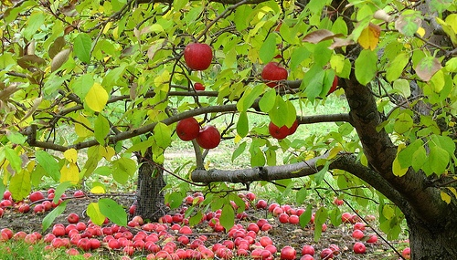
Fruit Tree Selection and Planting
Notes:
Mention today’s date: November 15, 2015. This is also so those watching this later will know when it was done. Like an archeological find.

Slide 2
Welcome!

Slide 3
Presented by UC Master Gardeners of Napa County
Welcome!
Who we are
What we do
What today is all about
The future

Slide 4
Who We Are
Workshops
Help Desks: UCCE, Mobile & Farmers Markets
Website
Weekly Newspaper Column
Demonstration Garden at Connolly Ranch
Monthly Guide to Gardening
Trees in Napa Updated Book
Tomato Sale: April
UC Master Gardeners’ Garden Tour: 2017 (Think ahead!)
Train New Master Gardeners
Like us on Facebook!
Notes:
And we have several services we want to make sure you know about!
First, workshops—you already know that, because you are here!
We have a Help Desk (bricks and mortar), and here (Hold up business card) is the information for that. And we have Mobile Help Desks at various nurseries in the area in the spring, and we are generally a presence at all the valley Farmers Markets. Have any of you seen us around?
Our website is just packed with help! Google Napa County Master Gardeners. We are also linked to the Agriculture and Natural Resources library at UC Davis.
We have a weekly column in the Napa newspaper—have you seen it? You can find an archive of our newspaper articles on our website.
We have a comprehensive demonstration garden in Napa at Connolly Ranch, at Browns Valley and Thompson roads. Have any of you been there? Please check our open garden schedule on our website and come have a look!
We have our Monthly Garden Guide specific to Napa County and have just completed an update to our book about Trees in Napa.
We want you to take advantage of all this information!
But wait, there’s more!
We train future Master Gardeners! Check our website to sign up to be notified when we begin recruiting for the 2017 class next summer! Our 2016 candidates are currently in interviews.

Slide 5
Fruit Tree Selection and Planting November 15, 2015
Site Considerations: Meredith Lavene
Tree Selection and Varieties: Meredith Lavene
Pollination: Gayle Nelson
Soil Preparation and Planting: David Layland
Fireblight: David Layland
Pruning and care?
We have a workshop for that!
(Jan 16 or 23, Silverado MS)

Slide 6
Climate
Climate Zones
USDA
Sunset
Microclimates – Property Issues
Slope
Aspect
Wind

Slide 7
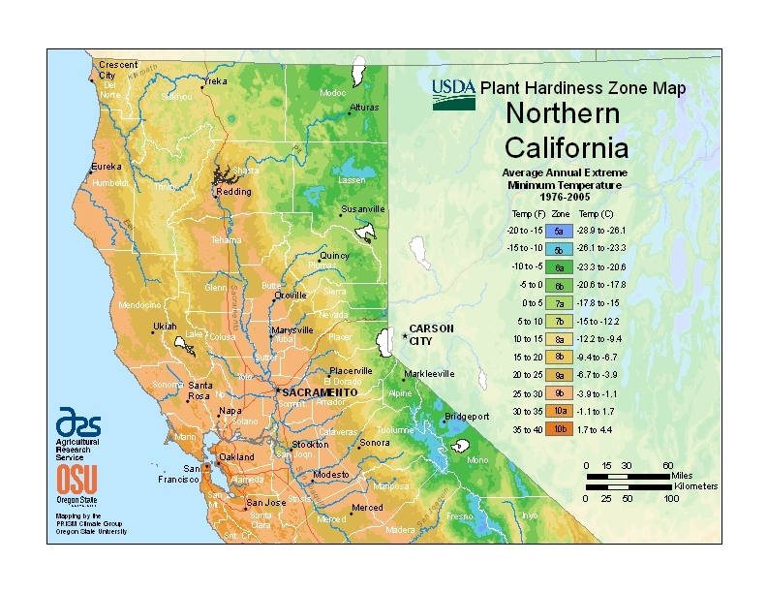
USDA Zones
Notes:
This is really hard to read—you can find it online by searching for USDA Zones.
What is important here is our USDA zones in Napa County indicating the average annual extreme minimum temperature.
Zone 9b, zip 94558, 94574, 94508: 25-30 F
Zone 9a, zip 94515: 20-25 F

Slide 8
Sunset Climate Zones
Notes:
Zone 7 owes its Foothill-Digger Pine name to the abundance of California foothill pines in the area. The zone comprises the eastern part of the county and includes Pope Valley and Lake Berryessa. These areas have a later spring and earlier frosts than the rest of the county, creating a growing season that may be as much as a month shorter. Summers are hotter and dryer. This is a good area for late- or long-blooming fruit and nut trees. This zone also defines most of Lake County.
Zone 14, the so-called Coastal Warm area, includes the major valley floors in the county. The coastal influence keeps this zone from being as hot as the Central Valley. It is protected from the summer fog by its distance from the ocean and the mountain ranges; thus, summers in this zone are very dry. Between April 1 and October 31, the area clocks more than 1,100 hours between 70°F and 90°F degrees. Most deciduous fruit trees and wine grapes do well here. Sonoma County’s valley floors, including the town of Sonoma, are in this zone, too.
Zone 15, nicknamed Coastal Cool, is affected by marine air 85 percent of the time and inland air 15 percent of the time. It covers the foggy hilltops above the valleys and the southern part of the county east of Napa and includes Mount Veeder, Spring Mountain and Howell Mountain. It logs from 800 to 1,100 hours between 70°F and 90°F during the growing season. Cane berries, some fruits and certain grape varieties prosper here. Many of the plants recommended for Zone 15 will not prosper in Zone 14 because they need moister air, cooler summers or both. The Coastal Cool area receives more chilling hours than Zone 14.
Zone 17, the Marine area, is the coolest zone in Napa County. It is also the largest, encircling the floor of the Napa Valley. It includes the Carneros District, American Canyon and the Soscol Ridge up to Napa. The heavy marine fog brings cooler temperatures and less intense sunlight here compared to other Napa County zones. The growing season may see as few as 800 hours between 70°F and 90°F. Consequently, growing sub-tropical plants here is a challenge.

Slide 9
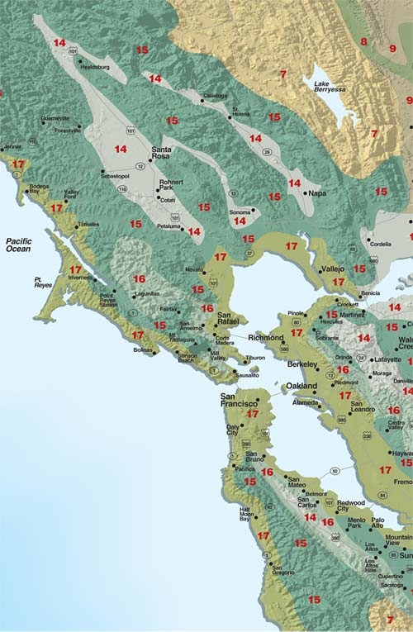
Notes:
Zone 7 owes its Foothill-Digger Pine name to the abundance of California foothill pines in the area. The zone comprises the eastern part of the county and includes Pope Valley and Lake Berryessa. These areas have a later spring and earlier frosts than the rest of the county, creating a growing season that may be as much as a month shorter. Summers are hotter and dryer. This is a good area for late- or long-blooming fruit and nut trees. This zone also defines most of Lake County.
Zone 14, the so-called Coastal Warm area, includes the major valley floors in the county. The coastal influence keeps this zone from being as hot as the Central Valley. It is protected from the summer fog by its distance from the ocean and the mountain ranges; thus, summers in this zone are very dry. Between April 1 and October 31, the area clocks more than 1,100 hours between 70°F and 90°F degrees. Most deciduous fruit trees and wine grapes do well here. Sonoma County’s valley floors, including the town of Sonoma, are in this zone, too.
Zone 15, nicknamed Coastal Cool, is affected by marine air 85 percent of the time and inland air 15 percent of the time. It covers the foggy hilltops above the valleys and the southern part of the county east of Napa and includes Mount Veeder, Spring Mountain and Howell Mountain. It logs from 800 to 1,100 hours between 70°F and 90°F during the growing season. Cane berries, some fruits and certain grape varieties prosper here. Many of the plants recommended for Zone 15 will not prosper in Zone 14 because they need moister air, cooler summers or both. The Coastal Cool area receives more chilling hours than Zone 14.
Zone 17, the Marine area, is the coolest zone in Napa County. It is also the largest, encircling the floor of the Napa Valley. It includes the Carneros District, American Canyon and the Soscol Ridge up to Napa. The heavy marine fog brings cooler temperatures and less intense sunlight here compared to other Napa County zones. The growing season may see as few as 800 hours between 70°F and 90°F. Consequently, growing sub-tropical plants here is a challenge.

Slide 10
Microclimate
Factors within Mediterranean Climate
Dry summer, rainy winter
Factors in Napa Climate
USDA and Sunset zones
Microclimate: temperature, frost, rain, hours
of sunlight, wind, elevation, topography
exposure, structures, chill factor, soil, eaves,
drainage.
Notes:
We have a “big tent party”: Mediterranean Climate. Our Golf umbrella are our Sunset Climate Zones for Napa Valley: Our specific gear (raincoat, hat) is microclimate
Microclimate includes temp (record daily high/low); frost (often, occasional); rainfall (direction, normal, drought, El Nino, which side of valley); sunlight in parts of year;
wind (direction, velocity, seasonal?); Elevation; topography (top or bottom of hill, open valley, under trees, rocky outcropping); exposure (placement of home, direction
of sun, note seasonal changes); structures (buildings, fences, walls, terraces, paved areas that cause wind, shade, heat, reflections); chill factor will talk about; Soil
(clay or sandy soil will impact drainage); eaves (direction of overhangs for frost protection); drainage (water table, percolation, standing water, run-off)

Slide 11
Microclimates

Slide 12
Location/Tree Size
Space availability: Site constraints
Type of tree(s) desired
-standard
-semi dwarf
-dwarf
Space saver: Espaliered trees
Fruit Tree hedge; Three in a hole

Slide 13
Site Constraints
Nearby structures and trees
Water availability
Fences, pavement, and utilities
Microclimates nearby

Slide 14
Site Considerations
Soil quality and drainage
Space available
Chilling requirement—total hrs below 45
Temperature extremes
Spring rains
Late frost
Water needs

Slide 15
Relative sizes of Fruit trees
Notes:
The height of these trees is:
Far left: 3 to 6 ft--Dwarf
Middle: 9 to 10 ft—Semi-dwarf. Rootstocks for this height: M7 (apple) , Pumiselect (prunus), Citation (prunus), OHXF333 (pear)
Right of middle: 12 to 13 ff—Semi-dwarf. Rootstocks for this height M111 (apple), OHXF97 (pear), Colt (cherry)
Far left: 18 to 20 ft—Standard size on standard rootstock

Slide 16
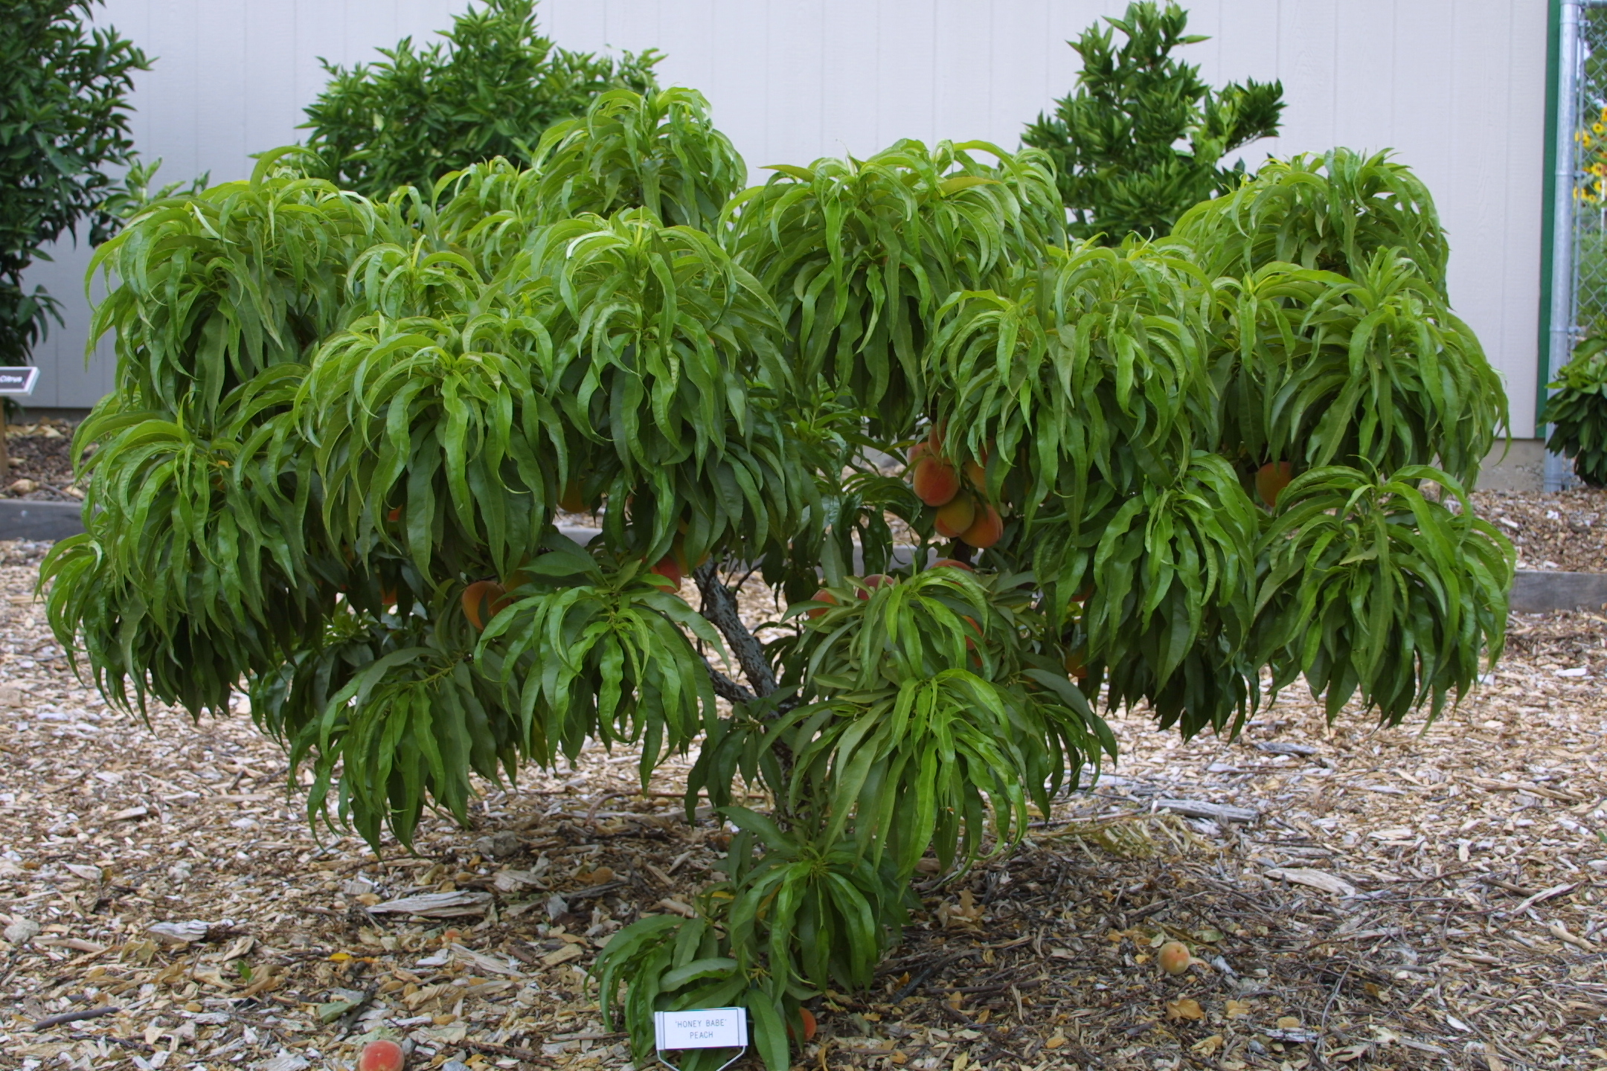
Genetic Dwarf Peach

Slide 17
Espalier Patterns

Slide 18
More Espalier

Slide 19
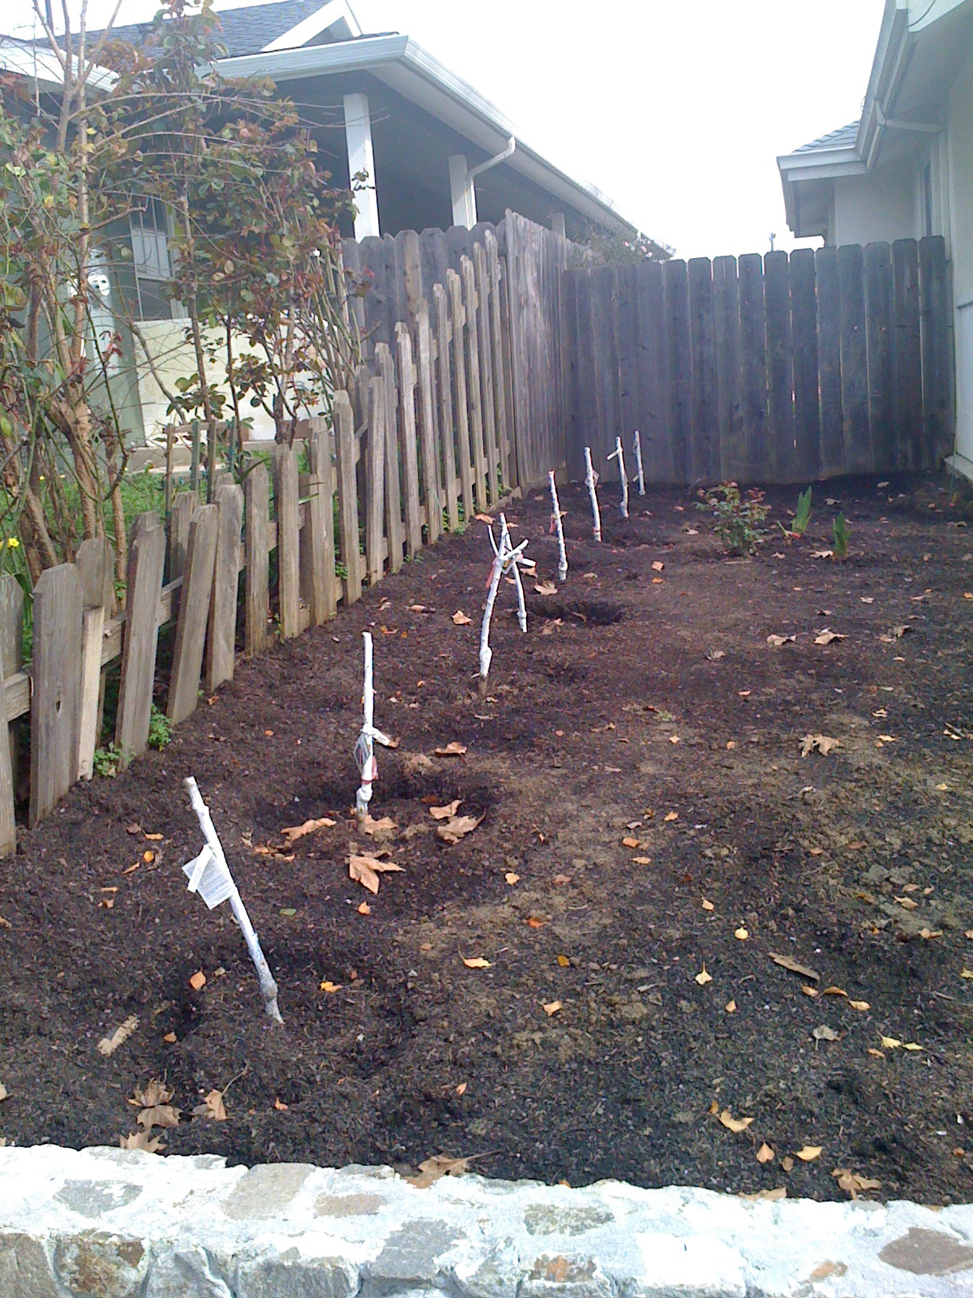
Fruit Tree Hedge

Slide 20
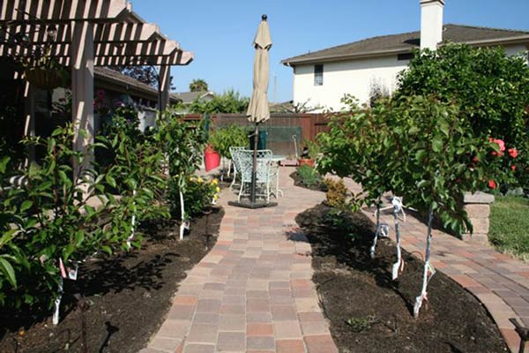
Fruit Tree Hedge

Slide 21
Fruit Tree selection: 3 or 4 in a hole
Plant in
one hole

Slide 22
Fruit Tree Terms
Rootstock/Stock: tree below graft union
Scion: tree above graft union; also grafted bud or shoot
Graft union: where bud has been grafted
Crown: trunk above ground; also the canopy
Tree size
Standard: 20-35 feet
Semi-dwarf on dwarfing rootstock: 12-20 feet
Genetic dwarf on standard rootstock: 6-12 feet

Slide 23
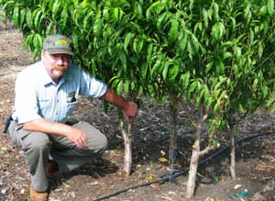
Fruit Tree selection: space considerations
4 in one hole

Slide 24
Trees requiring good drainage
Cherry
Peach
Nectarine
Almond
Walnut

Slide 25
Trees tolerating clay soil and wet spring
Pear
Apple
Plum and Pluot
Pomegranate
Quince
Persimmon
Fig

Slide 26
Drought-resistant trees
Apple on seedling rootstock – not grafted
Fig
Persimmon

Slide 27
Fruit Tree Terms: Chill Hours
Chilling requirement:
Total number of hours of winter dormancy needed for good bloom and growth in spring
Chilling hours:
Accumulated hours at or under 45 degrees F during winter. Hours need not be continuous.
Notes:
Annual pattern of growth of deciduous fruit trees changes with seasonal transitions. Grow rapidly during spring and first ½ of summer. Later in the season the growth rate declines. In the fall growth of trees stops as day length an temp decrease and drop their leaves. Dormancy is due to hormone growth inhibition and the trees internal processes are in a state of rest. Dormancy is then broken after sufficient cold temperature breaks down the growth inhibitor.
A specific number of hours of cold weather (below 45 degrees F) are required for each variety of deciduous trees, called CHILL HOURS Below 45degrees F/ 7 degrees C

Slide 28
Chill Hours
Usual Average Hours at 45 or below at:
Napa: 700-1000 hrs
St Helena: 700-1000 hrs
Calistoga: >1000 hrs
Lake Berry: >1000 hrs
Sonoma: 400-900 hrs
Healdsburg: 700-1000 hrs

Slide 29
Chill Hours
Chill hours in Carneros, from 2011 – 2015
show a decrease in cumulative chilling hours between Nov. 1 to Feb. 28 of each year,
from an average of 1,200 hours per year in
2011, 2012, 2013 to an average in 2014 of 800 hours
Note: this is only in Carneros
(information from UC Davis, Chill Calculators)

Slide 30
Good Performers, Napa County
Apple | Pollinator | Chilling | Rootstock | Harvest
Fuji | O | 800 hrs | M111* | November
Gala | O | 500-600 hrs | M7** | Late July
Gravenstein | + Fuji, Gala | 600 hrs | M111 | Late July
Golden Delicious | O | 700 hrs | M111 | September
Notes:
Many apple varieties are self-fruitful, including ‘Braeburn,’ ‘Empire,’ ‘Fuji,’ ‘Gala,’ ‘Granny Smith,’ and ‘Pippin.’

Slide 31
Rootstocks
Apple rootstocks:
MM111: Tolerates wet, poor soil; bears on young wood; ¾ standard size
M7: Resists fireblight and mildew; bears early and heavy; 2/3 standard size

Slide 32
Good Performers, Napa County
Pear | Pollinator | Chilling | Rootstock | Harvest
Bartlett | +D’Anjou | 800 hrs | OXHF333 | August
D’Anjou | +Bartlett | 800 hrs | OXHF333 | September
Bosc | +Bartlett | 800 hrs | OXHF333 | October
Comice | +Bartlett | 600 hrs | Quince rootstk | October

Slide 33
Rootstock
Pear rootstock:
OHXF 333: Fireblight resistant, 2/3 standard size

Slide 34
Good Performers, Napa County
Peach | Pollinator | Chilling | Rootstock | Harvest
Arctic Supreme | o | 700 hrs | Citation* | July-August
Nectar | o | 700 hrs | Lovell** | July
O’Henry | o | 750 hrs | Citation | August
Nectarine-- | Next slide
Notes:
Almost all citrus species are “self-fruitful.” Other self-fruitful species include quince, sour cherry, most apricots, fig (except the Smyrna type), peach (except ‘J.H. Hale’ and some others), and European-type plums and prunes. Some European pears are also self-fruitful. ‘Bartlett’ pear is parthenocarpic, which means that no pollination is required to set fruit (only in California). Some cherries are self-fruitful, such as ‘Lapins,’ ‘Stella,’ and ‘Sunburst.’ Many apple varieties are self-fruitful, including ‘Braeburn,’ ‘Empire,’ ‘Fuji,’ ‘Gala,’ ‘Granny Smith,’ and ‘Pippin.’

Slide 35
Good Performers, Napa County
Nectarine | Pollinator | Chilling | Rootstock | Harvest
Arctic Queen | o | 600-700 hrs | Citation | August
Fantasia | o | 500 hrs | Citation | July-August

Slide 36
Rootstock
Peach rootstock:
Citation: Peach-plum hybrid; dwarfing; tolerates wet winter; not drought tolerant; young bearing
Lovell: Tolerates wet winter; needs good drainage; grows full size tree

Slide 37
Good Performers, Napa County
Plum | Pollinator | Chilling | Rootstock | Harvest
Elephant Heart | +Santa Rosa | 500 hrs | Citation | August
Santa Rosa | o | 300 hrs | Citation | July
Pluot
Flavor King | +Santa Rosa | 500-600 hrs | Citation | August

Slide 38
Good Performers, Napa County
Persimmon | Pollinator | Chilling | Rootstock | Harvest
Fuyu | o | 300 hrs | Non-grafted | November
Hachiya | o | 300 hrs | Non-grafted | November
Pomegranate
Wonderful | o | 150 hrs | Non-grafted | October

Slide 39
Good Performers, Napa County
Quince | Pollinator | Chilling | Rootstock | Harvest
Pineapple | o | 300 hrs | Non-grafted | October
Fig
Black Mission | o | Low | Non-grafted | Sept, October
Brown Turkey | o | Low | Non-grafted | Sept, October

Slide 40
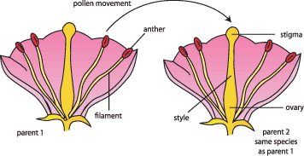
Pollination
Notes:
Fruit will not form until pollen from male parts are transferred to the female parts of a flower.
Without pollination, flowers may bloom abundantly, but will not bear fruit.
Pollination is the transfer of pollen from the stamens to the stigma of the same or a different flower.
Some species of fruit trees have perfect flowers—that is both the anthers which contain pollen, and the pistils which develop the fruit, are on the same blossom.
Trees THAT BEAR FRUIT from self pollination or from pollen from another tree of the same kind are called Self fruitful trees, or Self pollinating trees.

Slide 41
Pollination
Notes:
Pollination can be performed by animals, insects, wind, or water.

Slide 42
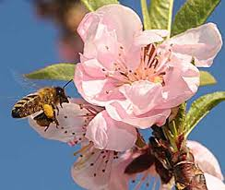
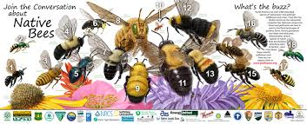
Pollination
Notes:
Mostly, fruit trees are pollinated by bees.
Fruit set refers to fertilized flowers that have developed fruit.

Slide 43
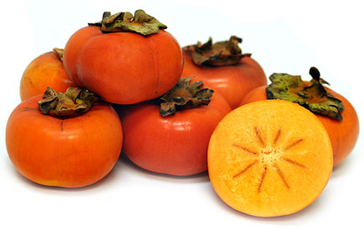
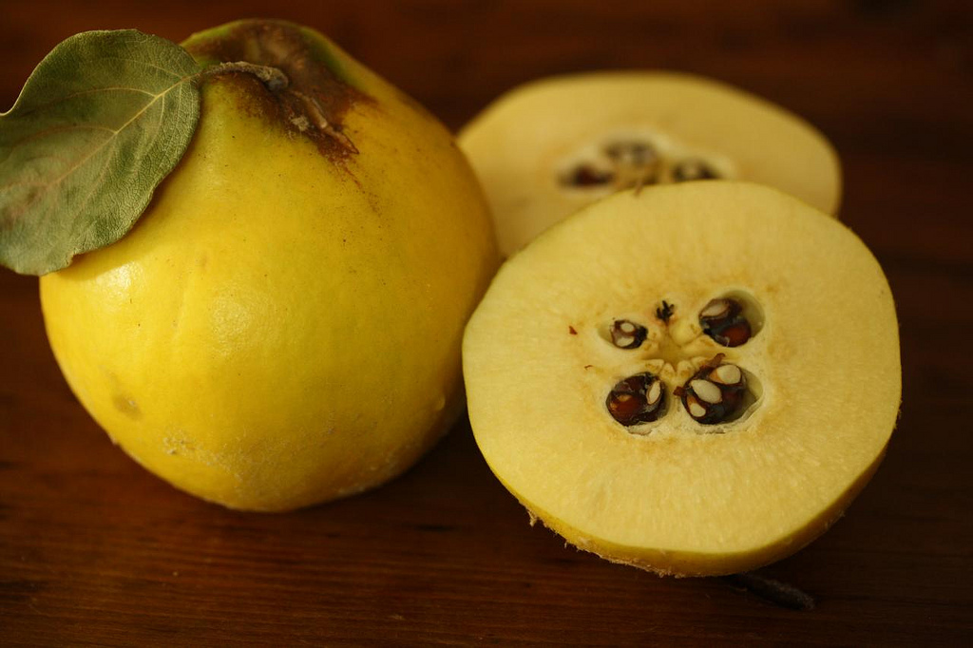
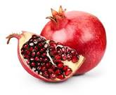
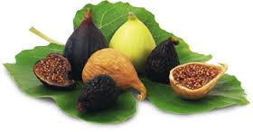
Self-Pollinating
Notes:
What do YOU as a home gardener need to know about pollination?
We talked about fruit trees with perfect flowers, that can bear fruit by self-pollinating.
Nearly all common varieties of apricot, peach, nectarine and sour cherry, persimmons, quince, and pomegranate are self-pollinating. MOST figs.

Slide 44
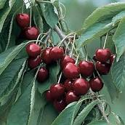
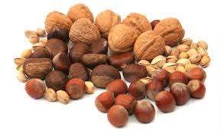
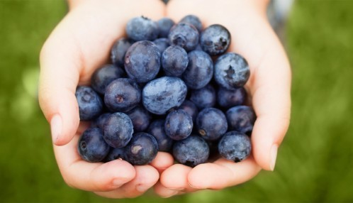
Self-Sterile
Notes:
Then there are Self sterile fruit trees.
However, there are many types of fruit trees with perfect flowers that cannot produce fruit from their own pollen.
They require pollen from a related cultivar.
That related cultivar is called a POLLENIZER.
In general, self-sterile types of fruit (and nuts) include many apples, sweet cherries, nuts, some pears, blueberries.

Slide 45
What’s a Home Gardener to do?
Learn about what you want to plant
What’s in the neighborhood?
Plant a pollinator in your garden
Graft a cultivar that will provide pollen
Check University publications
Visit commercial nurseries—Read the tag!
Notes:
Learn the needs of the tree you want to plant—some fruit species bear male and female parts on the same flower, some bear male and female flowers on the same tree, some bear male and female flowers on SEPARATE plants.
Often neighbors have fruit tree varieties that will serve as pollinators.
With appropriate bee activity (we’ll get back to that in a moment), neighboring trees or even wild trees can provide a source of pollen. Maximum distance, 100 ft.
Plant your own pollinator.
Graft a cultivar that will serve as a pollinator branch, or place a bouquet of flowers from a pollinator in a jug or basket and place in the tree. Do this in the early morning before the bees arrive.
We have a full listing of resources you can consult—it’s one of your handouts.
Please note especially the UC references—The Backyard Orchard, The Home Orchard, ANR PDF downloads.

Slide 46
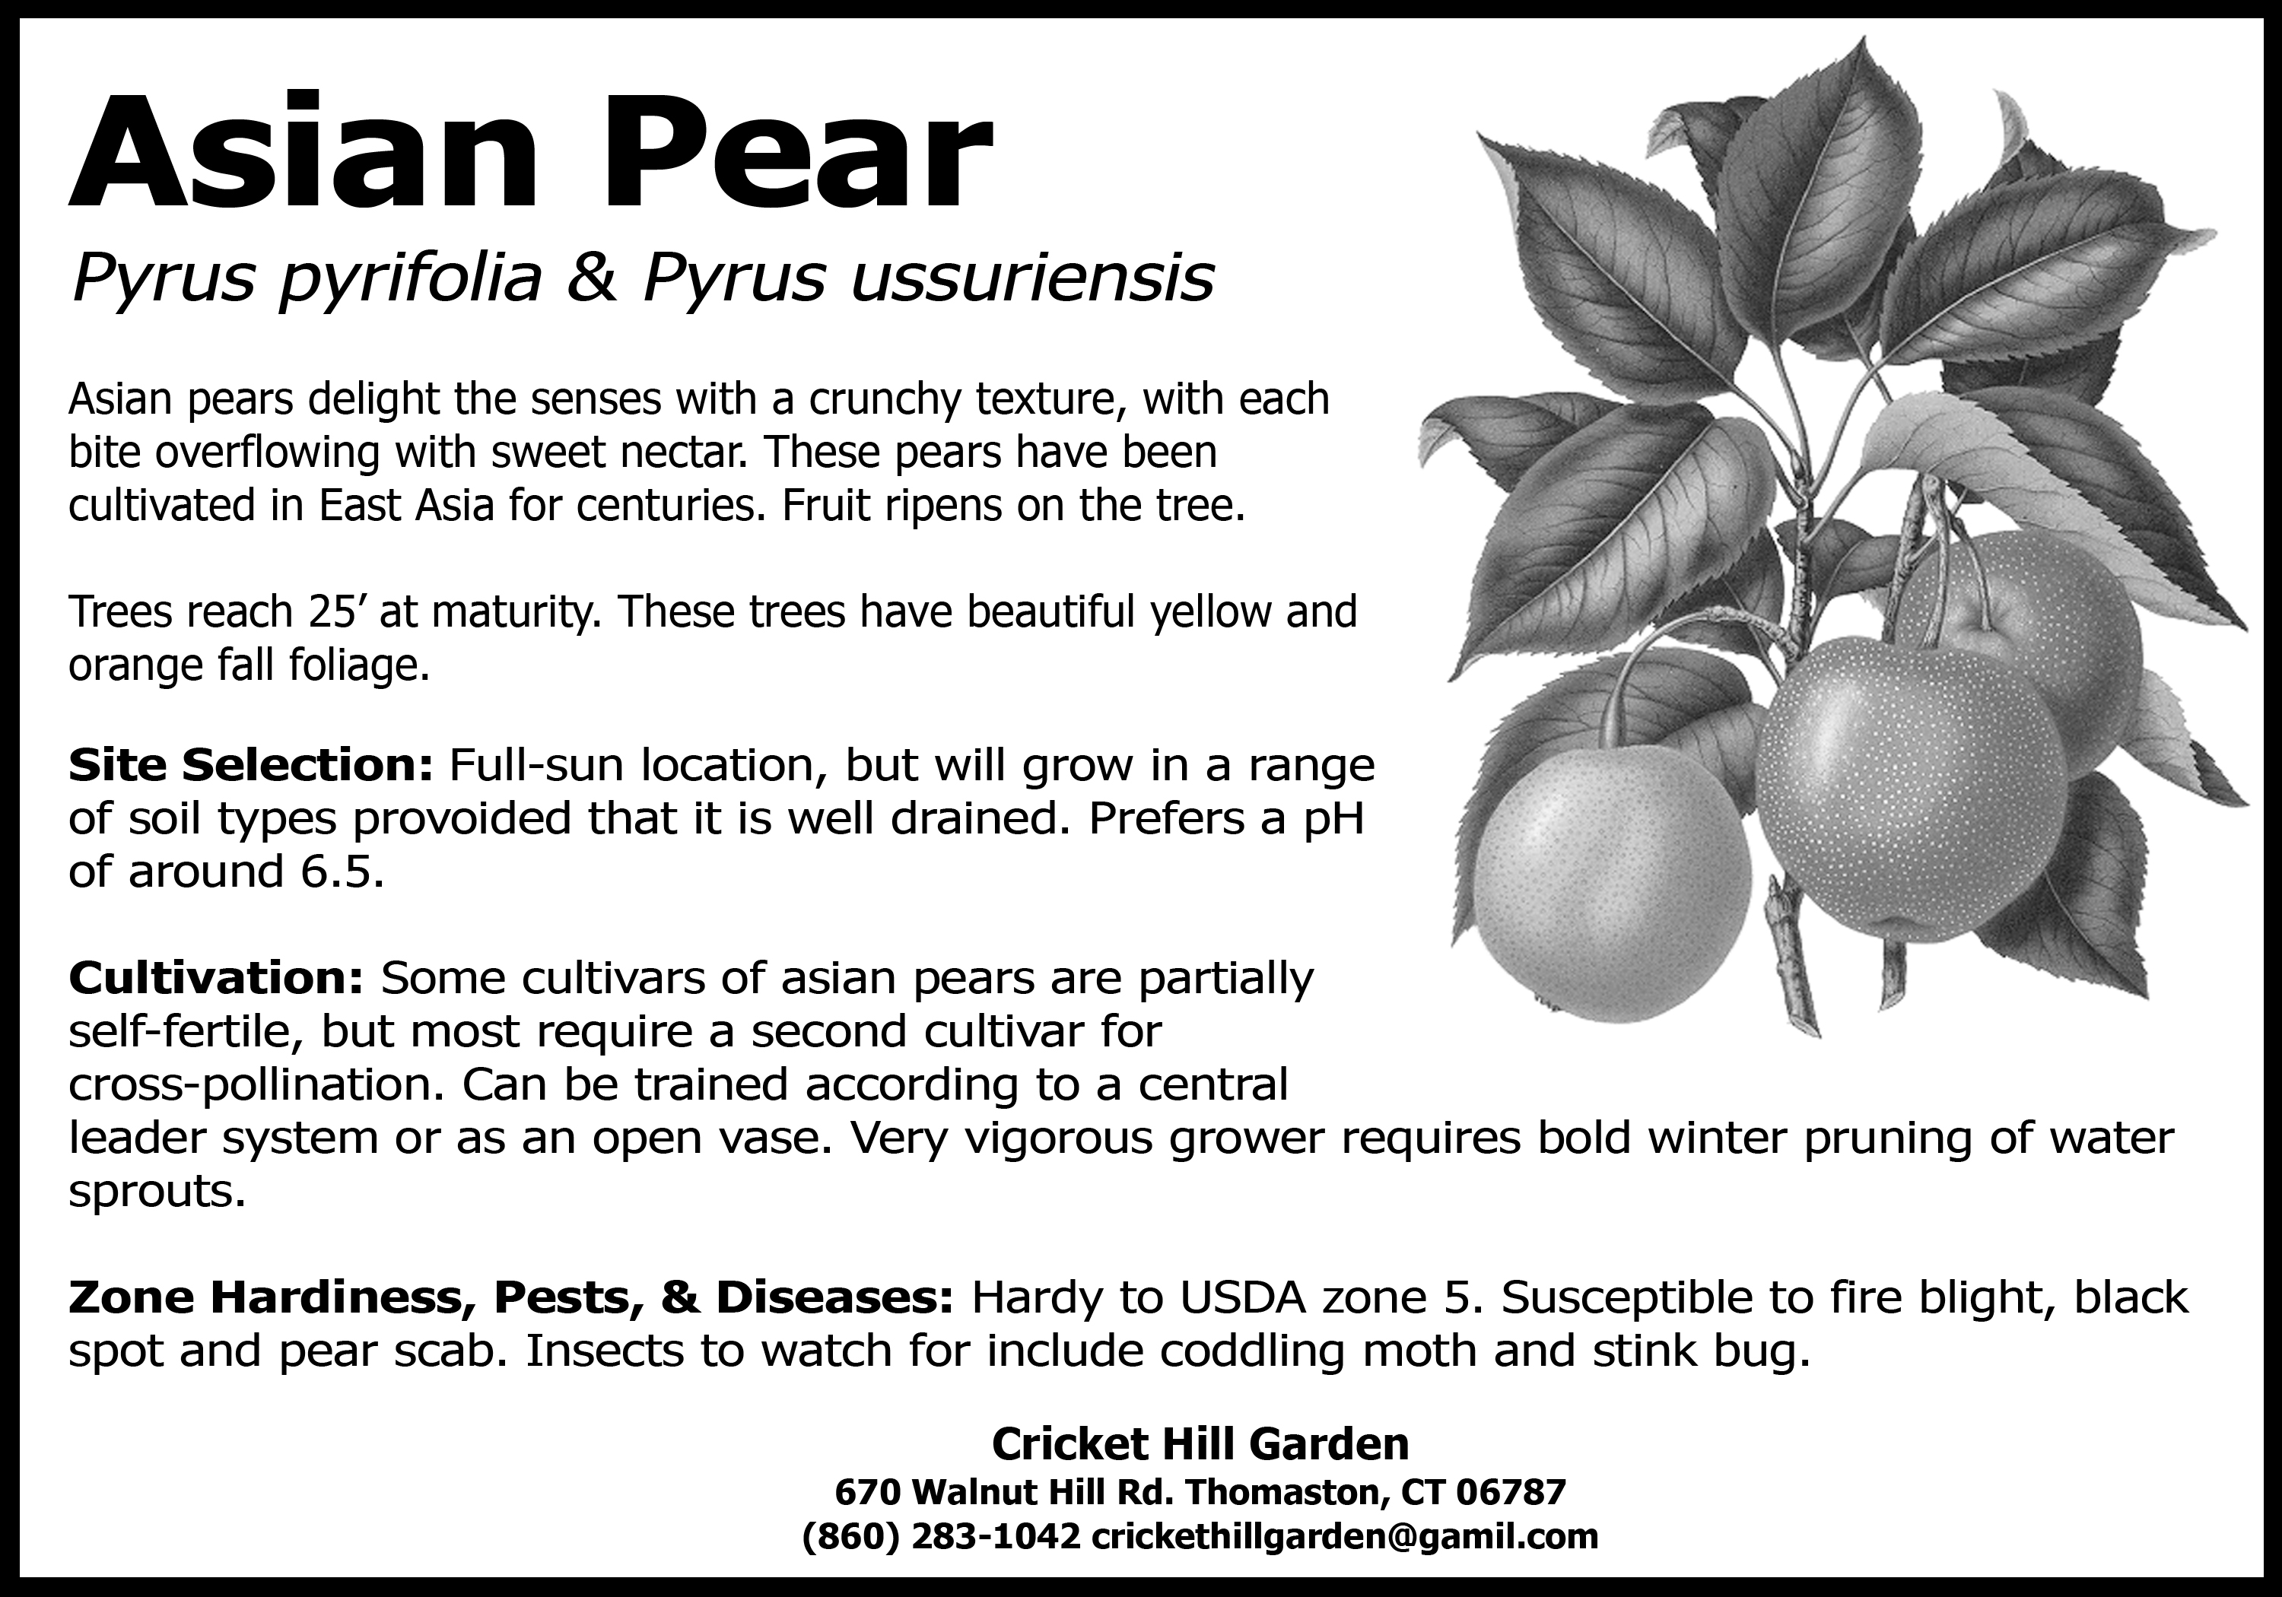
What’s a Home Gardener to do?
Read the tag!

Slide 47
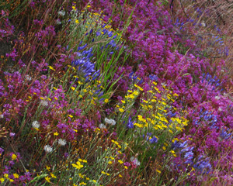
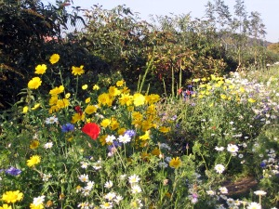
What else can you do?
Make sure you have bees!
Notes:
Make sure you have bees!
Invite them into your garden.
Find a little nook where you can plant some bee-friendly plants and let them become a little wild and alluring!
We suggest California natives, of course!
Find a whole list of them at the California Native Plant Society website. Or stay after and look at the pictures we have here.
Also, be sure to have water available. Bees LOVE water, too!

Slide 48
Planting Fruit Trees
Know your soil
Prepping the soil
Planting a bare root fruit tree
Planting a container grown fruit tree
Post planting
Fireblight
Notes:
You will find that Master Gardeners like to talk about their “tilth”- it is all about tilth in gardening.
This is your soil structure.
soil is made up of minerals, organic material, air and water. There needs to be enough balance of all 4 to have healthy trees. And you need to know what type of soil the tree requires
The air and water need to move around within the minerals and organic material so that the roots can absorb not only water but nutrients from the soil.
Identify soil problems- (show soil testing kit) (water meter)
Before becoming a master gardener- would buy a bareroot from a nursery, dig a hole and plant the tree. Water it and wonder two years later why no fruit.
Now I know there is more to a healthy fruit tree than sticking it in the soil and watering it.
You might want to buy a kit and determine soil type
Most soils in Napa are with clay, clay loam so problems with soil compaction
If compaction is shallow- tillage will aid in loosening the top layer.
If impervious layer, such as hardpan, drainage can be improved by breaking through the layer to allow water movement and rooting into the layers below.soils should have good soil drainage.
The “feel” test- grab some soil and squeeze to feel the structure
Well drained and deep 4-9 ft for good growth . Shallow, poorly drained sites will produce small, weak plants, with lower yields more pest problems and special water management
Drainage- need to know to set up irrigation…amount of water needed.

Slide 49
Fruit Trees
Type
Bare root
Container grown
Best varieties for clay soil
Apple
Fig
Pear
Persimmon
Plum and Pluot
Pomegranate
Quince

Slide 50
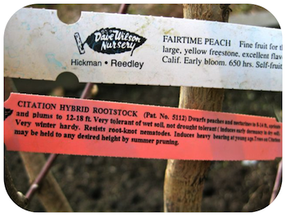
1st Step – Read the Tags
Top tag describes the variety
Bottom tag describes the rootstock
Notes:
Tag #1: The Variety
Harvested very late (early September), excellent freezer or fresh-market selection. Yellow-fleshed freestone peach with an attractive yellow skin and bright red blush where exposed to sun. The fruit features a very large size and a well-balanced peach flavor.
This tag shows the particular named variety of fruit, like an “Anna” apple, or a “May Pride” peach. This label lists the characteristics of that particular variety, such as the flavor, ripening time and chill hours required to set fruit. If you live near the coast, you need to be particularly careful in selecting a fruit tree that has a low chill hour requirement. After you’re done salivating over the fruit’s juicy details, pay close attention to other label.
Tag #2: The Rootstock
Citation
Peaches and nectarines dwarfed to 8 to 14 feet. Apricots and plums dwarfed to 3/4 of standard. Very tolerant of wet soil, induces early dormancy in dry soil. Very winter hardy. Resists root-knot nematodes. Trees bear at young age. (Zaiger)
The rootstock information is critical in determining whether the tree is best suited to your site. Fruit trees are grafted onto various rootstocks which impart particular attributes to the variety. For example, different rootsocks may extend the range for that tree, giving it the ability to grow where it might not normally be possible (due to sandy soils, wet soils, crown rots, nematodes, etc.). Rootstocks can also help control the height of the tree (creating dwarf or semi-dwarfing trees) or offer drought tolerance or more protection in cold winter areas. Generally, your local nursery will pick the combinations of variety and rootstock that will work best in your area. For additional information on varieties suitable for low chill coastal San Diego, check out this link to see a list of recommended fruit trees prepared by the California Rare Fruit Growers, San Diego Chapter.

Slide 51
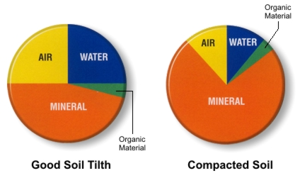
Good Soil Tilth
Has large pore spaces for air infiltration and water movement.
Roots only grow where the soil tilth allows for adequate levels of soil oxygen.
Also holds a reasonable supply of water and nutrients.
Notes:
You will find that Master Gardeners like to talk about their “tilth”- it is all about tilth in gardening.
This is your soil structure.
Soil is made up of minerals, organic material, air and water. There needs to be enough balance of all 4 to have a healthy trees. And you need to know what type of soil the tree requires.
The air and water need to move around within the minerals and organic material so that the roots can absorb not only water but nutrients from the soil.
Identify soil problems- (show soil testing kit) (water meter)
Before becoming a master gardener- would buy a bareroot from a nursery, dig a hole and plant the tree. Water it and wonder two years later why no fruit.
Now I know there is more to a healthy fruit tree than sticking it in the soil and watering it.
You might want to buy a kit and determine soil type
Most soils in Napa are with clay, clay loam so problems with soil compaction
If compaction is shallow- tillage will aid in loosening the top layer.
If impervious layer, such as hardpan, drainage can be improved by breaking through the layer to allow water movement and rooting into the layers below.soils should have good soil drainage.
The “feel” test- grab some soil and squeeze to feel the structure
Well drained and deep 4-9 ft for good growth . Shallow, poorly drained sites will produce small, weak plants, with lower yields more pest problems and special water management
Drainage- need to know to set up irrigation…amount of water needed.

Slide 52
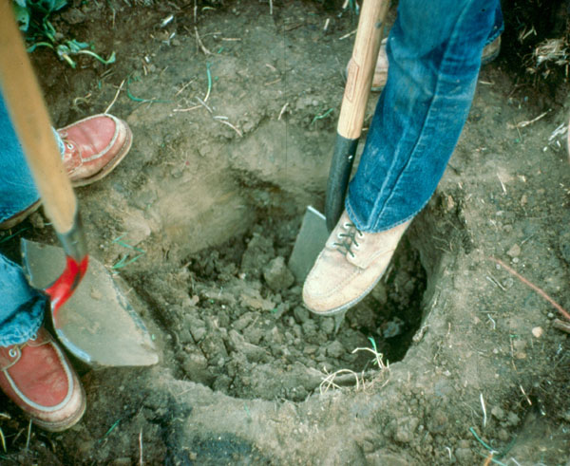
Identify Soil Problems
Physical – Dig a Hole
Texture
Too gravelly – not likely
Too heavy clay – very likely
Impervious layers
Clay, or compacted loam, that is resistant to water penetration.
Stratification
Abrupt porosity changes at various depths within the potential active root zone.
Compaction
Increased density or decreased porosity of soil.
Notes:
Impervious soil - a very fine-grained soil, such as clay or compacted loam, that is so resistant to water penetration that slow capillary creep is the only means by which water can enter.
Soil stratification - characterized by abrupt porosity changes at various depths within the potential active root zone. These changes in dimensions of the spaces between soil particles affect water and air movement and can limit the depth of the active root zone. In turn, this determines the total amount of soil water available to plant. Soil stratifications are caused by abrupt texture changes and compaction.
Soil compaction, also known as soil structure degradation, is the increase of bulk density or decrease in porosity of soil due to externally or internally applied loads.
Soil compaction - the process in which a stress applied to a soil causes densification as air is displaced from the pores between the soil grains. When stress is applied that causes densification due to water (or other liquid) being displaced from between the soil grains then consolidation, not compaction, has occurred. Normally, compaction is the result of heavy machinery compressing the soil, but it can also occur due to the passage of (e.g.) animal feet.

Slide 53
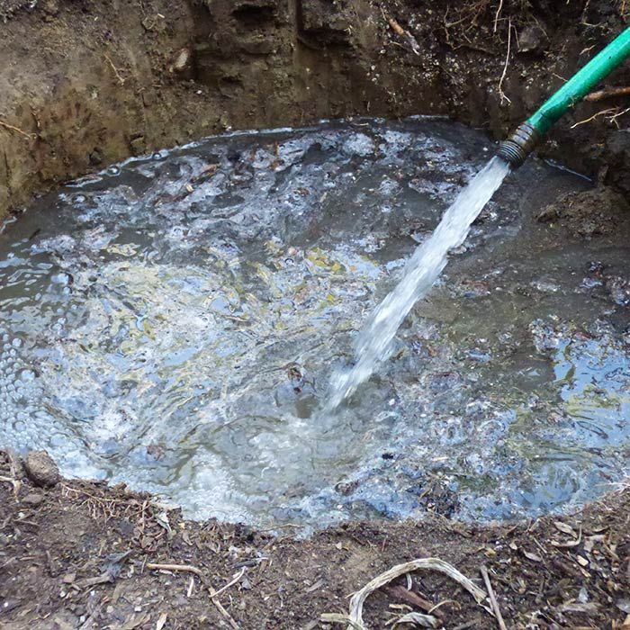
DIY Test for Drainage
Dig hole at least 3’ deep, fill with water.
Empties in less than 24 hours = GOOD
Empties in 24-48 hours = marginal
Water standing after 48 hours = unsuitable.
Back-fill hole and look for a better site.
Notes:
In the fall- or before the winter rains- dig a deep hole and test for drainage by filling with water.
This helps with determine where to plant the tree but also will help you with determining the amount of irrigation that will be needed.

Slide 54
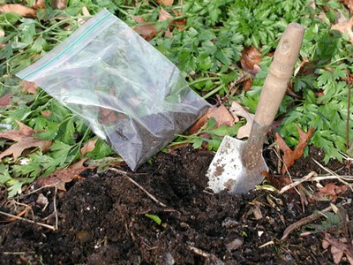
Identify Soil Problems
Chemical – Soil Test
pH high or low
6.0 to 7.5 is OK / 6.5 is best
NPK
Salt level
Toxic elements
Sodium
Boron
Chloride

Slide 55
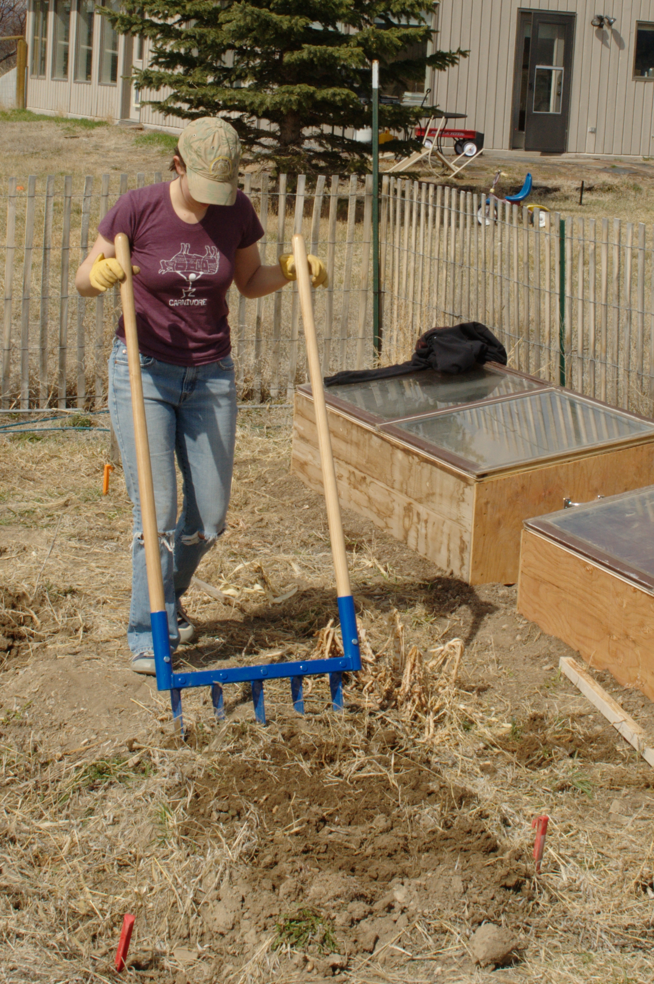
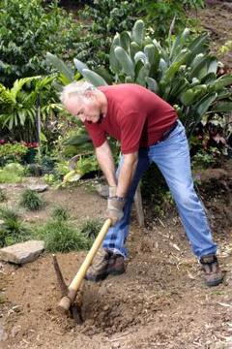
Breakup Surrounding Soil
Compacted or stratified soil can be broken up with a pickaxe
Breakup soil to a depth and width to allow for spreading of roots
Notes:
Remember – roots grow out more than they grow down.

Slide 56
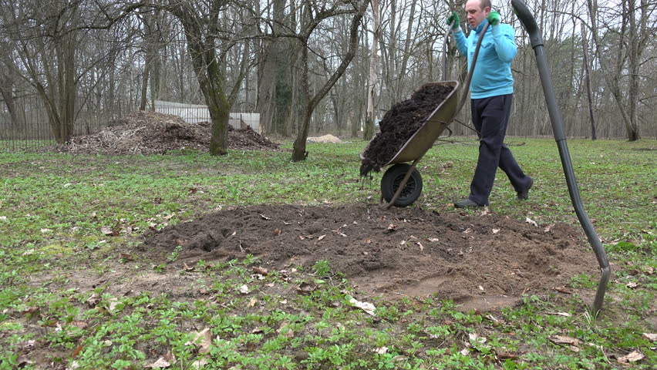
Add Amendments and Fertilizer
Add compost and, if necessary, gypsum, fertilizer or other amendments.
Work into soil.

Slide 57
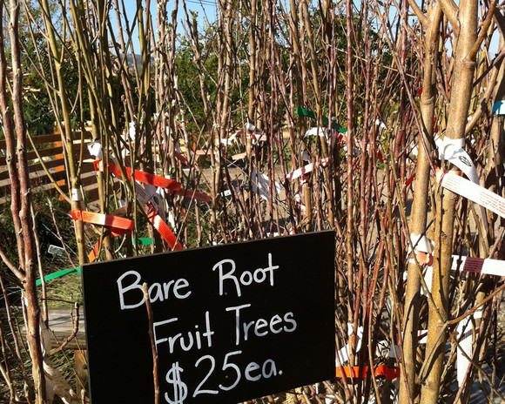
Bare Root Fruit Trees
Heeling in a bare root fruit tree for planting later
I’ve purchased a bare root tree so now what do I do?

Slide 58
Planting Hole Preparation Bare Root Fruit Trees
Hole should be at least twice the width of the trees roots.
Hole should be no deeper than the length of the roots.
Notes:
Exception is if soil is compacted – break-up compacted soil.
Score the sides of the hole so that roots can penetrate.

Slide 59
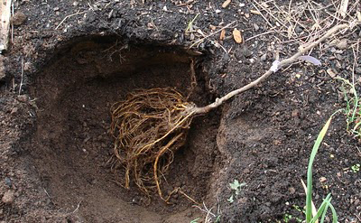
Planting Hole Preparation Bare Root Fruit Trees
Place tree in the hole to see if there is sufficient width and depth to accommodate the roots

Slide 60
Planting Preparation Bare Root Fruit Trees
Prune Roots
Examine the roots and remove any that are broken or kinked.
Avoid shortening roots – make the hole bigger to accommodate them.

Slide 61
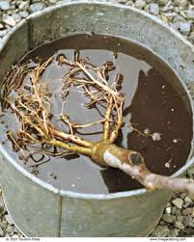
Planting Preparation Bare Root Fruit Trees
Soak roots a minimum of 4 to 6 hours but no longer than overnight.
Notes:
Don’t drown the trees.
They need air at some point.

Slide 62
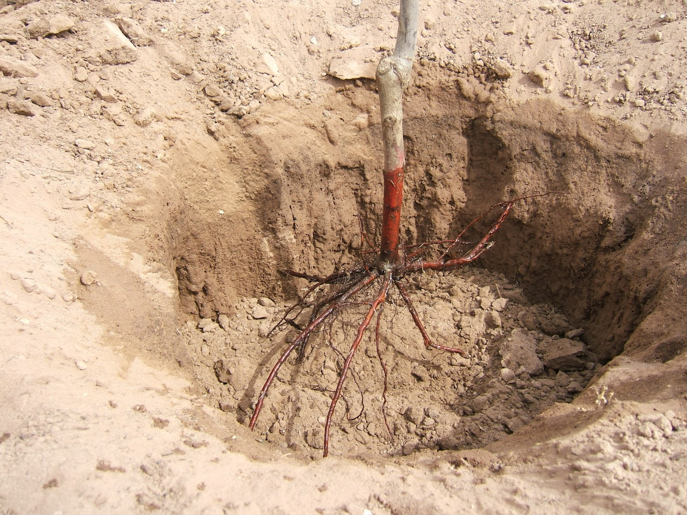
Planting Preparation Bare Root Fruit Trees
Build a dirt mound high enough to allow roots to drape over the mound.

Slide 63
Planting a Bare Root Fruit Tree
Now you’re ready to plant
Place the tree on top of the mound.
The graft union should be 2” to 4” above the soil surface and facing northeast.
Fill the hole with the excavated soil.
Tamp down the soil to remove air pockets.

Slide 64
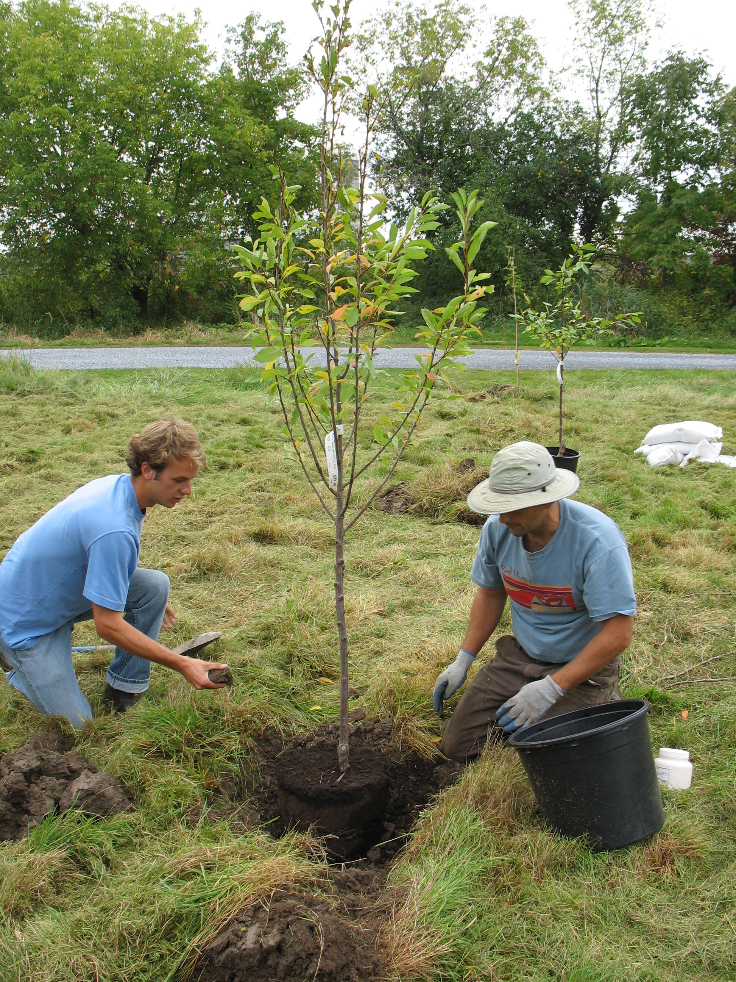
Planting Hole Preparation Container Grown Tree
Hole should be at least 2 to 3 times the width of the root ball.
Hole should be no deeper than the root ball.
Notes:
Exception is if soil is compacted – break-up compacted soil.
Score the sides of the hole so that roots can penetrate.

Slide 65
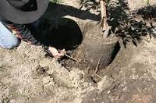
Planting a Container Grown Tree
Gently ease the tree from its container.
Check for girdling or circling roots and gently pull away from the root ball before planting.

Slide 66
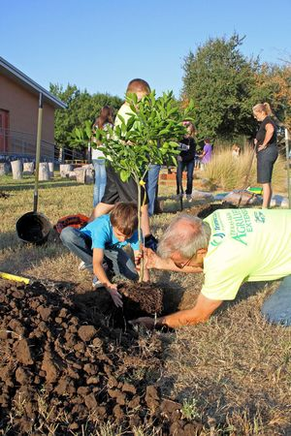
Planting a Container Grown Tree
Place the tree in the hole with the graft union at least 2” to 4” above the soil surface.
The protruding notch should face north/northeast to reduce the likelihood of sunburn.

Slide 67
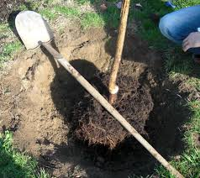
Planting a Container Grown Tree
Partially fill the hole with the same soil and firm gently.
Place a shovel across the hole while planting to endure the tree is level.

Slide 68
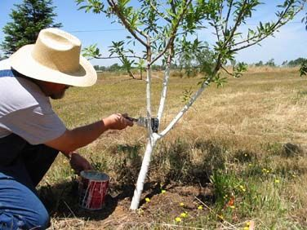
Planting Bare Root and Container Grown Trees
Paint the tree
Protect the bark from sunburn and infestation by borer insects.
Use white interior latex paint diluted to half strength.
Apply paint from 2” below soil surface up the entire trunk.

Slide 69
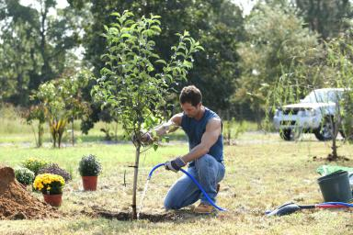
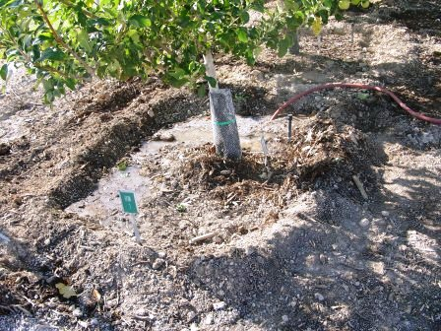
Planting Bare Root and Container Grown Trees
Construct a doughnut-shaped basin for watering. Should be slightly wider than the planting hole.
Thoroughly water to settle soil around the root ball.

Slide 70
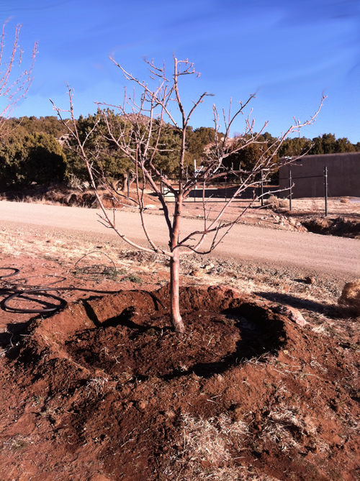
Planting Bare Root and Container Grown Trees
Thoroughly water to settle soil around the root ball.
Add a 3” to 6” layer of mulch to the basin to control weeds and conserve moisture.
Keep mulch several inches away from the trunk of the tree to minimize crown rot and hiding places for pests.

Slide 71
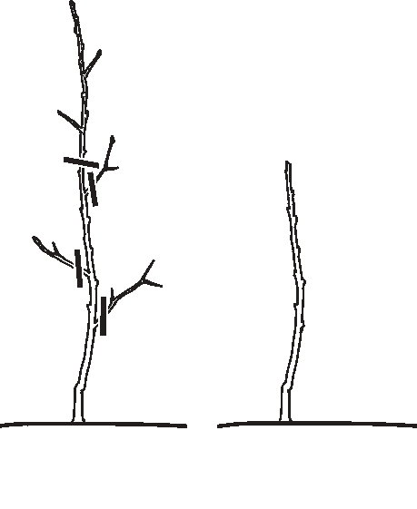
Planting Bare Root and Container Grown Trees
Heading the tree
Goal is to have a fruit tree that is relatively small, easy to prune and harvest.
By heading the tree to about knee height you force the tree to develop low branches.

Slide 72
Planting Bare Root and Container Grown Trees
Staking
Not necessary for bare root and small container grown trees.
Necessary for larger container grown trees.

Slide 73
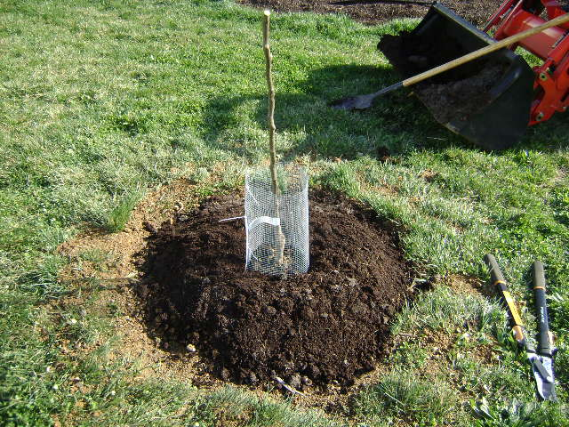
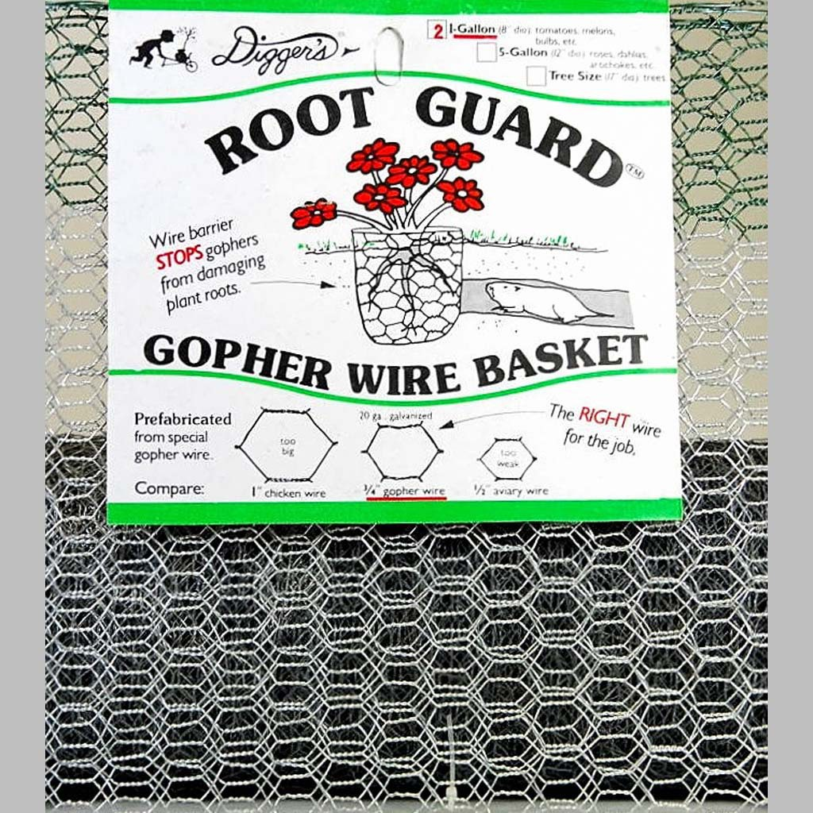
Planting Bare Root and Container Grown Trees
Protection from critters.

Slide 74
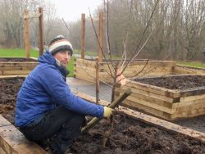
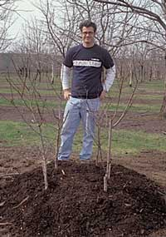
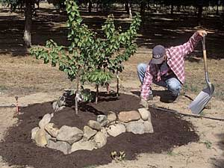
Option – Plant in a Raised Bed
Notes:
Use a combination of native soil and good-quality top soil.

Slide 75
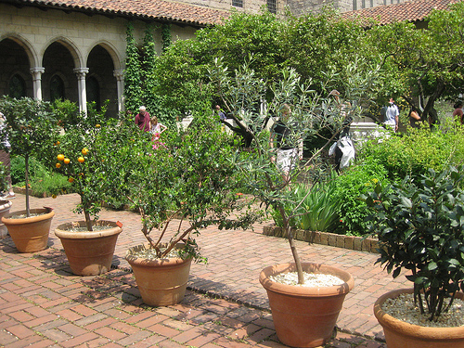
Another Option – Plant in a Container
A few Differences from planting in the ground
Requires dwarf rootstock
Requires annual repotting and root pruning
Requires a particular potting soil blend.
May require replanting in ground after a few years

Slide 76
Planting Bare Root and Container Grown Trees
The End

Slide 77
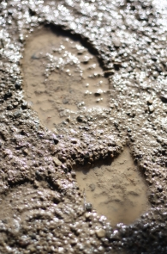
El Nino is Coming!
To plant or not to plant? What to think about.
If you definitely want to plant a fruit tree in 2016 then prepare the planting hole now before rain commences.
And . . . .

Slide 78
El Nino is Coming!
Never try to work wet clay soil as it is particularly susceptible to compaction and this will lead to poor drainage and the dreaded clods make working clay soil such a pain.
If your clay soil looks at all like this photo don’t dig. Wait for drier weather and consider postponing your fruit tree planting until 2017.

Slide 79
Post Planting
Irrigation
Start in the spring after the weather turns warm.
Soil in the root zone should be moist at all times.
Training and pruning
In the first summer prune to develop the desired structure.
Fertilization
Do not apply fertilizer before there is 6” to 8” of new growth.
Apply a high nitrogen fertilizer such as blood meal or feather meal or poultry or steer manure.

Slide 80
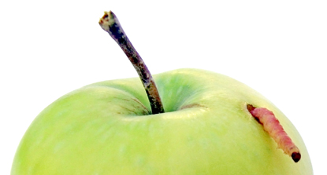
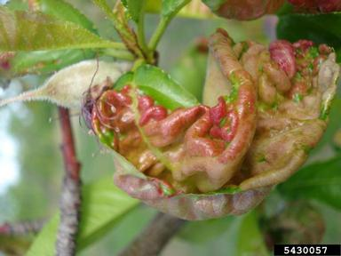
Focus on Four Common Problems
Codling moth
Peach leaf curl
Fireblight
Aphids
Notes:
Who here has had issues with these. (name one at a time). These are the focus of this presentation, but there are other pests: birds, deer, gophers, Brown Rot, scale insects, borers. Search the website pest notes if these are suspected. Decide what you can live with, and use accepted control methods.

Slide 81
Fireblight
Notes:
Who has experienced fireblight? It is very insidious, hideous bacterial disease. Not easy to deal with. Can kill branches & whole plants. I lost a young pear tree to it. Infections usually originate in the flowers.

Slide 82
Fireblight
Notes:
More symptoms.

Slide 83
Fireblight
Notes:
Dead, blackened leaves and fruit cling to branches throughout the season, giving the tree a scorched appearance, hence the name “fire blight.” Infections can extend into scaffold limbs, trunks, or root systems and can kill highly susceptible hosts. Less susceptible varieties might be severely disfigured. Once infected, the plant will harbor the pathogen indefinitely.

Slide 84
Fireblight Management
Reduce new growth
Low or no nitrogen or heavy pruning.
Do not irrigate during bloom
Plant resistant varieties
Notes:
All three are to avoid new growth. Clean & sterilize tools between cuts and plants. Copper products often don’t provide adequate control even with multiple applications. Sprays prevent new infections but won’t eliminate wood infections; these must be pruned out.

Slide 85
Fireblight Management
Remove infections in summer or winter when bacteria are not spreading through the tree.
Not IPM approved
Notes:
ACA may not cover avoidable accidents. Very susceptible trees (pear, Asian pear, and some apple varieties) infections should be removed as soon as they appear in spring. Very important to read the IPM pest notes on Fireblight, including a list of resistant and susceptible varieties. Far too much to cover here.

Slide 86
Fireblight Management
Remove infections in summer or winter when bacteria are not spreading through the tree.
Not IPM approved
Notes:
ACA may not cover avoidable accidents. Very susceptible trees (pear, Asian pear, and some apple varieties) infections should be removed as soon as they appear in spring. Very important to read the IPM pest notes on Fireblight, including a list of resistant and susceptible varieties. Far too much to cover here.

Slide 87
For more details and more pests
ipm.ucanr.edu/PMG/PESTNOTES
And for more on gardening in general
ipm.ucanr.edu/PMG/menu.homegarden.html
Notes:
And the rewards of successful production of home-grown fruit greatly outweighs nature’s sometimes problems. Always first decide what you can live with. A sort of “détente”. And follow good cultural practices as has been covered earlier.

Slide 88
Thank you!
(Psst!
Tell a friend!)

Slide 89
UC Master Gardeners of Napa County

