Slide 1
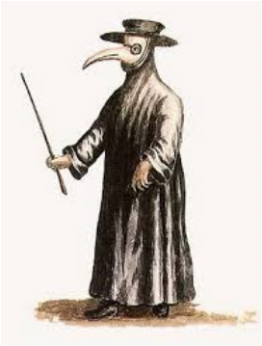
It’s Alive!!!! How to stay healthy in a world of microorganisms*
Nov 2015
UC-ANR All Staff Meeting
Malendia Maccree, RBP
Safety Specialist
*Disclaimer: Nothing in this presentation should be taken as a substitute for medical advice.
Please consult your health care provider for disease prevention recommendations.
Notes:
Trivia question: what is the occupation of the person in this picture?

Slide 2
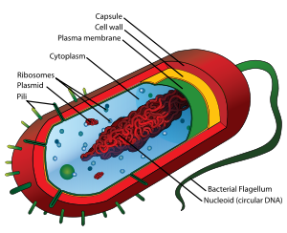
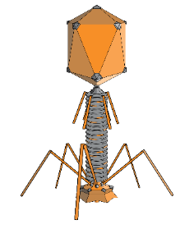
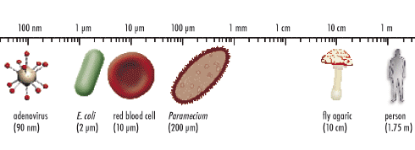
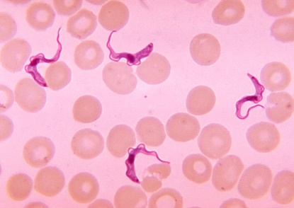
What is a microorganism?
A living microscopic organism (virus, bacteria, fungi, parasite)
May live inside of a host or live freely in the environment
May cause disease, have no effect, or provide benefits for the host
Preventive treatment may or may not be available
Some microbes can resist desiccation/destruction or produce potent chemical toxins
Photo credits: Microbiology online, Wikipedia, http://www.clker.com
Notes:
Some viruses are racing your immune system to find another host. Others integrate and hideout into your DNA so they can stay a lifetime.
Vaccines work for viruses (and some bacterial diseases). Antibiotics only work on bacteria
Bacteria, fungi and parasites can form resistant spores or cysts which are hard to destroy.
Bacteria and fungi can produce toxins.
Fungi and Parasites can be hard to kill.
Viruses: Influenza, Rotavirus, Hepatitis, West Nile Virus, Human Papilloma Virus (HPV), Hanta Virus, Measles virus, Herpes virus
Bacteria: E. coli, Salmonella, Clostridium dificile, Yersinia pestis (plague), Mycobacterium tuberculosis, Legionella
Fungi: Coccidiodes immitis (Valley Fever), Aspergillus, yeasts
Parasites: Cryptosporidium, Giardia, Malaria, Toxoplasma gondii, Chagas disease

Slide 3
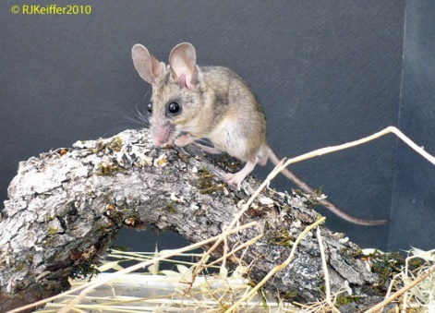
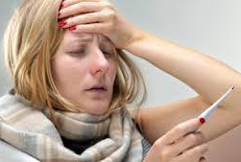
Are you a good host?
In the human body, microbial cells outnumber human cells 10 to 1
Most microbes are not harmful, some are beneficial
Previously exposed hosts may have protection (vaccination, past history of exposure and disease)
Immune-compromised hosts may be more susceptible (elderly, very young, medical conditions)
Zoonotic diseases (from animal to human)
Opportunistic infections
Photo credits: R. Keiffer, umb.edu
Notes:
The global initiative known as the Human Microbiome Project currently estimates that the microorganisms that live inside or on Homo sapiens outnumber somatic (body) and germ cells [germ cells as in gametes, not bacteria] by a factor of ten.¹⁰ Since the inception of the Human Microbiome Project in 2007, dozens of research teams have gathered data which redefine what it means to be human. Some commentators have gone so far as to refer to the human body as a superorganism whose “whose metabolism represents an amalgamation of microbial and human attributes.”¹⁴
Immune system is adaptive and capable of clearing most disease causing microbes from our system. Sometimes our immune system does not work well or disease agents can evade it.
Immune compromised populations: diabetes, pregnancy, steroid drug treatment, cancer treatment
Zoonotic diseases: hanta virus (peromyscus feces), Q-fever (sheep placenta), Herpes B (old world primates), Ebola (bats)
Opportunistic infections: More common for fungi and bacteria. Organism does not usually cause disease, but finds an opportunity to colonize body tissues and causes disease condition (staphylococcus, yeast, bacteria infection after respiratory virus)
Trivia Questions:
Which bacterial disease can you catch from participating in animal births? A: Q-fever (Coxiella burnetti)
What is the most common cause of acute kidney failure in children? Hemolytic-uremic syndrome caused by toxins from food poisoning bacteria (E. coli, Shigella)
What disease can you get from cleaning up after the rodent in the photo? A: Deer mouse (peromyscus)
Which fungal disease might you be exposed to while walking the streets of Bakersfield? A: Valley Fever (Coccidioides immitis)
What animal is the suspected as the source of the most recent ebola outbreak? Bat

Slide 4
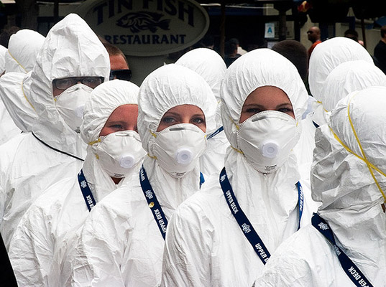
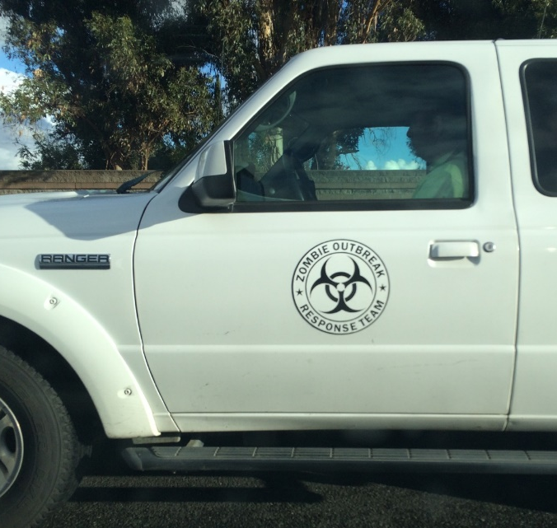
How do we protect ourselves?
Photo credits: B. Oatman, shutterstock,
Notes:
Photo of July 2014 quarantine of Yumen China (pop: 30,000) after a man died of bubonic plague. Do we were moon suits, call the zombie outbreak response team or take a lot of antibiotics?
Trivia questions:
Which disease can be caused by viruses, fungi, bacteria and parasites? A: Meningitis
Name one of the two mosquito-vectored diseases which are common in Mexico, but not yet common in the U.S.
Answer: Dengue Fever or Chikungunya virus

Slide 5
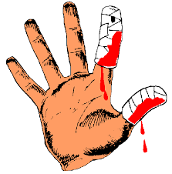
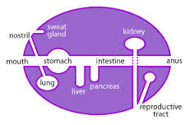
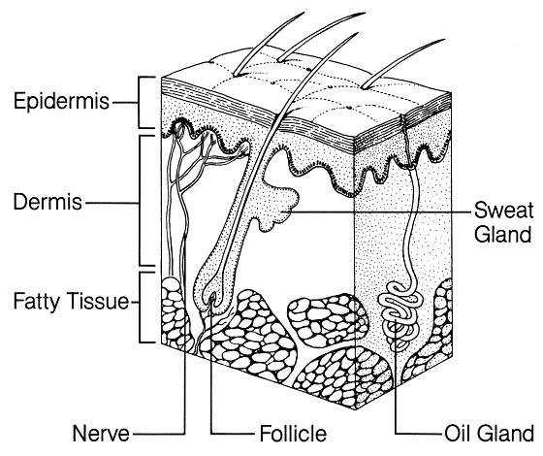
Your Skin
Healthy skin provides an excellent barrier for microorganisms
Overly dry or constantly wet skin is susceptible to infection
Wound care is important
Cover wounds to prevent casual contact with others
See your doctor if wounds do not heal as expected or become red, swollen, or hot to the touch
Handwashing and winter weather can cause dry cracked skin

Slide 6
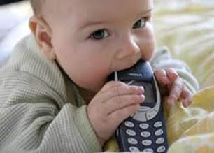
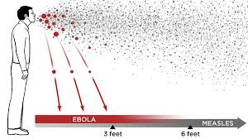
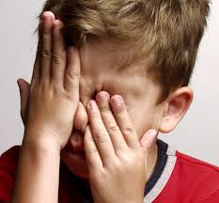
Your Face
Most infectious agents gain access to your body via your face
Eyes and nose (mucous membranes)
Mouth (inhalation and ingestion)
Try to avoid touching your face when you may be exposed to infectious agents
Pay attention to what your kids put in their mouth
Maintain social distance (approx. 3ft) from others if you are sick
Photo credits: npr.org, alllaboutvision.com

Slide 7
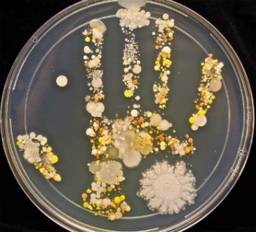
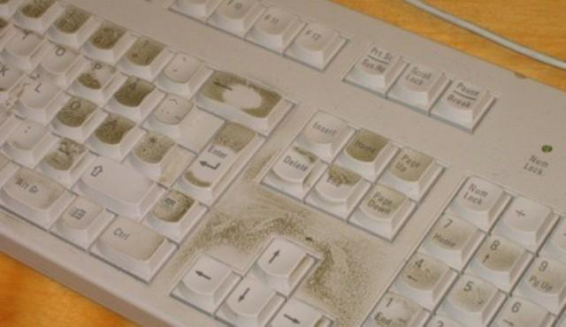
Your Hands
Handwashing – an effective and safe disease prevention tool!
Wash at least 20 seconds with soap
Remember to wash fingertips, thumbs, between fingers
Rinse with clean water, dry hands thoroughly
Avoid touching contaminated surfaces after handwashing (use towel for door or facet handle)
If soap AND clean water are not available, use hand sanitizer gel that contains at least 60% alcohol
Periodically sanitize items that you touch a lot (keyboards, doorknob, phones, kids toys)
Photo credits: Tasha Sturm, thegminigeek.com,
yourhealth.asiaone.com

Slide 8
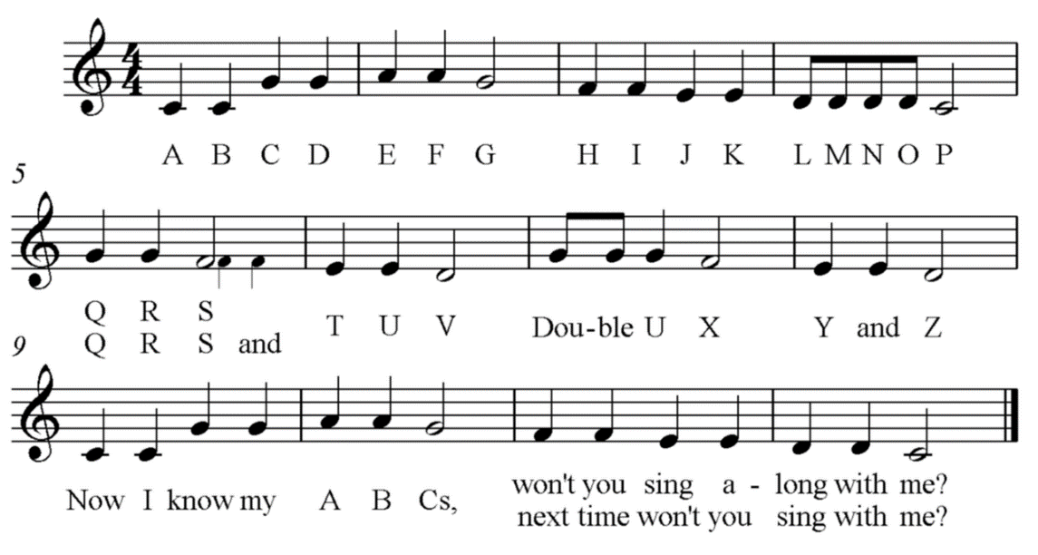
Do you have twenty seconds to spare for good health?

Slide 9
Do you have twenty seconds to spare for good health?
When should you wash your hands?
Before, during, and after preparing food
Before and after caring for a sick person or caring for skin wounds
Before eating, using cosmetics, handling contact lenses
After using the bathroom or helping someone else use the bathroom
After handling animals or their bedding, food, and waste
After sneezing, coughing, vomiting, or handling trash/compost

Slide 10
Disease Prevention Tips
Sanitation – Hand washing and household hygiene
Vaccination – Important for personal and public health
Travel quarantines – Know disease risks in other countries if you travel or host international guests
Eat, sleep, rest – Lifestyle choices affect your immune system and ability to recover from illness
Medical care – Report any suspected foodborne illness to your doctor and ask your doctor about vaccinations and symptom management
Self-quarantine – Keep your bodily fluids to yourself, treat and cover open wounds
Photo credits: Shutterstock, allfreedownlaod.com
Notes:
Quarantines - Measles and polio are still common disease in other countries. Dengue and Chikungunya viruses exist in Mexico—Aedes species mosquitoes are not in US that can vector these viruses.
Lifestyle: “Sleep is essential for good health; it is a necessity, not a luxury.” http://www.cdc.gov/pcd/issues/2013/pdf/13_0081.pdf

Slide 11
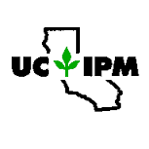
Resources and References
UC-ANR Safety Notes: (http://safety.ucanr.edu/Safety_Notes/Safety_Notes_by_Number/)
Fieldwork Safety Series (#79, #82, #85, #86)
#151 Preventing Spread of Disease – Urban Focus
4H Clover Safe Notes: http://safety.ucanr.edu/4-H_Resources/Clover_Safe_Notes_by_Project_Area/
Food preparation, animal care, and disease prevention
UC IPM Pest Notes: http://www.ipm.ucdavis.edu/PMG/PESTNOTES/
Pest management guidelines for invertebrates (mosquito, tick, flea)
Notes:
UC-ANR safety notes on disease prevention and awareness for rural and urban workers
4H CloverSafe notes on food preparation, animal care, and communicable disease prevention
UC-IPM pestnotes for vertebrate disease vectors - Pest management guidelines for common invertebrate disease vectors: Mosquitoes, Ticks, Fleas

Slide 12
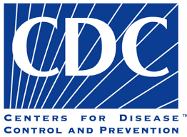
Resources and References
Cal Dept. of Public Health – Center for Infectious Disease (CID): https://www.cdph.ca.gov/programs/cid/Pages/default.aspx
Disease information, local disease outbreaks and incidents
Centers for Disease Control and Prevention (CDC)- Disease Information: http://www.cdc.gov/diseasesconditions/
Disease information, traveler’s health, emergency preparedness, and healthy lifestyle choices
Health Agency of Canada Pathogen Safety Data Sheets: http://www.phac-aspc.gc.ca/lab-bio/res/psds-ftss/index-eng.php
Technical (Lab) information for pathogenic microorganisms
Notes:
CDPH – Local disease outbreak information (West Nile etc)
CDC - Disease information, traveler’s health, emergency preparedness, and healthy lifestyle choices
Health agency of Canada - Technical (Lab) information for pathogenic microorganisms

Slide 13
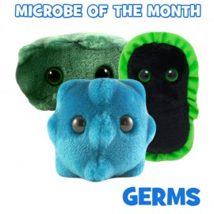
Educational Videos and Toys
Handwashing - Sklar Brothers You’re Doing It Wrong (YDIW): https://youtu.be/5bcdM6lTveY
Handwashing Gangnam Style: https://youtu.be/TGddyTW5eMc
Mythbusters – The Safe Sneeze Test: https://youtu.be/3vw0hIs2LEg
Why Don’t We Do It in Our Sleeves: https://youtu.be/CtnEwvUWDo0
Giant Microbes: http://www.giantmicrobes.com/

