Slide 1
Compost Basics
Home Composting Workshop
Today’s Workshop Leaders: Melanie Burgess
Bridget Ballatori
Master Composters
Santa Clara County - Composting Education Program

Slide 2
Objectives
Learn the basic processes for:
Backyard Composting
Grasscycling
Vermicomposting
Enable you to:
Decide which composting method(s) is/are appropriate for you & your home
Create a plan to start composting or expand/improve your current composting system
Find additional composting resources

Slide 3
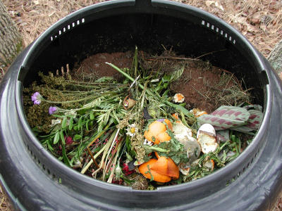
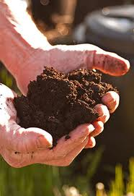
What is Composting?
Composting
Recycling organic materials
Composting: Recycling Organic Materials
The bio-oxidative degradation of organic wastes under controlled conditions
Large Scale Composting: Commercial composting facilities, Farms
Small Scale Composting: Homes, Schools, Offices
Notes:
- Controlled decay of organic material. Produces a humus rich material from yard and food waste which would otherwise become part of the waste stream.
- Composting is a controlled natural biological process where bacteria, fungi (microbes), and other organisms decompose organic materials like leaves, grass clippings, and food wastes.
- Decomposition is what you would call composting in nature. If decomposition or composting didn’t occur our world would be riddled with dead animals and plants. The nutrients cycle back into the system to be used again by other plants and animals.
Another way to look at composting is that it is recycling materials to give growing things what they need. By removing organic material from our home and property by putting it in the garbage, we are exporting nutrients that could be recycled in our lawn or garden.
A house resident may fill bags and bins with leaves and grass clippings, and leave them on the curb for pick up. Essentially, exporting the resources the plants, trees and grasses in his yard need. The resident then spends money to add fertilizer, soil enhancer and excess water to his lawn, essentially buying back the resources he just threw away.

Slide 4
One step in ongoing backyard process
What is Backyard Composting?
Plant growth
and production
Pruning and
harvesting
Natural
Cycle
Incorporate compost into
soil as amendment
Composting
waste

Slide 5
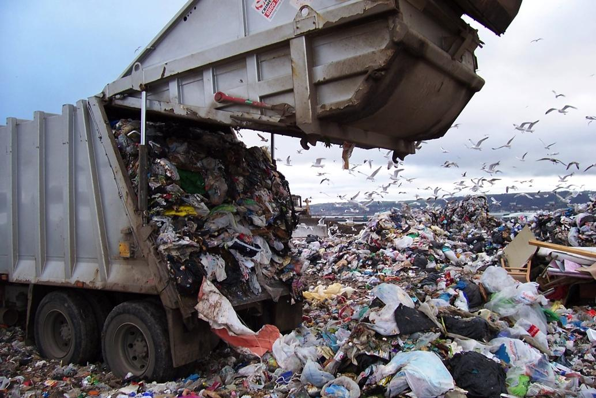
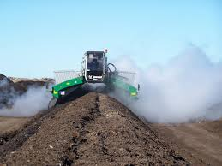
Why Backyard Composting?
Let’s Minimize:
Landfills -- they lock away valuable materials in un-usable forms
Transportation and handling costs
Using fossil fuels and increasing CO₂ emissions
Landfill
Commercial Composting is appropriate when on-site composting is not possible (e.g. restaurants). Home gardens are perfect for small-scale composting and avoids transportation and processing costs and pollution.
Notes:
So, why should we compost? To get to the answer, look at the alternative, landfill.
Have you ever driven by your local landfill?
Have you ever been to your local landfill?
What was your impression of a landfill?
There is a distinction between a landfill and a dump. A dump is how we used to dispose of garbage, find somewhere out of the way and make a big pile. Today we use the term landfill and they are engineered storage facilities for our garbage. There is a misconception that landfills are just giant composters and organic material will just decompose, but almost no decomposition takes place in a landfill.
- Makes environmental sense even if your city has a yard waste composting program
- Commercial composting is useful for businesses that generate a large volume of organic waste (e.g. restaurants and food processing plants) and for homes with no backyard (*try vermicomposting!)
Backyard composting reduces landfill pressures (AB939)
Captures carbon back into the soil

Slide 6
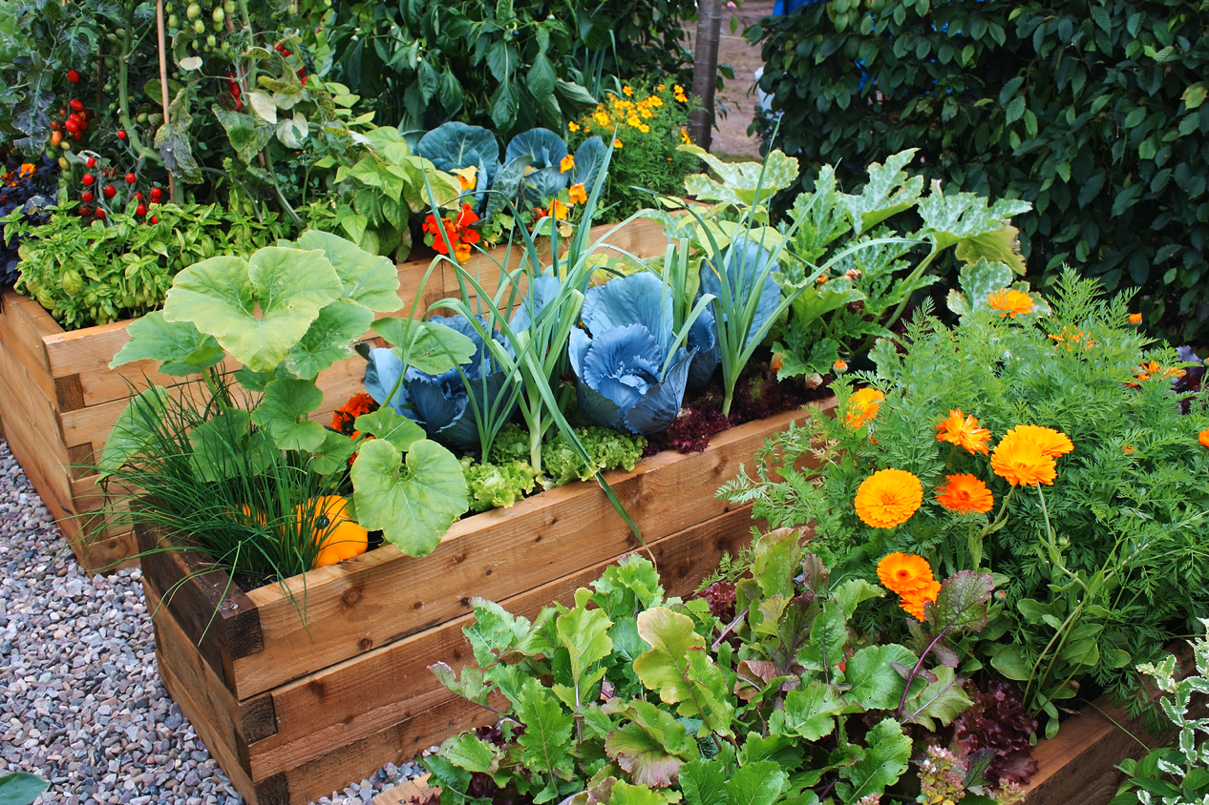
Home Composting Advantages
Reuse valuable nutrients to feed your plants & trees
Use less water in your garden
Grow healthy plants
Good exercise
Fun and rewarding
Get in touch with nature
Reduces carbon emissions
Promotes a more sustainable lifestyle
4/14/16
‹#›
Notes:
‹#›

Slide 7
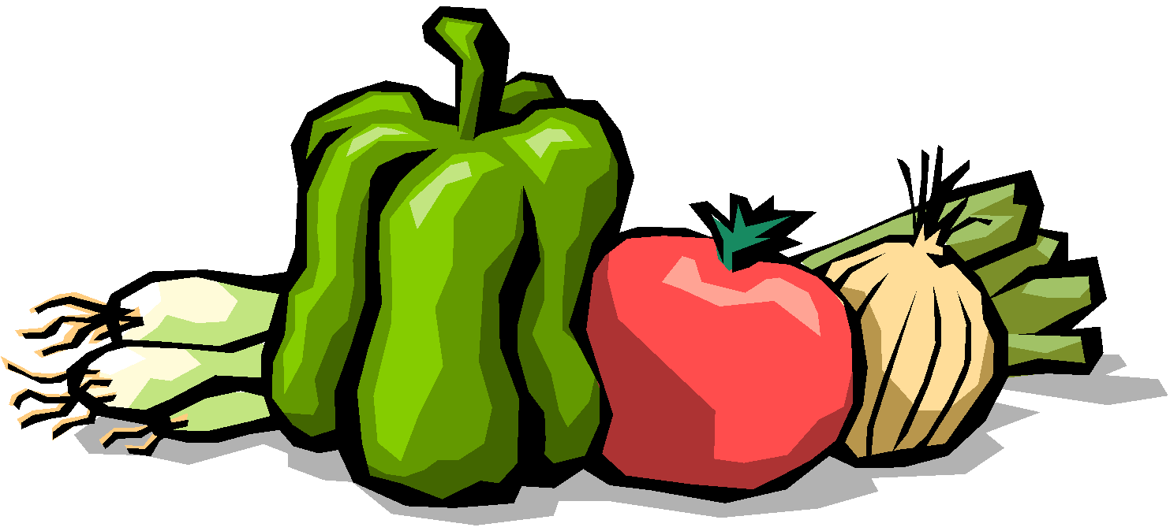
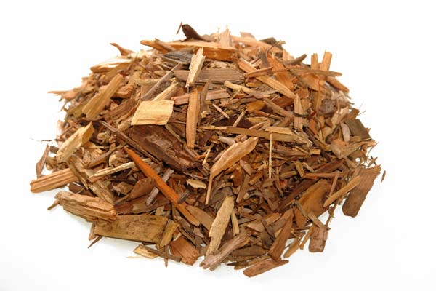
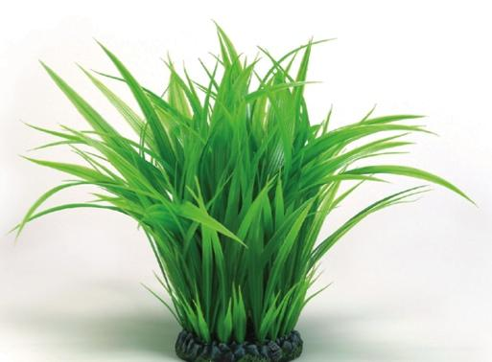
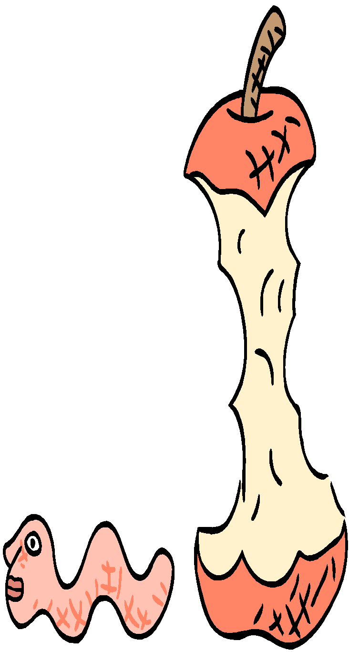
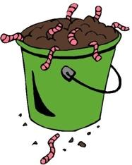
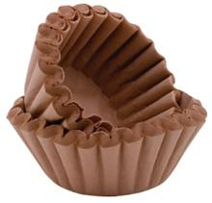
Compost Pile Ingredients
Greens
Water
Browns
Air
Soil
Notes:
‹#›
Browns and greens should be approximately equal in weight (50% carbon-rich, 50% nitrogen-rich)

Slide 8
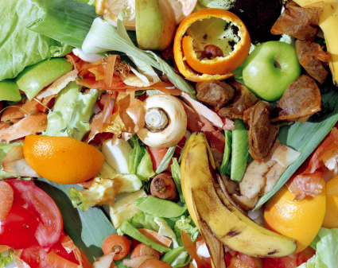
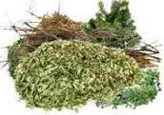
Ingredient #1: Greens (~50%)
Nitrogen-rich organic material
The majority of our kitchen waste
Green yard waste
Nitrogen is food for fungi and bacteria
Examples:
Disease-free green leaves and stems, grass clippings, weeds (before they go to seed), vegetable/fruit peels and scraps, coffee grounds, tea bags, flowers, fleshy roots, leguminous plants
Herbivore manures: cow, poultry/bird, rabbit, horse droppings and cage cleanings (none from meat-eating animals)
Notes:
Leguminous plants: fava beans are especially good in the spring

Slide 9
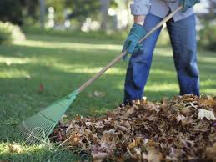
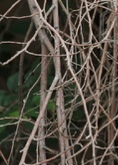
Ingredient #2: Browns (~50%)
Carbon-rich organic material
Dry, dead yard waste
Brown, woody plant material
Carbon is food for fungi and bacteria
Examples:
Dried leaves, evergreen needles, straw, coir (coconut husk), shredded woody stems/stalks/branches, dried tree/shrub prunings (a few stalks and thin branches provide good air pockets)
Also, dryer and vacuum lint, wood chips, sawdust (from untreated wood) and shredded paper/cardboard — use sparingly
Did you know whole or crushed egg shells can go into a compost pile? It’s a good calcium source!
Notes:
.

Slide 10
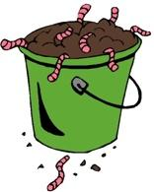
Ingredients #3 - #5
Ingredient #3 Air
Air is necessary for microorganisms to thrive and to breakdown the organic materials into compost.
A compost pile needs aeration by turning or fluffing.
Ingredient #4 Water
Moisture allows microorganisms be active and to move around.
Moisture is easier to regulate in bins that are contained and have lids.
Your pile should be kept as moist as a wrung-out sponge.
Ingredient #5 Soil
Not always necessary! Soil contains very helpful microorganisms (bacteria and fungi) but most greens and browns have them also. If dirt is added, only a small quantity is needed. Too much dirt makes the compost pile heavier to turn.
Air
Notes:
Now we know what should go in our compost bin, we should also discuss what shouldn’t.

Slide 11
What to Avoid
No animal products - meats, bones, fish
Egg shells are OK
No dairy products: cheese, milk, yogurt
Be careful with breads (because of molds)
No pet wastes or litter from carnivores (e.g. cat or dog feces)
No oils or plastics
No wood ash or charcoal
No diseased plants
No plants treated with herbicides
No toxic materials

Slide 12
Ingredient Tips
These items may spread undesirable plants or have negative effects when using your compost:
Bermuda grass
Bind weed (wild morning glory)
Oleander or any weed with seed heads or persistent roots (ok if hot composting higher than 140ºF)
Ivy (ok if dried and finely chopped)
Thorny plants (ok if finely shredded)
Notes:
Consider put these in your yard waste bin for curb-side pick up. Commercial hot composting is the best way to process these difficult materials.

Slide 13
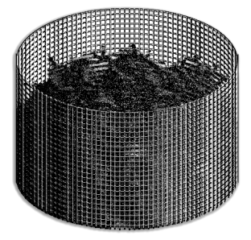
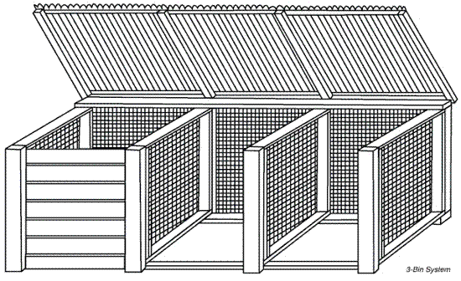
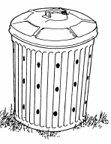
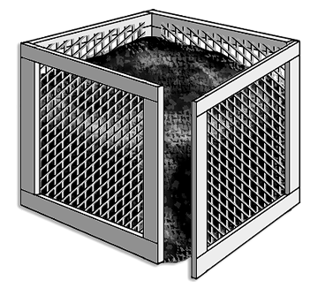
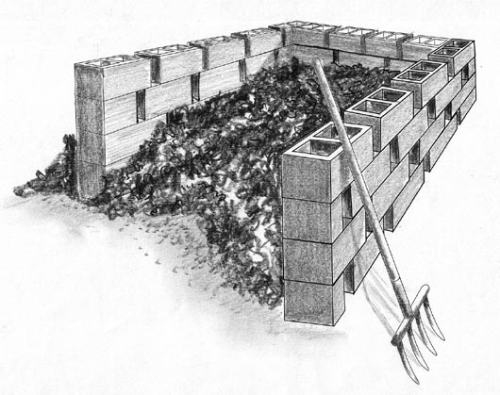
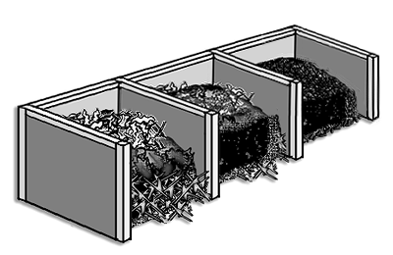
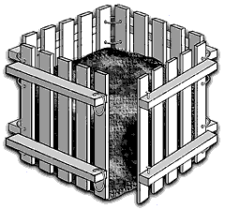
Compost Bins – Build Your Own
Notes:
Wire Bin
Wood Pallet Bin
Trash Can Bin
Block or Brick Bin

Slide 14
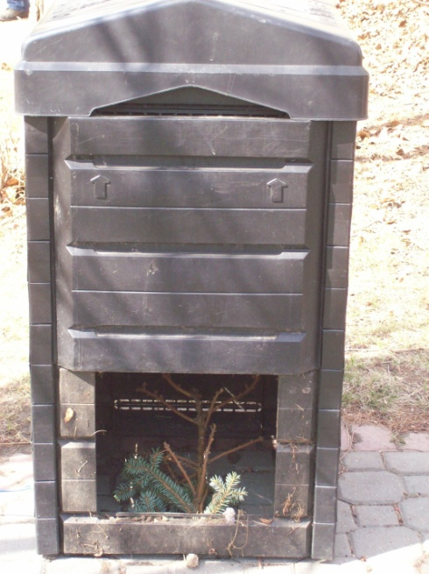
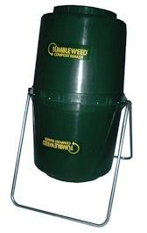
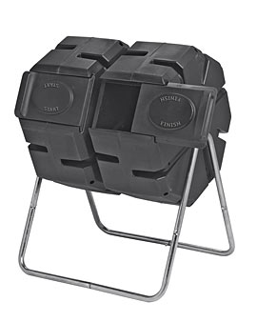
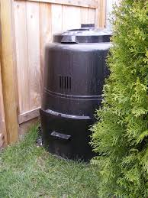
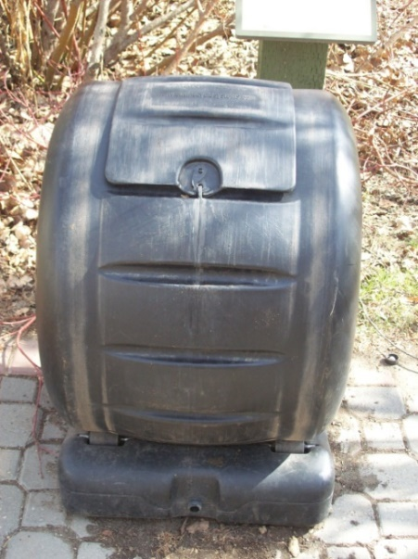
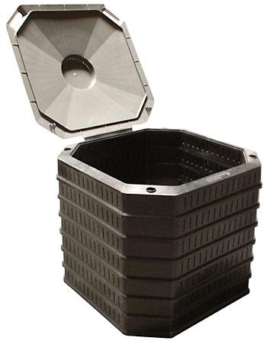
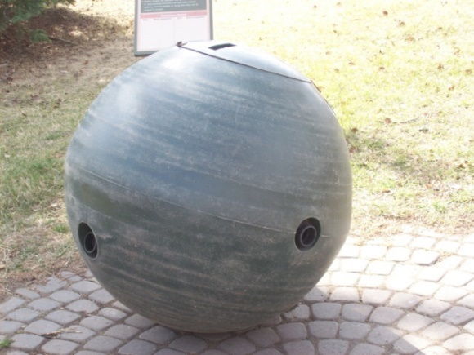
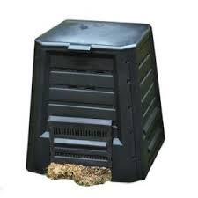
Compost Bins – Many Designs
Notes:
Note: If food scraps are to be added to a cold compost pile, use a rodent-proof bin.
Commercial Bins: Can be purchased at most hardware stores or online.
Plastic Stationary Bin
Tumbling or Rotating Bin
Tumblers allow for mixing without a pitchfork or shovel.

Slide 15
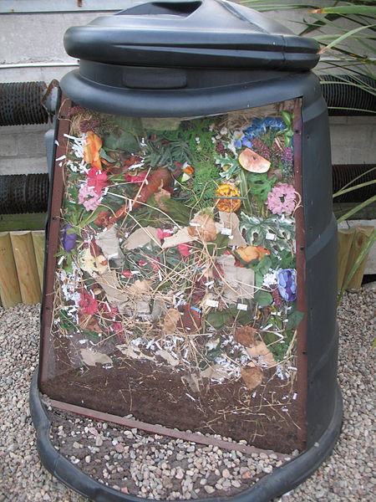
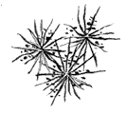
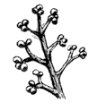
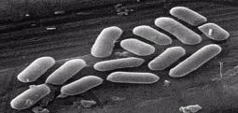
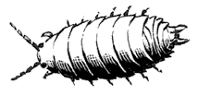
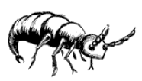
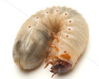
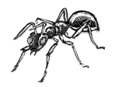
Inside a Compost Bin
Good example of mixed greens and browns
What’s missing? Not enough air?
Does it look as damp as a wrung-out sponge?
Other Organisms:
Actinomycete
Bacteria
Fungus
Nematodes
Mite
Sow Bug
Springtail
Worm
Ant
Green June Beetle larva

Slide 16
Two Basic Backyard Pile Types
Hot Pile
Super-active microbes generate heat in proper conditions
All materials must be available at the same time, chopped (½” - 1½”) & mixed
Minimum volume: 3’x 3’x 3’ (1 cubic yd. = 27 cubic ft.)
Requires frequent turning
Finished compost in one to three months
Cold Pile
Slow decomposition of materials. Little heat produced
Minimal chopping of materials
Minimal concern with proper mixture of materials
Add materials over time
Occasional turning
No minimal volume
Finished compost in six months to two years
Notes:
Nature provides the bacteria:
Psychrophilic - 0ºF to 55ºF - low temp
Mesophilic - 70ºF to 90ºF - middle temp
Thermophilic -104 ºF to 170ºF - high temp
These are all aerobic bacteria - need oxygen
Anaerobic bacteria - absence of oxygen

Slide 17
Tradeoffs
Hot Pile
Temperatures over 140º F kill most seeds and plant disease pathogens
Compost is made quickly requiring minimal space
Little concern with pests due to the heat
Requires effort in chopping materials
Requires pile to be built over a few days
Frequent turning required!
Cold Pile
Seeds and many plant diseases are not killed
Requires more space than a hot pile for an equivalent volume of input material
Must use rodent-resistant compost bins if food scraps are added to pile
Minimal chopping
Piles can be built over months
Minimal turning
Notes:
There are MANY different methods to compost that combine some aspects of hot and cold composting, and give varying results.
Practice and select/develop the composting method that best fits into your lifestyle and gardening needs.

Slide 18
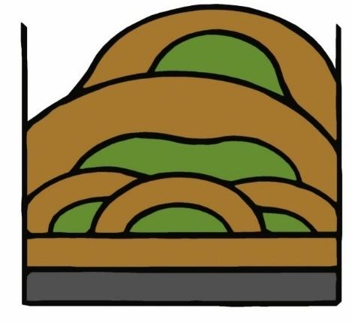
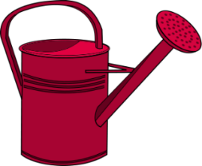
Building a Cold Compost Pile
Materials can be added as they become available
Little or no chopping required
Stir new material into pile, mixing greens and browns
Add water as needed, keep it damp, not wet
Mix food scraps with dry browns, add mixture to center of pile and cover with non-food ingredients
Use a rodent-proof compost bin if adding food scraps to the compost pile
Turn once per month, or when pile smells, or has zones that are too wet/too dry
Perhaps add a little soil to the pile
Produces compost in six months to two years
Harvest compost from the bottom of the pile
“The more effort you put in, the more compost you’ll get out”
Notes:
A variety of materials increases the chances of getting very nutritious compost mix for plants.
One good source of inoculum is your own good garden soil.
Small amounts of soil added to your compost pile will provide all the bacteria and fungi it needs to get fired up.

Slide 19
Troubleshooting
Symptom | Problem | Solution
Smells like eggs | Too much moisture | Add dry ingredients
 | Too compact not enough air | Mix more often, turn or aerate
Smells like ammonia | Too much nitrogen (green) | Add more browns (carbon) and mix, turn or aerate
Process is slow | Not enough surface area | Shred or break organics into smaller pieces
Large critters are interested in my compost pile | Wrong material has been added | Don’t add any grains, meat or bones
 | Vegetable scraps are exposed | Make sure food is covered with soil or 6” of material
Winter is coming – process has slowed | This is normal for cooler temperatures | Continue adding to your compost bin. Process will speed up again in the spring.
Notes:
Rodent-proof your compost bin:
When rodents are entering from under your bin, add hardware cloth
When rodents are entering your open bin, obtain a lid and secure it with weights (e.g. old concrete blocks)

Slide 20
Building a Hot Composting Pile
Reminder: Hot Composting
A monitored compost pile that is turned frequently, reaches high temperatures and is ready for harvest in shorter time than cold composting.
Preparation:
Accumulate enough organic material to fill the compost bin with shredded/chopped pieces (50% greens, 50% browns)
Day 1: Build the Compost Pile
Chop or shred the organic material into pieces 1” – 3”, or smaller.
Layer 50% greens & 50% browns, 3” deep layers.
Add water as pile grows. Make it “as wet as a wrung out sponge” -- not dripping wet, not dry.
Leave air pockets to provide oxygen.
Completely fill the bin. Hot composting needs a minimum size of 1 cubic yard (3’ x 3’ x 3’ = 27 cubic feet).
Notes:
Days 3 – 14: Thermophilic Range
Check temperature of compost pile in several locations. If it doesn’t heat up, check green/brown mix, moisture level and air exposure. The ideal temperature is 140ºF-150ºF uniformly throughout the pile. Avoid temperatures exceeding 160ºF (creates ash which is low in nutrients).
Turn compost pile a minimum of once per week with a spade or fork, ideally every 2-3 days for the first 2 weeks. If turning is not possible, use an aeration tool to allow oxygen and water to enter the pile.
While turning, look for dry spots, add water as needed (normally a pile needs some water at this stage). Make it as wet as a wrung out sponge -- not dripping wet, not dry. It’s normal for the pile to be steaming.
Days 15 – 30: Thermophilic - Mesophilic Range
Check temperature of compost pile in several locations. The ideal temperature is 140ºF-150ºF at the beginning, then approximately 100ºF towards the end of 30 days (uniformly throughout the pile). If it’s not, check moisture and air levels. Avoid temperatures exceeding 160ºF.
Turn compost pile a minimum of once per week. If turning is not possible, use the aeration tool to allow oxygen and water to enter the pile.
While turning, look for dry spots, add water as needed. Make it as wet as a wrung out sponge.
The pile may or may not be steaming (depends on the ambient temperature), but will be still warm/hot to the touch.
Days 31 – 60: Mesophilic Range
Turn the compost pile every 2 - 3 weeks. If turning is not possible, use an aeration tool to allow oxygen and water to enter the pile. The temperature should be between 70ºF – 100ºF.
While turning, look for dry spots, add water as needed (normally needs a small amount of water at this stage).
The pile will not be steaming, but still warm to the touch.
Bugs and worms may join in to assist the decomposition process.
Days 61 – 90 or longer: Completing the Process (Psychrophilic Range)
Let the compost mature. The temperature should be approximately 50ºF – 70ºF (depends on the ambient temperature). Use an aeration tool to allow oxygen to enter the pile. Add water if needed (normally not needed).

Slide 21
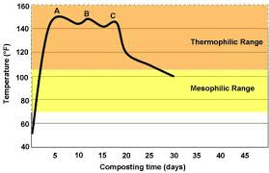
Maintaining a Hot Composting Pile
Days 3 – 14: Monitor & Turn Often Thermophilic Range, 140ºF-150ºF ideal
Days 15 – 30: Monitor & Turn Thermophilic - Mesophilic Range 100ºF-140ºF ideal
Days 31 – 60: Monitor & Turn Occasionally Mesophilic Range, 70ºF – 90ºF ideal
Days 61 – 90 or longer: Complete the Process Psychrophilic Range, 50ºF – 70ºF ideal

Slide 22
Maintaining a Hot Composting Pile
Days 3 – 14: Thermophilic Range
Check temperature in several locations. If it doesn’t heat up, check green/brown mix, moisture level and air exposure. The ideal temperature is 140ºF-150ºF uniformly throughout the pile. Avoid temperatures exceeding 160ºF (creates ash which is low in nutrients).
Turn compost pile a minimum of once per week with a spade or fork, ideally every 2-3 days for the first 2 weeks. If turning is not possible, use an aeration tool to allow oxygen and water to enter the pile. It’s normal for the pile to be steaming.
While turning, look for dry spots, add water as needed (normally a pile needs some water at this stage). Make it as wet as a wrung out sponge -- not dripping wet, not dry.
Days 15 – 30: Thermophilic - Mesophilic Range
Check temperature of compost pile in several locations. The ideal temperature is 140ºF-150ºF at the beginning, then approximately 100ºF towards the end of 30 days (uniformly throughout the pile). If it’s not, check moisture and air levels.
Turn compost pile a minimum of once per week. If turning is not possible, use the aeration tool to allow oxygen and water to enter the pile.
While turning, look for dry spots, add water as needed. Make it as wet as a wrung out sponge.

Slide 23
Maintaining a Hot Composting Pile
Days 31 – 60: Mesophilic Range
Turn the compost pile every 2 - 3 weeks. If turning is not possible, use an aeration tool to allow oxygen and water to enter the pile. The temperature should be between 70ºF – 100ºF.
While turning, look for dry spots, add water as needed (normally needs a small amount of water at this stage).
The pile will not be steaming, but still warm to the touch.
Bugs and worms may join in to assist the decomposition process.
Days 61 – 90 or longer: Completing the Process (Psychrophilic Range)
Let the compost mature. The temperature should be approximately 50ºF – 70ºF (depends on the ambient temperature). Use an aeration tool to allow oxygen to enter the pile. Add water if needed (normally not needed).
Adapt the “recipe”to fit your backyard, materials on hand, time available and how the composting process is progressing. It’s like cooking or baking, each time you do it -- you can get a different result.

Slide 24
Troubleshooting a Hot Compost Pile
Why Won’t My Pile Get Hot?
Not enough volume
A small yard/garden generates about 1 - 3 cubic ft. of material per week (varies by season). 27 cubic ft. is needed to initiate a hot compost pile.
Materials not chopped fine enough
Ideal size for raw materials is 0.5” – 1.5”
Improper C:N ratio (25-30:1 is ideal)
If there’s too much nitrogen, the pile quickly “burns out”, cools, and becomes soggy.
If too little nitrogen, the pile never heats up.
Not enough water
A dry pile decays very slowly, if at all.
Not enough oxygen
All the oxygen inside the pile has been used up by the rapid decomposition process. Turn the pile to aerate it.
Notes:
Remember a Hot Pile needs:
Minimum Volume of a Cubic Yard
Proper Carbon/Nitrogen Ratio of Around 30/1
Chopped Materials
Oh the wonders of coffee grounds, grass clippings and leaves
Wet Like a Wrung Out Sponge.
Proper Turning to Ensure Adequate Oxygen

Slide 25
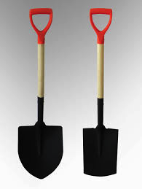
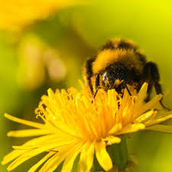
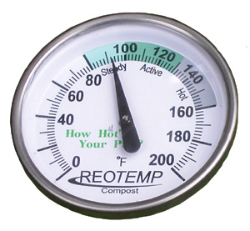
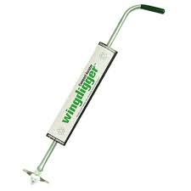
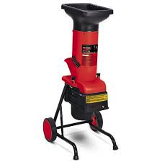
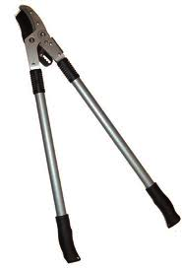
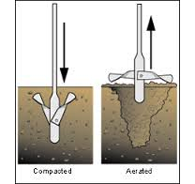
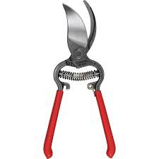
Composting Tools
Pitch Fork, Shovel, Spade
Compost Thermometer
Compost Aerator
Shears, Pruners, Chipper/shredder
Notes:
Some composters prefer a Turning Fork which is similar to a Pitch Fork, but with slightly broader, flat tines.
Don’t forget you can use a lawn mower or weed eater to chop materials.

Slide 26
Harvesting Compost
The pile is ready to harvest when:
Material has turned to a dark brown and original materials are no longer identifiable
The smell is mild and earthy
Little or no heat is being produced in a hot pile
Screening can be used to remove large pieces that are not fully decomposed
Mainly needed for cold piles
It’s easy to build your own screen
Notes:
Know when your compost is ready and how to put it in to good use.
Is it done yet?
Finished compost should look, feel and smell like dirt. One quick test is to put compost in a plastic ziploc bag and seal it, wait 24hrs, then open the bag if the compost still smells like earth your compost is finished if there is a foul smell, it is not finished.

Slide 27
Using Compost
Typical Applications:
Incorporate in soil prior to planting
Amend potting mixes
Mulch or “top dress” planted areas
Liquid extract or compost drench
Compost tea: Aerated liquid extract abundant in active bacteria and fungi
Well-made compost is a nutrient-rich soil conditioner
Benefits:
Improves soil structure by adding humus and micro organisms
Restores top soil
Inoculates soil with a wide variety of bacteria and fungi that feed the plants
Holds moisture
Saves money
Notes:
Prepare a new planting bed by working in 5% - 10% compost, by volume
Compost can be added directly as a top soil for lawns, gardens and around trees
Good mulching medium, 3” – 5” deep
Add to potted plants: mix compost with soil, about ⅓ compost to ⅔ soil
Liquid extract or compost drench – place compost in a permeable bag (e.g. burlap sack, stocking, muslin cloth) and let sit for 2 – 8 hours in a bucket of water
Compost tea: requires aeration pump, 5-gallon bucket or larger, optional ingredients, various techniques –another workshop!
Show finished compost, even show demo test.

Slide 28
Healthy Soil is Alive

Slide 29
Grasscycling
Recycle grass easily by leaving clippings on lawn when mowing
Grass clippings decompose quickly (within 2 weeks), returning valuable nutrients back to the soil
Optimal grasscycle techniques include:
Cutting no more than 1/3 the length of the grass
Cutting when grass is dry to the touch
Cutting when grass height is between 3 and 4 inches
Ensure the the mower blade is sharp
Reduces fertilizer and water requirements, minimizes chemical runoff entering storm drains and polluting creeks, rivers, and lakes
MAKES SENSE!
Notes:
Grasscycling saves time and money, and helps the environment. Mowing time is reduced since bagging and disposal of clippings is eliminated.
Grass clippings consist of water (75% of weight) and nitrogen, thus adds valuable nutrients and organic matter to the soil and produce healthy, green lawns.
Proper grasscycling does not cause thatch build up, but does promote deeper roots.
Use a mulching mower or mower modified to run without a grass catcher
Reduces the amount of yard trimmings disposed in landfills. Research has shown that lawns generate approximately 300 pounds of grass clippings per 1,000 square feet annually. This amounts to 6 1/2 tons per acre each year. Grass clippings are too valuable to throw away, and grasscycling allows reuse of this green material in our urban landscapes.

Slide 30
Vermicomposting a.k.a Worm Composting
Notes:
‹#›

Slide 31
Vermicomposting
Cultivating worms to eat our food and paper waste and produce the best fertilizer for our plants
You’re right! Worms don’t actually have eyes
Notes:
Worm composting or vermicomposting, takes advantage of the worms natural role as a decomposer. Household waste is transformed into a nutrient rich soil conditioner.

Slide 32
Vermicomposting
Worm composting is neat, easy, and odorless – when properly maintained
A great way to turn hard-to-dispose food waste and some paper waste into fertilizer
Can be done indoors, in garage, on the patio or porch, or in any moderate temperature place (50ºF - 90ºF)
Compost year round
Limited space is ok
Notes:
Minimum is 38 degrees F. Maximum is 95 degrees F. Ideal range is 70º-80ºF. Heat tolerance is dependent on moisture level

Slide 33
Vermicomposting
And… the finished product, worm castings, is a nitrogen rich fertilizer which can be used on plants both indoors and outdoors
Reduces or eliminates the need for purchased fertilizer
Is of great interest to children and adults alike, the well-behaved and silent creatures become pets.
Gardener’s Black Gold

Slide 34
Worms for Composting
Thousands of worm species live in the soil, we find some in our gardens and compost piles
Only a few species are feasible for vermicomposting:
Red Wiggler (Eisenia fetida), aka brandling worm, tiger worm
Red Tiger (Eisenia andrei), often confused with red wiggler
Blue Worm (Perionyx excavatus) for tropical climate
Red Worm or Red Earthworm (Lumbricus rubellus)
African Nightcrawler (Eudrilus engeniae)
European Nightcrawler (Eisenia hortensis)
Best compost worm for our area is the Red Wiggler

Slide 35
Species of Worms
There are more than 4400 different types of worms!
Notes:
Epigeic earthworms live on the surface of the soil in leaf litter. These species tend not to make burrows but live in and feed on the leaf litter. Epigeic earthworms are also often bright red or reddy-brown, but they are not stripy.
Endogeic earthworms live in and feed on the soil. They make horizontal burrows through the soil to move around and to feed and they will reuse these burrows to a certain extent. Endogeic earthworms are often pale colours, grey, pale pink, green or blue. Some can burrow very deeply in the soil.
Anecic earthworms make permanent vertical burrows in soil. They feed on leaves on the soil surface that they drag into their burrows. They also cast on the surface, and these casts can quite often be seen in grasslands. They also make middens (piles of casts) around the entrance to their burrows. Anecic species are the largest species of earthworms in the UK. They are darkly coloured at the head end (red or brown) and have paler tails.

Slide 36
Common Mis-Identification
These guys are not baby compost worms
They are White Worms (Enchytraeids)
a.k.a. Pot Worms
A very distant relative of the red wriggler
Large numbers indicate that the bin is acidic

Slide 37
What are the parts of a Worm?
Did you know a worm has a crop, a gizzard, and 5 “hearts”?
Notes:
The anatomy of a worm is quite complex. Fortunately, we don’t need to know all the details to be good caretakers.

Slide 38
A Worm’s Life Cycle
Worm Cocoon

Slide 39
Selecting a Worm Bin
Build Your Own Bin – box style
Don’t use chemically
treated or highly aromatic wood

Slide 40
Selecting a Worm Bin
Stacking trays
Worm bins are available in many designs and styles!
Flow- through bag
For Santa Clara County Residents: Special pricing on Wriggly Wranch worm compost bin

Slide 41
Making a Worm Bin
Many 1/4” holes for drainage and air circulation
Old 2x4
from anything
Old fence
wood

Slide 42
Any Size Bin Can Work
A rule of thumb is two square feet of surface area per person or one square foot per pound of waste per week
Start with a pound of worms (purchased or donated by a friend)
Worms will reproduce to fill the box but will not overpopulate
hermaphrodites (both male and female organs)
reproduce at two months of age

Slide 43
Locating the Worm Bin
Ideal temperature is between 55ºF and 77ºF
Plenty of air circulation
In the shade during summer, especially if a plastic bin is being used
Good locations include: under a shade tree or in covered patio, garage or laundry room, or under the kitchen sink

Slide 44
Worm Food
Vegetable and fruit scraps e.g., banana peel, apple core, lettuce, potato peel, carrot tops, etc.
Cut into small pieces, bruise/pierce hard skins
Pasta, cooked beans
Coffee grounds, including paper filters
Tea leaves, tea bags
Paper towels, napkins (food soiled)
Egg cartons (paper)
Egg shells (crushed) worms need a small amount of grit!
Notes:
Other sources of grit: fine sand, vermiculite, perlite
Also OK:
Corn cobs! Takes longer to break down, but worms love them
SMALL AMOUNTS of citrus, onion, garlic, ginger & other strongly aromatic or acidic foods. Your regular backyard compost bin is the best place for large amounts of these materials.
AGED manure from herbivores (chicken, rabbit, cow, horse, etc.)

Slide 45
What to Avoid
Animal products - meats, bones, fish, etc.
Dairy products - cheese, milk, yogurt, etc.
Pet wastes (from carnivores)
Oils or plastics (petroleum products)
Be careful with breads (for folks with mold allergies)
Avoid seeds and nuts with hard hulls & shells – they break down slowly and may sprout later when conditions are right
Avoid large amount of acidic or pungent produce – lemon, lime, orange, ginger, onion, garlic, etc.
Yard clippings - may include herbicides, pesticides; branches & woody stems break down slowly, soft ‘edible’ leaves ok
Soil (small amount ok)

Slide 46
Bedding Material
Shredded newsprint
Hand-shred or use paper shredder
“Spaghetti” shredder works best, cross-cut shredded paper tends to clump when moist
Avoid glossy inserts
Shredded cardboard
Pizza boxes, cores from paper towel & toilet paper rolls
Cardboard is a valuable recyclable material, best in recycle bin
Shredded office and junk mail paper
Use sparingly, mix with shredded newsprint
Can dry out faster than newsprint, or clump together
Some inks are petroleum-based, best avoided
Dried, partially-decomposed leaves
Avoid leaves that decompose slowly
Notes:
The best bedding material is shredded newsprint. Most newspapers use vegetable-based ink (soy).
When setting up a new worm bin, if worm food is taking a long time to break down, sprinkle in a handful of soil to inoculate the bin
A layer of cardboard on top & bottom is sometimes helpful if your bin dries out quickly
When using coir, moisten thoroughly by soaking in water before adding to bin

Slide 47
Source of Worms
The Worm Dude (San Jose)
Jerry Gach – (408) 227-5267
http://www.thewormdude.com/
One pound minimum order
Sonoma Valley Worm Farm
(800) 447-6996
http://www.sonomavalleyworms.com/index.php
Two pounds minimum order
Worms are safe to ship in mild temperatures
Tips for starting a new worm bin:
Set up the bin, add food & bedding
Wait 1 – 2 weeks before adding worms
Give worms a few days to recover from transportation and adjust to new environment

Slide 48
Putting It All Together
Air
Bedding + Moisture + Air + Food + Worms
Q: How much water?
A: As damp as a wrung-out sponge (moist, not dripping)
And a small amount of grit e.g., crushed egg shells, coffee grounds, fine sand, vermiculite, perlite, etc.
Notes:
Also OK:
Corn cobs! Takes longer to break down, but worms love them
SMALL AMOUNTS of citrus, onion, garlic, ginger & other strongly aromatic or acidic foods. Your regular backyard compost bin is the best place for large amounts of these materials.
AGED manure from herbivores (chicken, rabbit, cow, horse, etc.)

Slide 49
Inside a Worm Bin
Example: Worm Box
Bin Cover
Dry Bedding Material
four inches or more
Moist layer of
Paper/cardboard
8” to
16”
Food layer
Damp Bedding Material
four inches or more
air circulation

Slide 50
Inside a Worm Bin
Example: Stacking Trays
Plastic lid
Cardboard layer and/or bedding
“Fresh” fruit & veggie scraps, bedding material
Partially decomposed
Ready to harvest
Base: Collector tray with spigot for liquid (leachate)

Slide 51
Maintaining Your Worm Bin
Check weekly (more often if temperatures are very low or very high)
Move to a different location if needed
Add food if previous batch is being eaten (disappearing)
Don’t over-feed! Remove food if there’s too much (smelly)
If bedding is dry -- add water (spray bottle)
If bin is too moist -- add dry bedding & mix in to absorb
Add moist bedding if bedding layer is thin
Sprinkle a small amount of grit every month or so
Preparing for vacation
Add extra food and moist bedding in thin layers (minimizes anerobic decomposition) and top with a thick layer of bedding
Creative long-lasting food can be: whole apple or potato with a small hole in skin, sprinkling of flour, cereal, raisins, etc.
Add extra moisture in summer time

Slide 52
Harvesting Castings
Castings are toxic to worms and should be harvested when most of the bedding materials have become dark castings
There are many ways to harvest
Worm box:
vertical harvest: take lower layers
horizontal harvest: move finished materials to one side and feed on the other side
dump and sort: spread out and pick out worms
Keep the worms to go back into the worm bin
Stacking trays:
Harvest the “oldest” tray, normally the bottom one
If worms are still there, put the tray on top or the stack and leave the cover off. As moisture evaporates, worms head down to the tray below
Use the castings to fertilize your plants!

Slide 53
Using Worm Compost
Slow Release Nitrogen-Rich Fertilizer
Use it instead of fish emulsion on bedding plants in greenhouse
Spread around potted plants
Spread around vegetables or flowering plants in the garden
Can be sifted onto lawns
Incorporate into soil around shrubs and trees
Can be incorporated into a planting soil mix
Preferred ingredient for brewing compost tea

Slide 54
Troubleshooting a Worm Bin
Fruit Flies in Worm Bin
Food scraps not adequately covered
Add four or more inches of dry or slightly moist shredded paper over food scrap layer
Set a bowl of vinegar in the bin on top of the shredded paper
Fruit flies already present in food scraps before adding to bin
Store food scraps in covered container or freezer before adding to the worm bin
Worms Die
Worm box overheated (more than 100°F) common with plastic bins
Keep worm bin in shady area
Add a few ice cubes for quick cooling
Consider using a wood worm bin if adequate shade can’t be found
Bedding material has dried out
Check moisture when feeding, add extra water on hot, dry days
No food scraps have been added for long period of time (weeks/months)
Don’t be mean to your pets, feed them as required!

Slide 55
Where Do I Get Help?
The ROTLINE: (408) 918-4640
http://cesantaclara.ucanr.edu/Home_Composting_Education/
United States Environmental Protection Agency (EPA), Composting At Home http://www2.epa.gov/recycle/composting-home
California, CalRecycle, Backyard Composting http://www.calrecycle.ca.gov/organics/homecompost/
Bay Area Eco-Gardens http://bayareaecogardens.org/
Libraries Santa Clara County Library District (sccl.org) or your city's library Search for "home composting" to find related books, magazines and videos
Lots of Information Available!

Slide 56
Hands-On Demonstration

