Slide 1
Optimization of Strawberry Production in Fusarium Infested Soil Part 2
Joji Muramoto
UC Santa Cruz
February 14, 2019

Slide 2
Outline
Lessons learned on ASD at a Fusarium-infested field
Soil temperature
Effect of tarp color, bed orientation and soil depth
Nitrate leaching
Comparing ASD, Chloropicrin, and UTC

Slide 3
Lessons Learned: ASD at Fusarium infested fields (1)
“ASD using rice bran in fall is not a good choice for Fusarium infested soils, especially under green plastic”
The site: No history of Fusarium wilt
2015: Raspberry (w/ fumigation)
2016: Strawberry (w/ fumigation)
2017: Cover crop (Barley: Mustard = 90:10)
2018: Strawberry (this trial)
One year break is not enough to avoid Fusarium wilt without fumigation in the Northern district …at least 2 year break, ideally 3 years, necessary
Important lesson for organic strawberry growers who use fall ASD (or fall RBF*) *Rice bran farming

Slide 4
Lessons Learned: ASD at Fusarium infested fields (2)
“ASD using rice bran in fall is not a good choice for Fusarium infested soils, especially under green plastic”
Fusarium oxysporum….saprophytic
Can feed on dead organic matters (e.g. rice bran!)
Need a rapid and accurate soil test for Fusarium oxysporum f. sp. fragariae

Slide 5
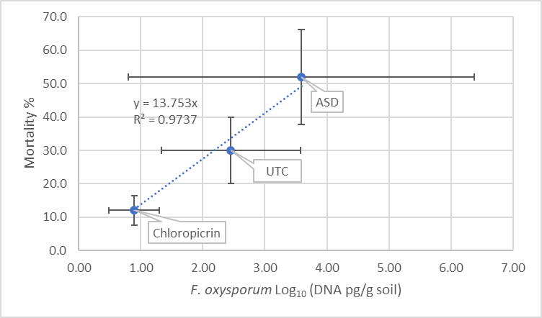
Soil total F. oxysporum population and strawberry mortality (Aug. 2018)

Slide 6
Lessons Learned: ASD at Fusarium infested fields (3)
“ASD using rice bran in fall is not a good choice for Fusarium infested soils, especially under green plastic”
Summer flat ASD using clear mulch can control Fusarium wilt of strawberry in the Northern district
Have bacteria use the C-source (e.g. rice bran) for fermentation before Fusarium feed on it

Slide 7
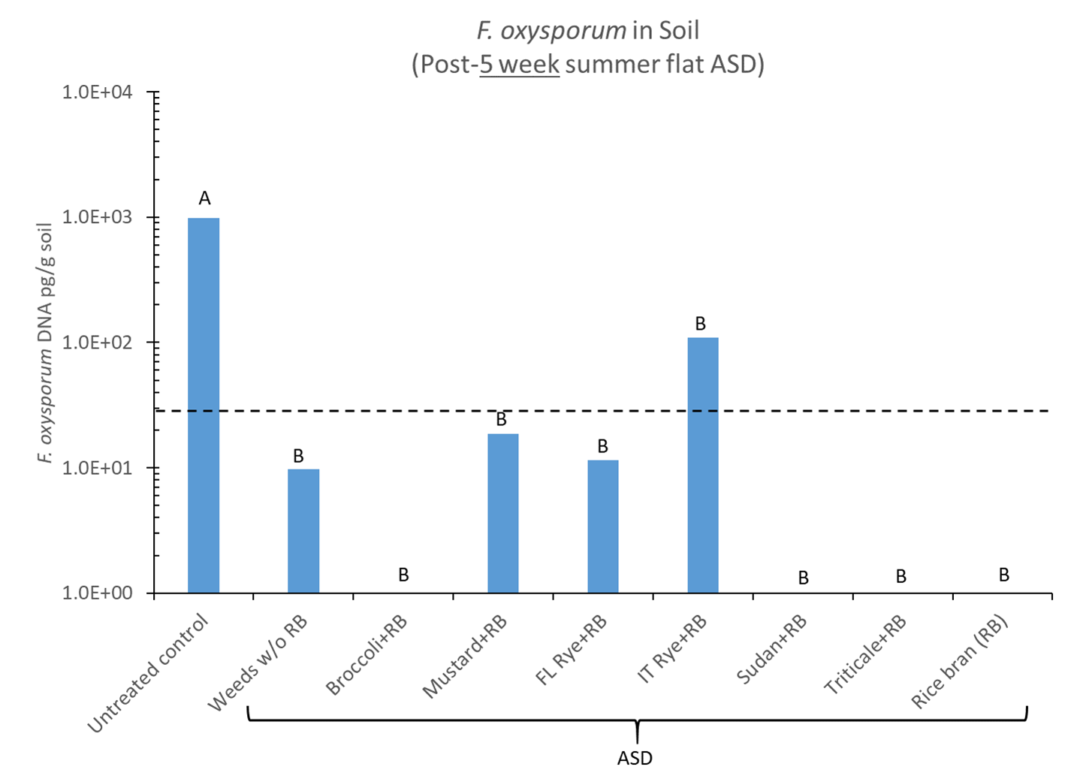
Summer-cover crop/rice bran ASD for Fusarium oxysporum
(MBA field trial using clear plastic mulch in late July-August 2017)
Average of Chloropicrin-treated plots at MBA trials
>460 hours above 86 °F at 8” soil depth
(Muramoto et al., In review)

Slide 8
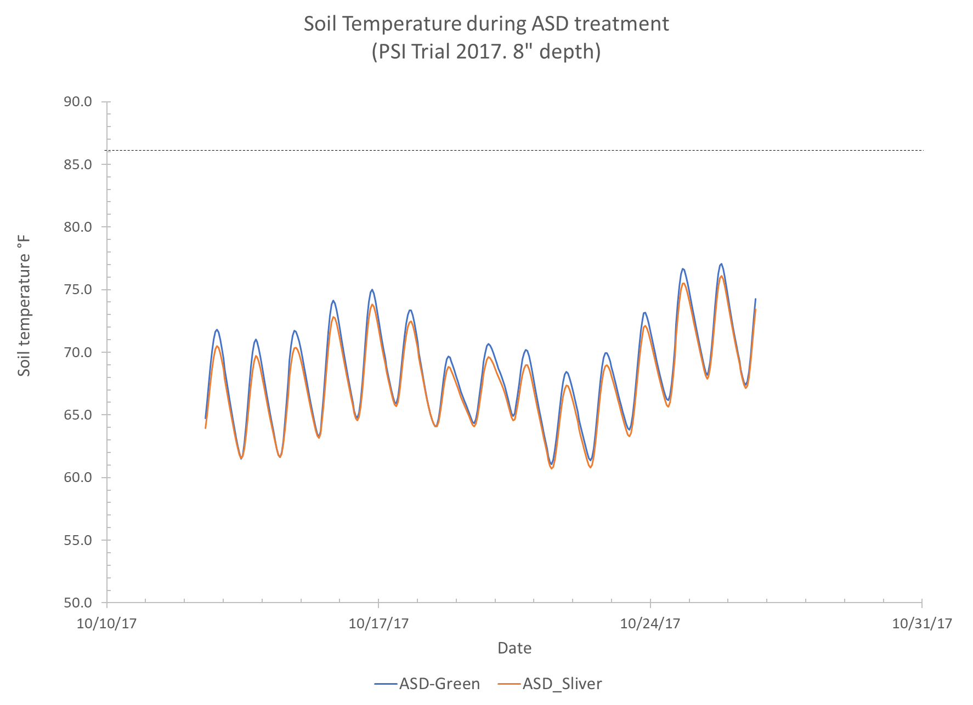
Soil temp during ASD

Slide 9
Lessons Learned: ASD at Fusarium infested fields (4)
“ASD using rice bran in fall is not a good choice for Fusarium infested soils, especially under green plastic”
Higher soil temperature makes Fusarium wilt worse…..Dr. Tom Gordon
Effect of tarp color on soil temperature

Slide 10
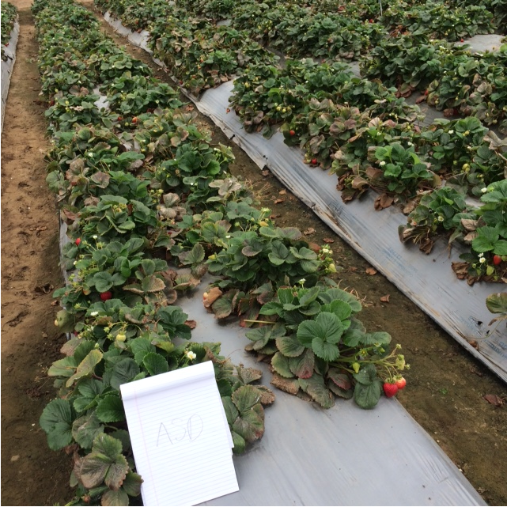
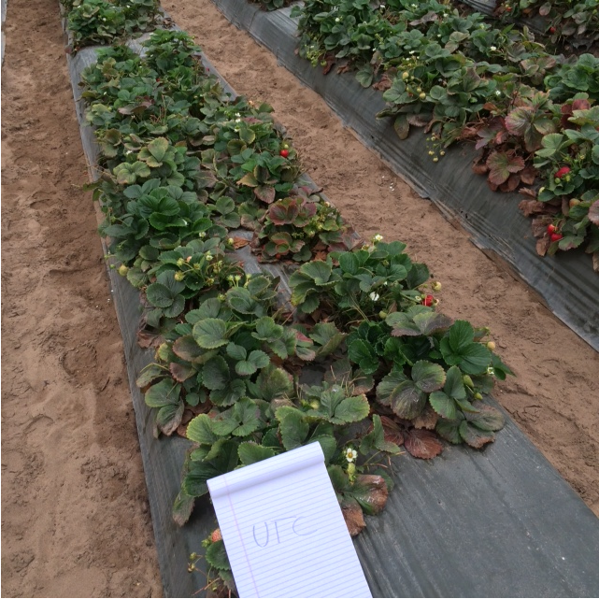
Plastic colors
Silver Green

Slide 11
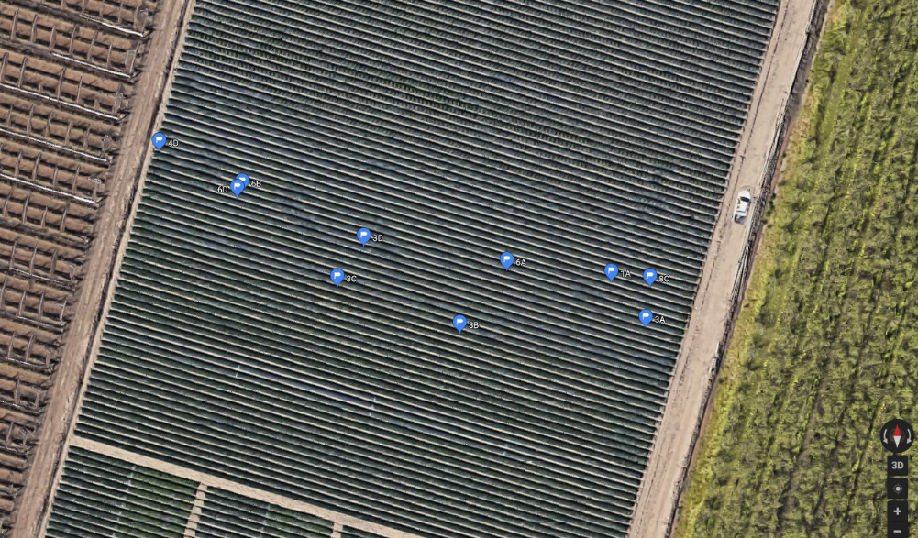
Soil temperature
TidbiT temperature dataloggers (every 30 min)
Tarp: Green vs. Silver
6” depth (11/2/17-8/30/18) vs. 2” depth (2/21-8/30/18)
South bed side vs. North bed side
2” from the bed shoulders at chloropicrin plots
N
W
E
S

Slide 12
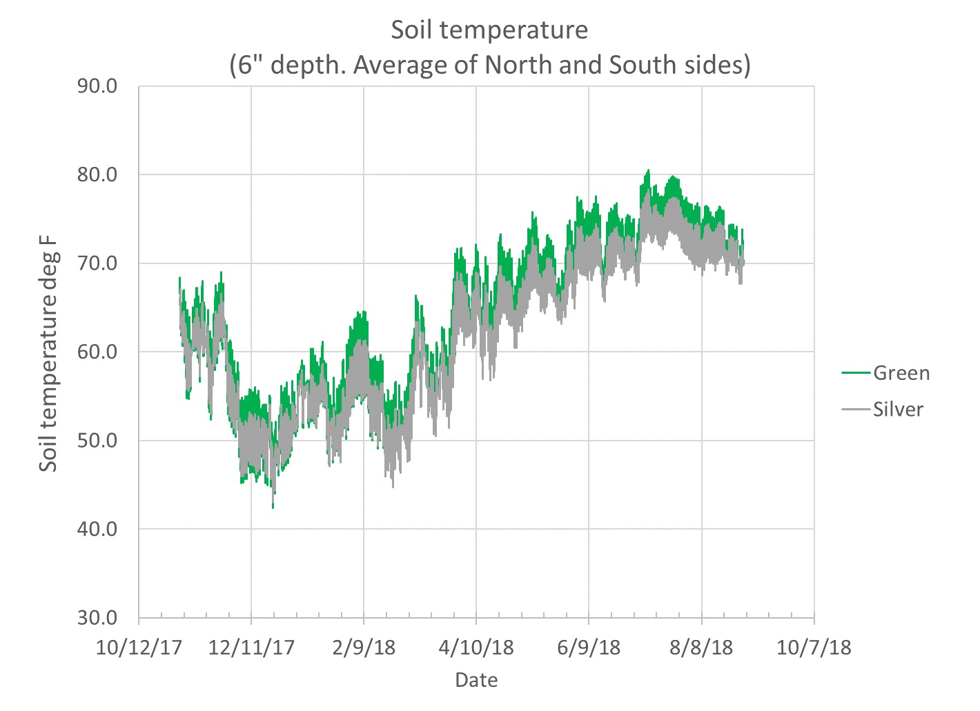
Green: Ave. 63.3 (Min. 42.4 – Max. 80.5)
Silver: Ave. 62.3 (Min. 43.0 – Max. 78.3)

Slide 13
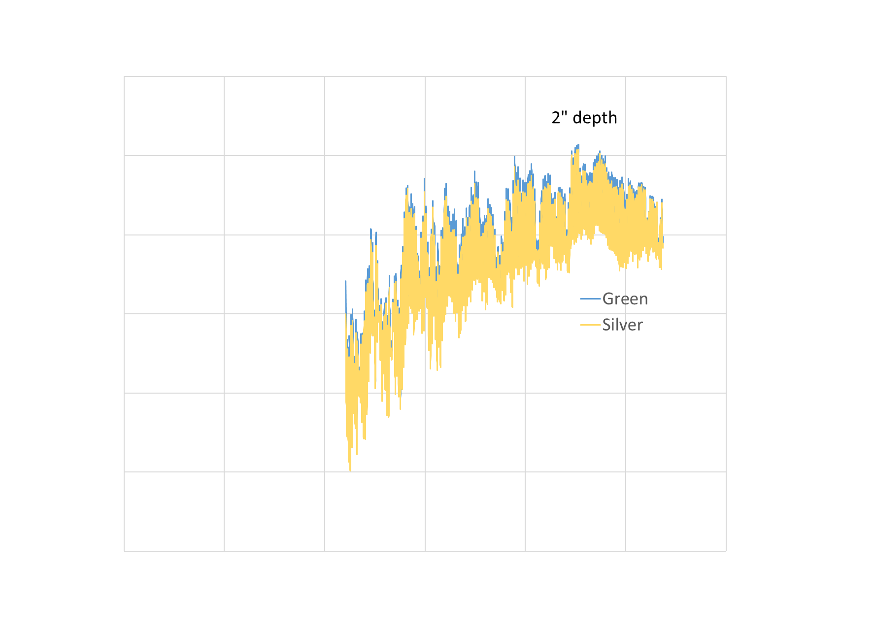

Slide 14
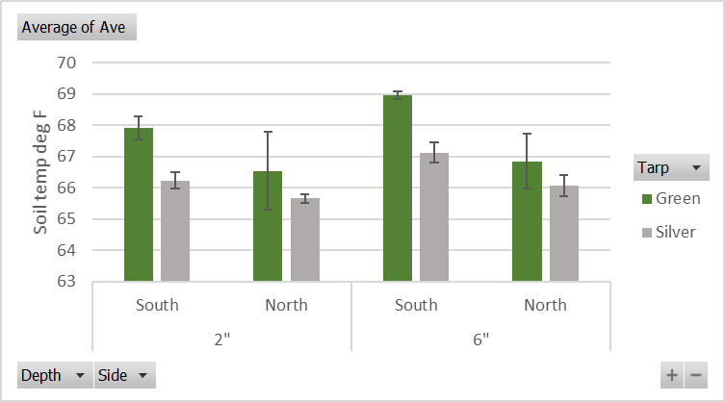
Average soil temperature (2/21/18 – 8/30/18)

Slide 15
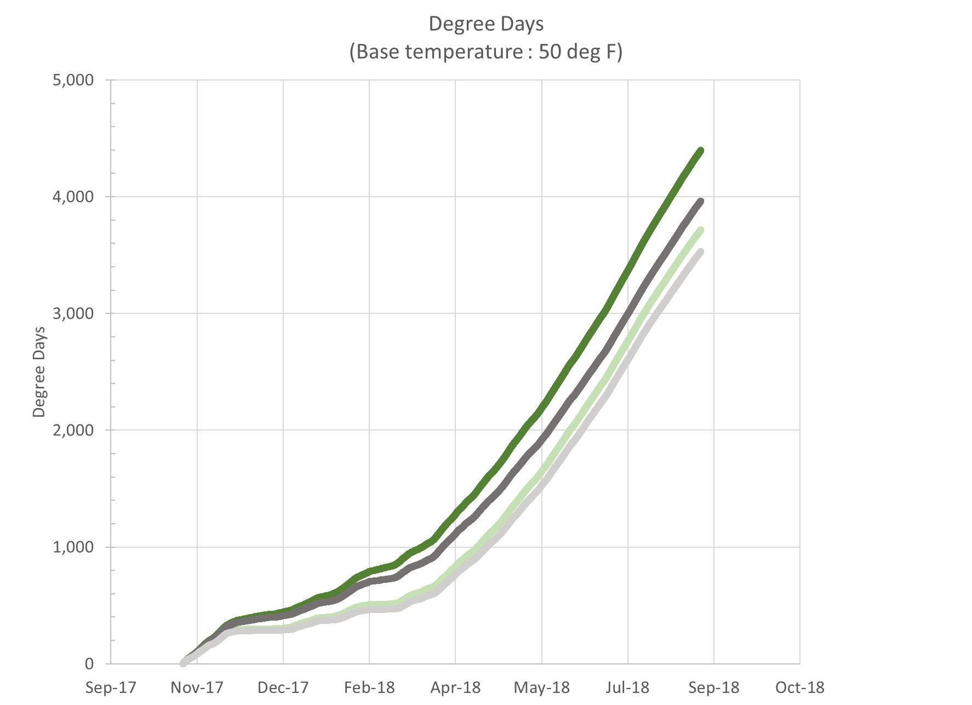
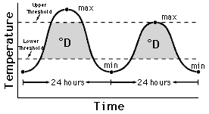
Green
(Top: South, Bottom: North)
Silver
(Top: South, Bottom; North)
Av. Difference in July: 262
Av. Difference in April: 107

Slide 16
Summary: Soil temperature
Difference in average soil temp at 6” depth
Green > Silver
South side: 2 °F, North side: 1 °F
South > North
Green: 2 °F, Silver: 1 °F
Degree day at 6” depth
Green > Silver
Ave. 107 degree day in April
Ave. 262 degree day in July

Slide 17
Nitrate leaching monitoring
Soil water sampling + Water balance residual method (Cahn et al., 2011)
Sample leachate at 24” depth after each irrigation and rain event
Leach NO₃-N (lb/ac) = NO₃-N in leachate (mg/L) x Amount of water leached (L/acre)**
** Water input – soil water retention (0”-24” depth) – evapotranspiration - runoff***
*** Not measured in this project
Nov. 2017- Aug. 2018
Compared green mulched
ASD rice bran 6 t/acre to bed area (no preplant fert.)*
Chloropicrin (97 lb-N/ac preplant)
UTC (97 lb-N/ac preplant)
All plot: 75 lb-N/ac in-season
Lysimeters
Soil moisture sensors
6”
12”
24”
* Rice bran provides total N: ~360 lb-N/ac Assuming 30% mineralization: ~100 lb-N/ac of inorganic N

Slide 18
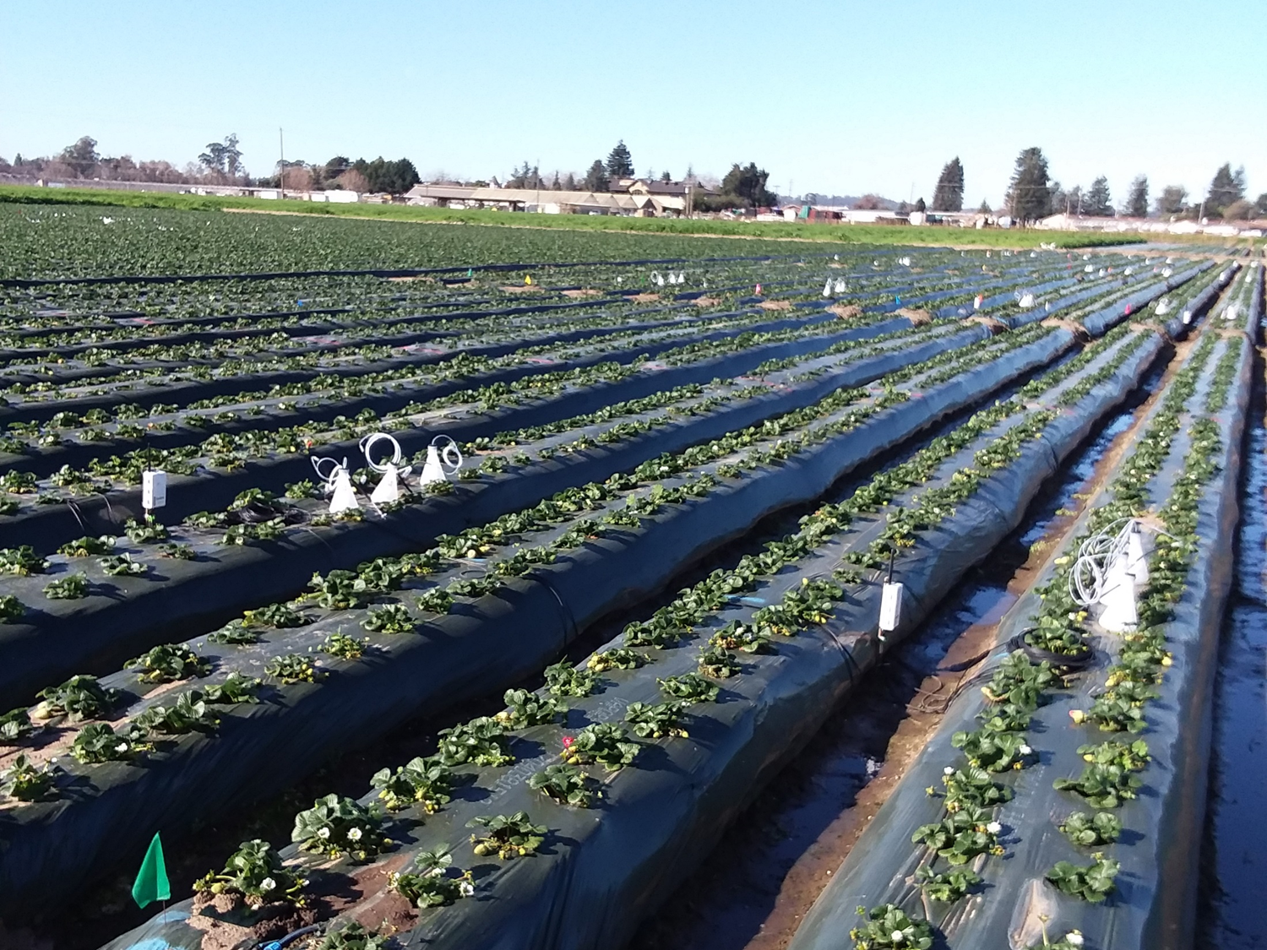

Slide 19
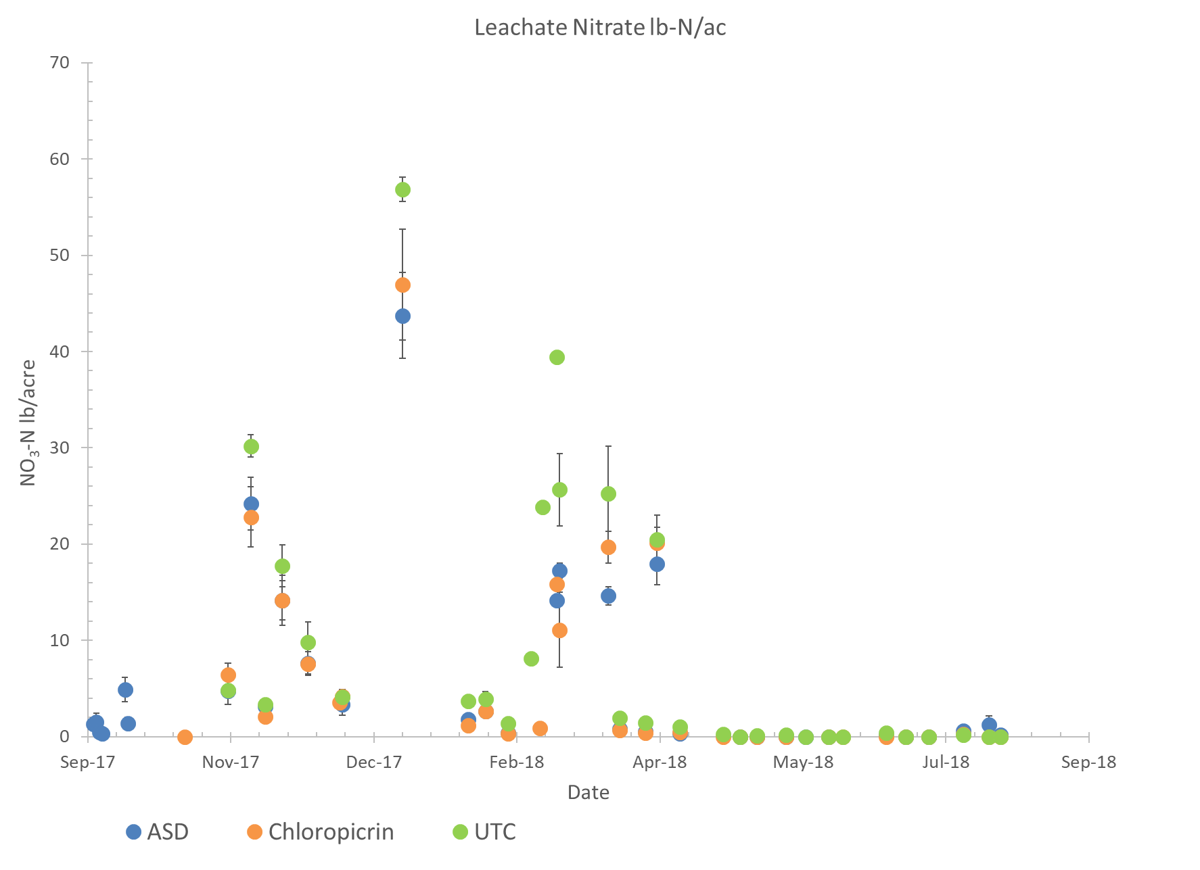

Slide 20
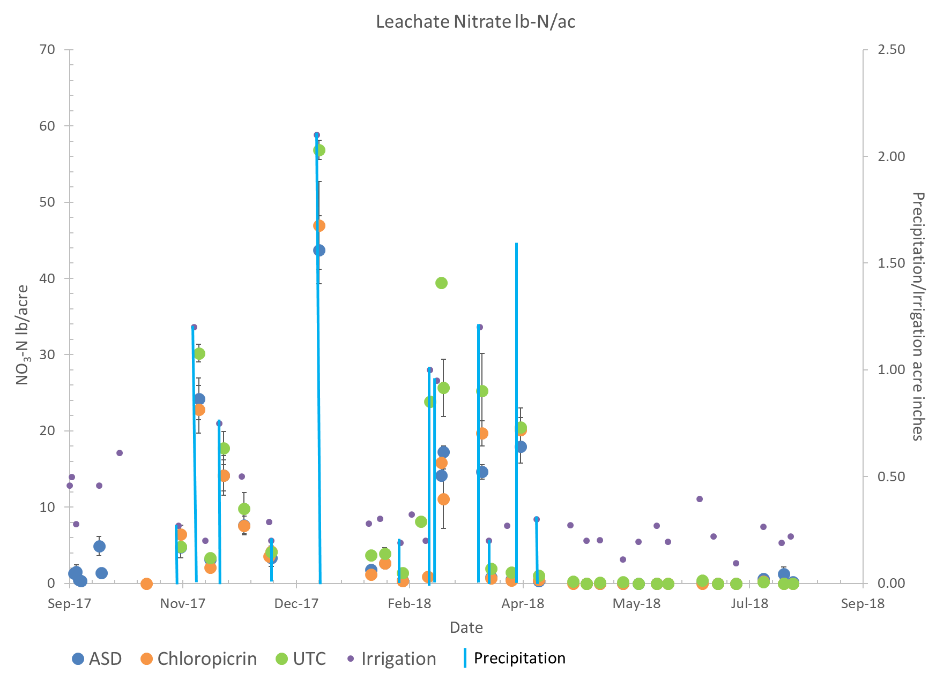

Slide 21
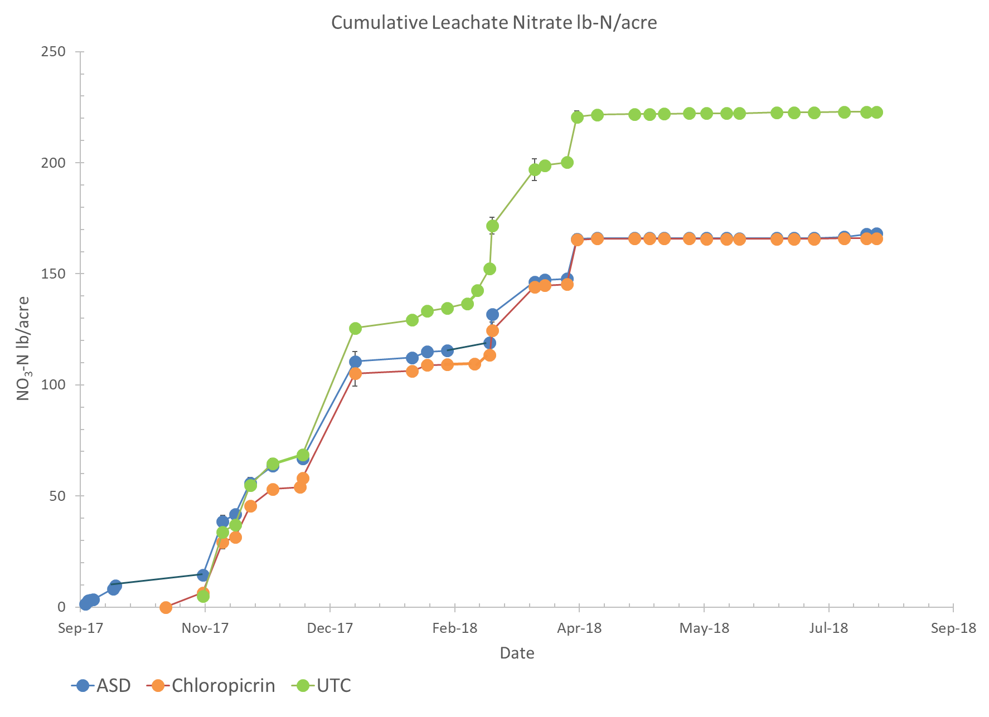

Slide 22
Summary: Nitrate leaching
Preliminary estimate of total nitrate leaching
UTC: 223 lb-N/ac
ASD: 168 lb-N/ac
Chloropicrin: 166 lb-N/ac
Mainly rain event driven
Nitrate leaching after ASD under healthy plant growth may be worth monitoring in the future

