Slide 1
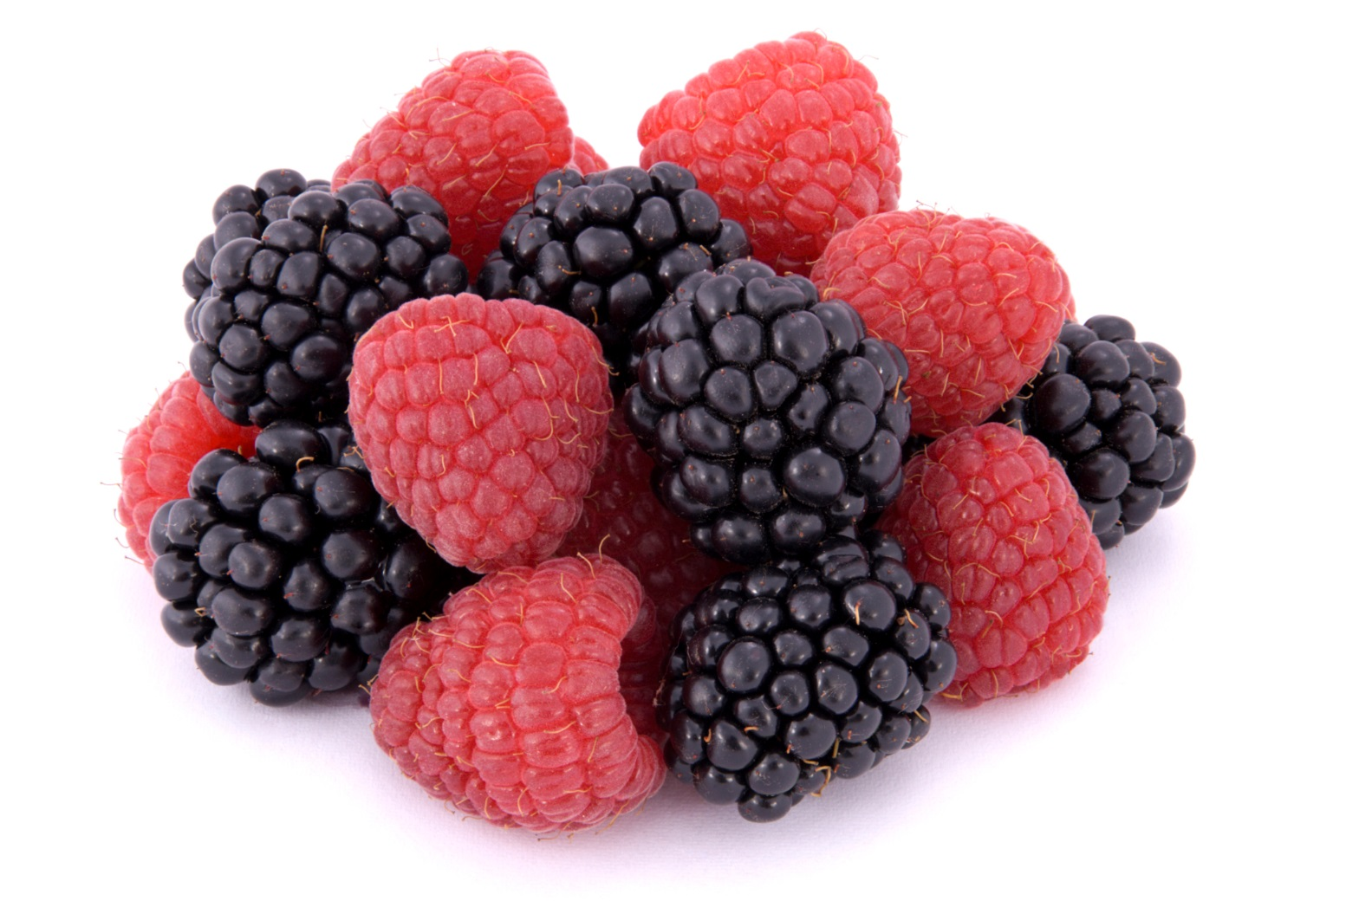
Caneberry Market Trends
Central Coast Caneberry Meeting
Watsonville, CA February 21, 2019
Roland Fumasi, Ph.D.
Vice President & Senior Analyst
RaboResearch Food & Agribusiness

Slide 2
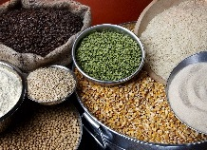


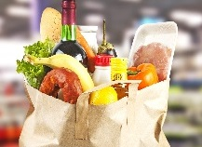
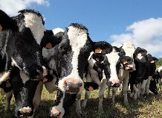


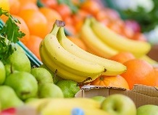

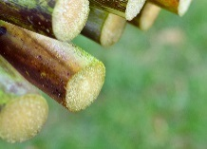
RaboResearch
Food & Agribusiness
A global network…
One of the largest
F&A research hubs in
the world and the world’s
leading F&A financial
services provider
Broad knowledge of
innovation, strategic
development and
risk-reward balances
along the value chain
Unique combination
of strategic business
development and
in-depth research
Vast global network
with access to all
players in the market
F&A coverage from farm
to fork, across rural and wholesale sectors
Global team of experts
with real-time insights
into local markets
of local experts
Agri
Commodity
Markets
Animal
Protein
Beverages
Consumer
Foods
Dairy
F&A Supply
Chains
Farm Inputs
Fresh
Produce
Grains &
Oilseeds
Sugar

Slide 3









Team of 87 professionals in 9 different countries
Netherlands
33
Hong Kong and China
7
UK
6
US
22
Singapore
4
India
2
Brazil
4
Australia
7
New Zealand
2

Slide 4
Raspberries & blackberries continue to gain ground
U.S. berry consumption 2005-2017
1.5%
5.9%
1.5%
7.6%
6.8%
14.9%
90.2%
71.6%
Source: USDA/ERS, University of California, Rabobank 2019
Notes:
Retail Spend-Berries #1
Strawberries 45-50% of berry value, 70-75% of berry volume, 71% of households.
Berry retail spend is _____% more than ________:
Bananas 75%
Apples 43%
Citrus 42%, including mandarins & lemons
Avocados 212%

Slide 5
Fresh fruit & nut consumption – a few are key
U.S. fresh fruit & nut “use” – CAGR 2005-07 vs 2015-17 Avg
Source: USDA/ERS, Rabobank 2019

Slide 6
The definition of “quality” is now more complex
Product & Process Matter, but…
left-hand side still rules the day
Berries tick some important boxes
Health
+
+
+
+
Environmental Sustainability
=
Taste
Convenience
Appearance
Affordability
My Values
+
Social Good
Food Safety
Information
Consumer Purchasing Decision
Source: Produce Marketing Association (PMA), Rabobank 2018

Slide 7






Importance of convenience cannot be overstated
A SOCIETY OF SNACKERS
62%
39%
41%
17%
16%
18%
All
F&V
All
Fruits
All Vegetables
Value-Added
Fruits
Value-Added
Vegetables
All Packaged
Salads
% Changes in F&V Retail Spend, USA 2012-2017
Source: United Fresh Produce Association, Nielsen Perishables Group, Rabobank 2018
Notes:
Title change: Convenience is Queen
The chart title has different font types. Move the chart title to bottom of the slide and add placeholder for source
1st click: left graph comes up
2nd click: right graph comes up with a chart title above the right graph “A society of snackers”

Slide 8
Berries: #1 overall and #2 in organic at retail
Organic Berries
109%
97%
Berries 24%
84%
77%
62%
67%
39%
41%
17%
16%
18%
All
F&V
All
Fruits
All Vegetables
Value-Added
Fruits
Value-Added
Vegetables
All Packaged
Salads
All Organic
F&V
Organic
Fruits
Organic
Vegetables
Organic
Packaged Salads
% Changes in F&V Retail Spend, USA 2012-2017
Source: United Fresh Produce Association, Nielsen Perishables Group, Rabobank 2018

Slide 9
Supply adjustments do work
U.S. non-organic raspberry shipping-point data – domestic & imports*
*Prices represent the average weekly shipment-weighted price in each year
Source: USDA/AMS, Rabobank 2019

Slide 10
Working on the California piece of the puzzle
U.S. raspberry shipping-point data – 2012-14 vs 2016-18 averages*
*Domestic & imported production
Source: USDA/AMS, Rabobank 2019

Slide 11
Raspberries: Santa Maria & Mexico gaining volume share
2007-09 Avg Share
2016-18 Avg Share
Source: USDA/AMS, Rabobank 2019

Slide 12
Blackberry prices need to find a bottom
U.S. non-organic blackberry shipping-point data – domestic & imports*
*Prices represent the average weekly shipment-weighted price in each year
Source: USDA/AMS, Rabobank 2019

Slide 13
Hard to find any upward price momentum
U.S. blackberry shipping-point data – 2012-14 vs 2016-18 averages*
*Domestic & imported production
Source: USDA/AMS, Rabobank 2019

Slide 14
Blackberries: Santa Maria & the Southeast gain
2007-09 Avg Share
2016-18 Avg Share
Source: USDA/AMS, Rabobank 2019

Slide 15
Organic raspberry supply responding
U.S. organic raspberry shipping-point data – domestic & imports
Source: USDA/AMS, Rabobank 2019

Slide 16
Organic blackberry supply increase is dramatic
U.S. organic blackberry shipping-point data – domestic & imports*
*Prices represent the average weekly shipment-weighted price in each year
Source: USDA/AMS, Rabobank 2019

Slide 17
Organic blackberry premiums need to hold now
U.S. organic blackberry shipping-point data – domestic & imports*
*Prices represent the average weekly shipment-weighted price in each year
Source: USDA/AMS, Rabobank 2019
Notes:
Premium not any better during SE window

Slide 18

Contact Details
Rabobank N.A.
Roland Fumasi
Vice President, Senior Analyst
RaboResearch Food & Agribusiness
Roland.Fumasi@Rabobank.com
DISCLAIMER
This presentation has been prepared exclusively for the benefit and internal use of RABOBANK (“COMPANY” or the “Company”), and does not carry any right of publication or disclosure other than to COMPANY. Neither this presentation nor any of its contents may be used for any other purpose without the prior written consent of the Coöperatieve Centrale Raiffeisen-Boerenleenbank B.A. (“Rabobank” or “Rabobank International”).
The information in this presentation reflects prevailing market conditions and our judgement as of this date, all of which may be subject to change. This presentation is based on public information. The information and opinions contained in this document have been compiled or arrived at from sources believed to be reliable, but no representation or warranty, express or implied is made as to their accuracy, completeness or correctness. The information and opinions contained in this document are wholly indicative and for discussion purposes only. No rights may be derived from any potential offers, transactions, commercial ideas et cetera contained in this presentation. This presentation does not constitute an offer or invitation. This document shall not form the basis of or be relied upon in connection with any contract or commitment whatsoever.
“The financial link in the global food chain”™

Slide 19
Appendix / Additional Slides

Slide 20
Smaller growers & the “local” market opportunity
Remember, the left side of the equation still rules the day
-Product quality
-Affordability (cost)
-Convenience
But, the right side of the equation gains traction
-Fewer miles
-Social good (local economy & a connection)
-But, it’s economic too (revenue)
Opportunity to blend big with local????

Slide 21
Changing attitudes – Does it matter whose?
U.S. organic food sales 2005 – 2020f
11.2% CAGR
Source: USDA/ERS, Organic Trade Association, Rabobank 2017

Slide 22
Labor constraint will continue to tighten
Change in the 15-35
age cohort in Mexico
Undocumented Mexican residents
in the U.S. in decline
2007
6.9 Mill
2016
5.6 Mill
Source: Washington State University, World Bank, Pew Research Center

