Slide 1
Can exclusion manage spotted wing drosophila (SWD) in organic blackberry production?
Anna D. Howell, Oleg Daugovish, Gina Ferrari, &
Heidi McMahan (UCCE – Ventura Co.)
@bugAnnaDHowell
@AnnaDaritaHowell

Slide 2
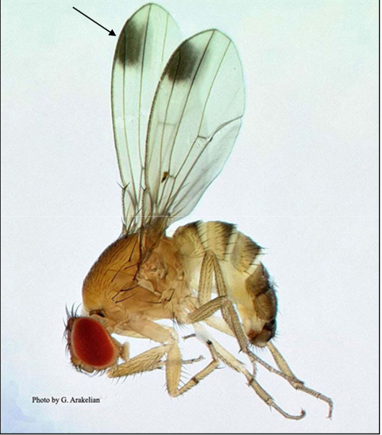
♂
ADH

Slide 3
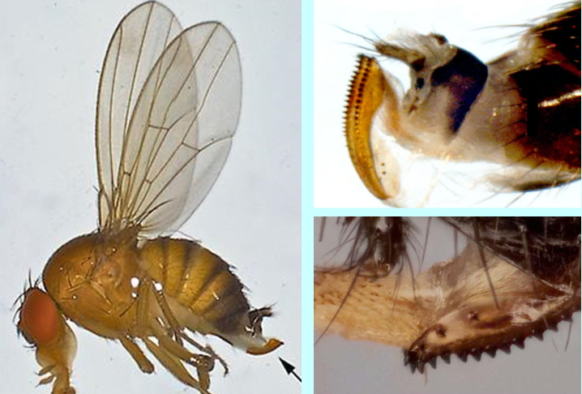
♀
serrated ovipositor
1/8 – 1/16”

Slide 4
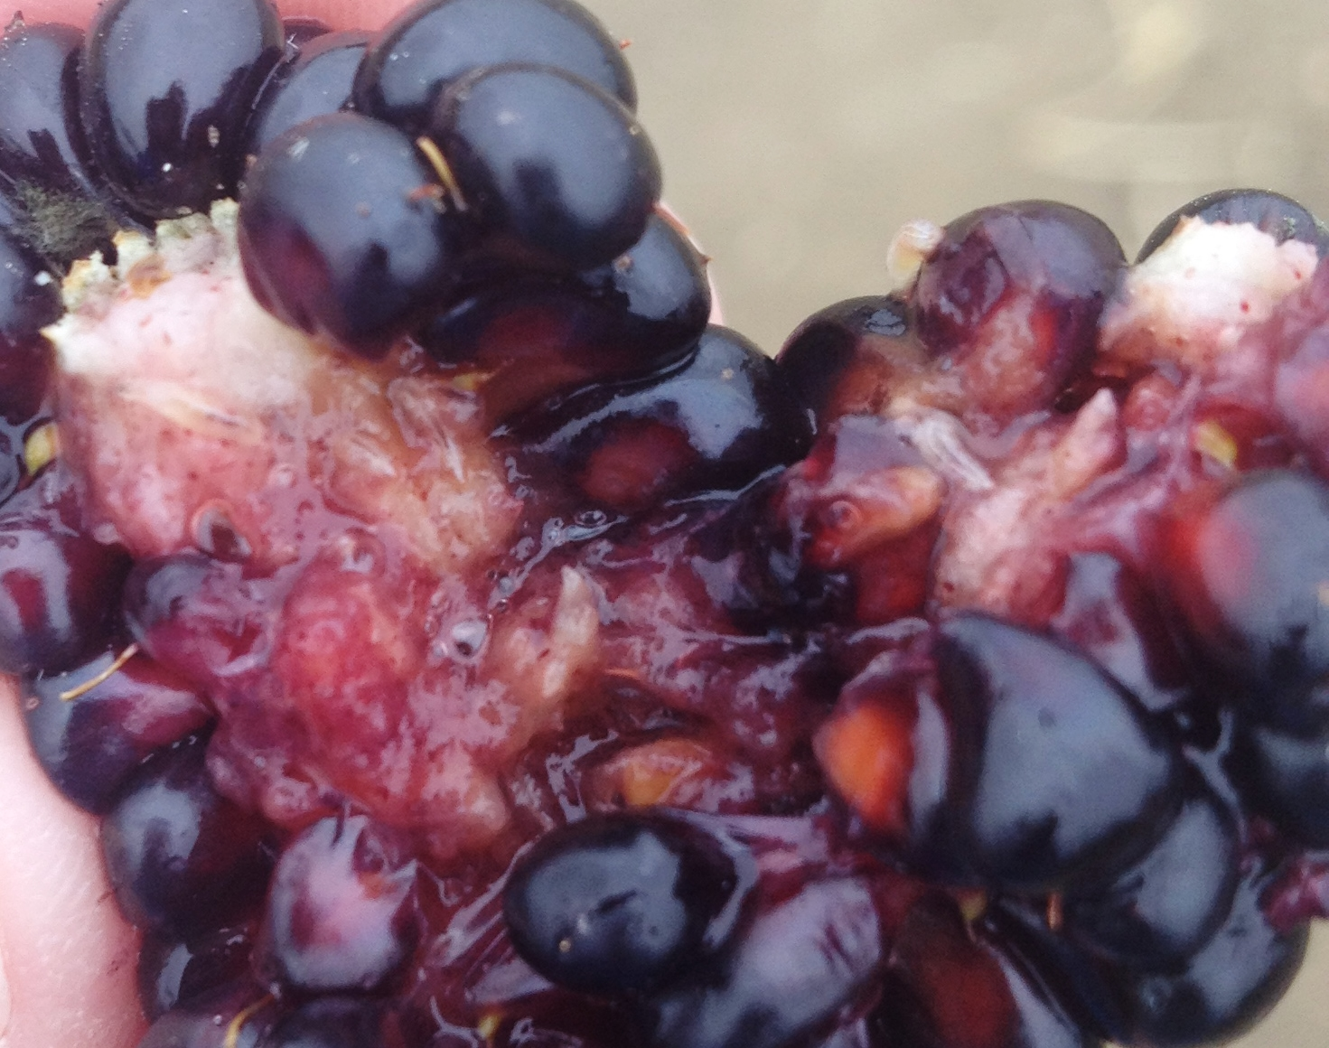
ADH

Slide 5
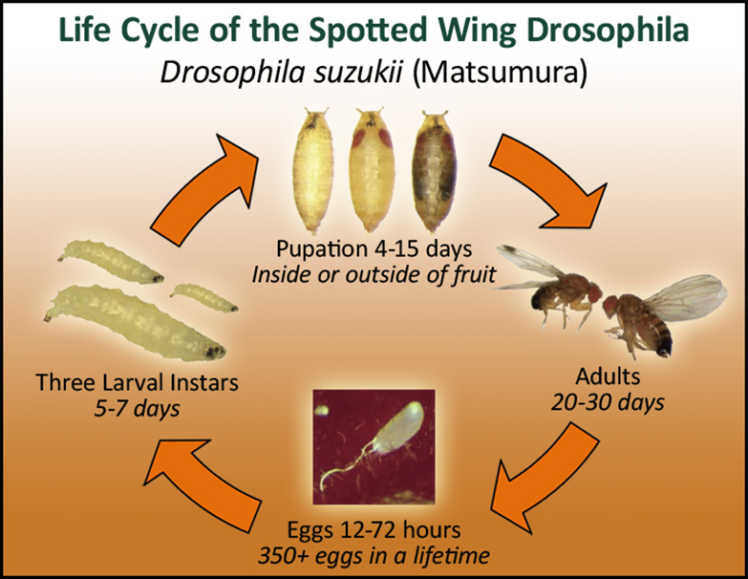
Most active: 60-80 ᵒF
Activity decreases: ≥86 ᵒF
Generations per year:
10+
ADH

Slide 6
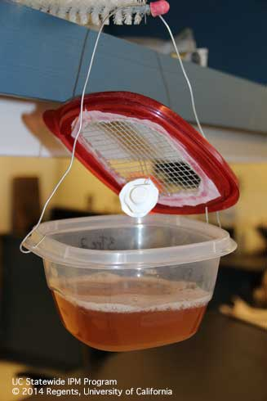
Management strategies
Monitoring to detect early infestations
Sanitation
Clear out old fruit
Sprays & baits to decrease populations
Timing of sprays is key
What about exclusion?
ADH

Slide 7
Mini Mesh Hoop House
Anti-insect mesh 50 (Green Tek)
Excludes WF, leafminer, thrips, aphids, SWD adults
20-29% shade
Double zipper doors
4 plots under mesh, 4 plots outside mesh (UTC)
ADH

Slide 8
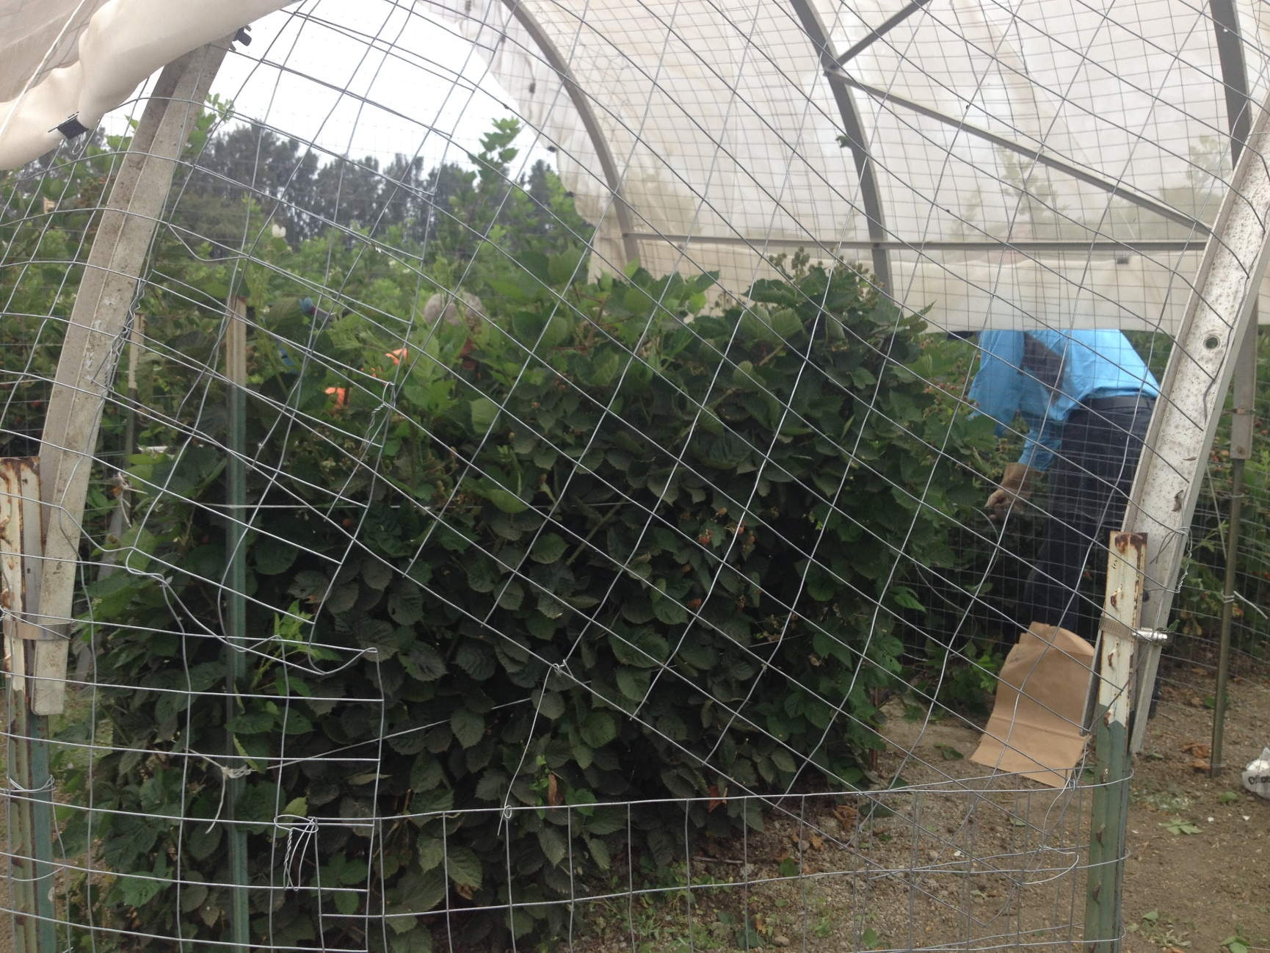
5 plants per plot
ADH

Slide 9
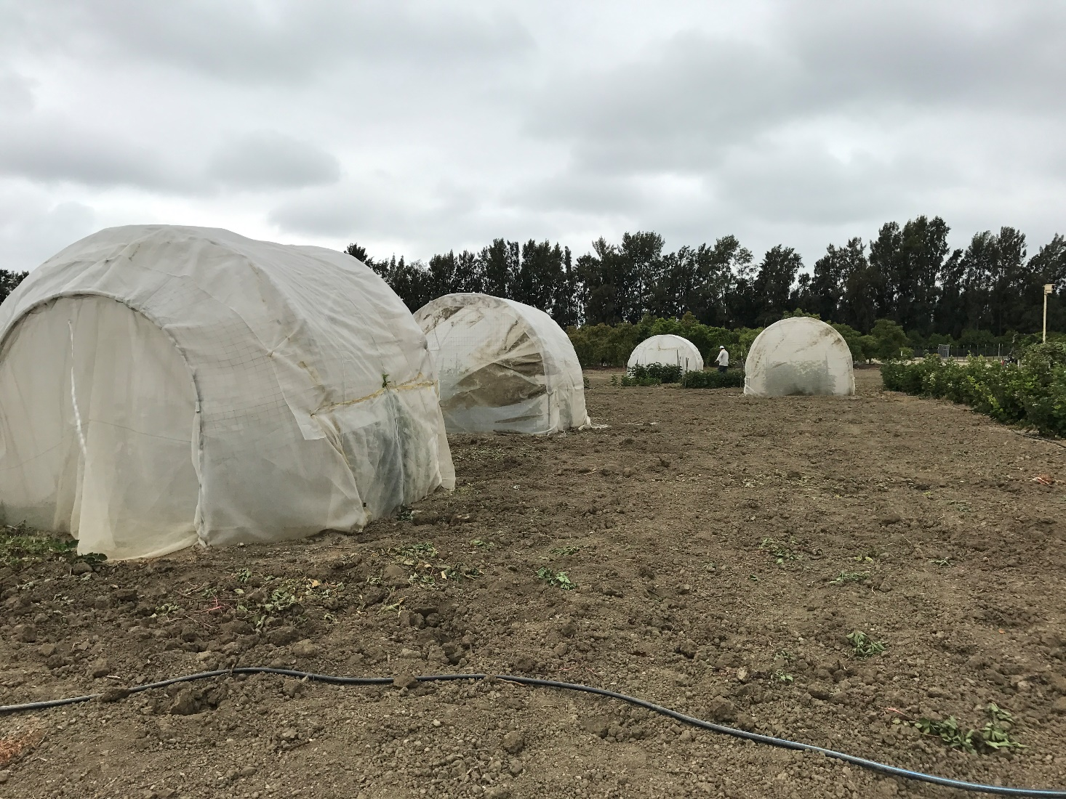
ADH

Slide 10
Mini Mesh Hoop House
Harvested marketable & marketable
Unmarketable taken to the lab to look for SWD larvae
Not all fruit was removed from mesh during 2016-2017
ADH

Slide 11
Average Temperature (F) in 24 hrs
ADH

Slide 12
2016 Marketable Yield
ADH

Slide 13
2016 Unmarketable Yield
ADH

Slide 14
2016 %SWD
ADH

Slide 15
2017 Marketable Yield
ADH

Slide 16
2017 Unmarketable Yield
ADH

Slide 17
2017 %SWD
ADH

Slide 18
2018 Marketable Yield
ADH

Slide 19
2018 Unmarketable Yield
ADH

Slide 20
2018 %SWD
ADH

Slide 21
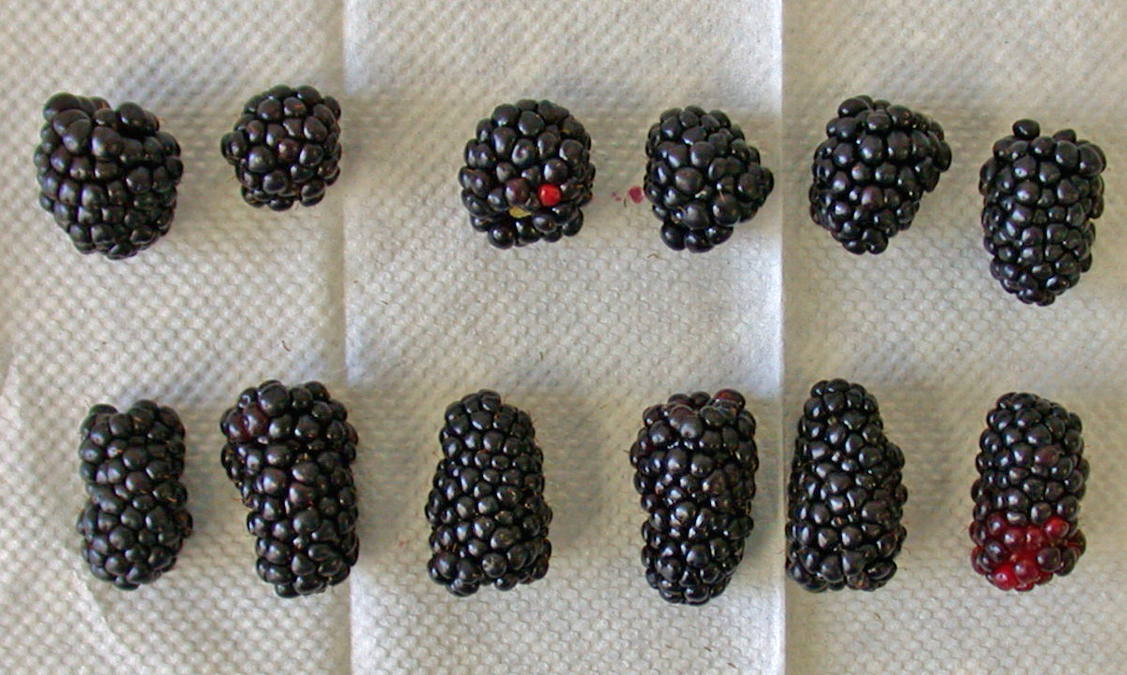
UTC
Mesh
ADH

Slide 22
Summary
Exclusion was not full proof
Need to start clean
Tunnels produced slightly higher yields early in the season & less unmarketable fruit
Tunnels also protected berries from other environmental factors

Slide 23
Acknowledgements
UCCE Master Gardeners Ventura County

Slide 24
Questions?
@bugAnnaDHowell
@AnnaDaritaHowell

