Slide 1
About UC ANR: Cooperative Extension & the Land Grant System.
Part of the “Building Success” Series

Slide 2
This Is Module 5:
Overview - designed to help you understand the fit and role of UC ANR.
Welcome to UC ANR!
Are you confused by the terms…..
Land Grant?
UC ANR?
Cooperative Extension?

Slide 3
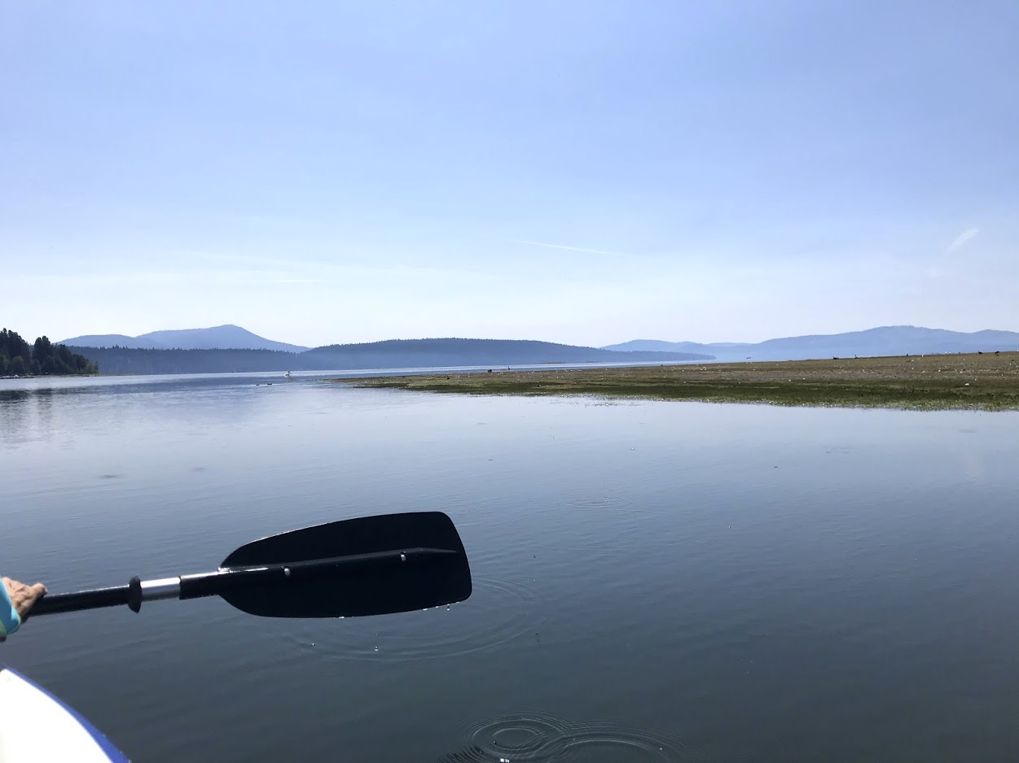
In this Session
Just 11 slides to better
understand the Land Grant
System and our role
About UC ANR: Part 1
Understand what the Land Grant University system is and where Cooperative Extension fits.
Know why, while we are Cooperative Extension, we are called UC ANR.

Slide 4
What is a Land Grant University?
(oh no, a history lesson?)
1
pikrepo.com

Slide 5
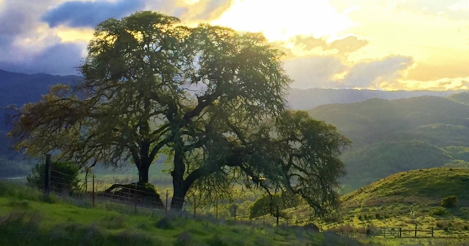
Land Grant Universities
Did you know that UC ANR is part of the Land Grant University System?
Two questions:
What is the Land Grant System?
Which university is the Land Grant university in California?
UC ANR Hopland REC - Research and Extension Center

Slide 6
Let’s start at the very beginning

Slide 7
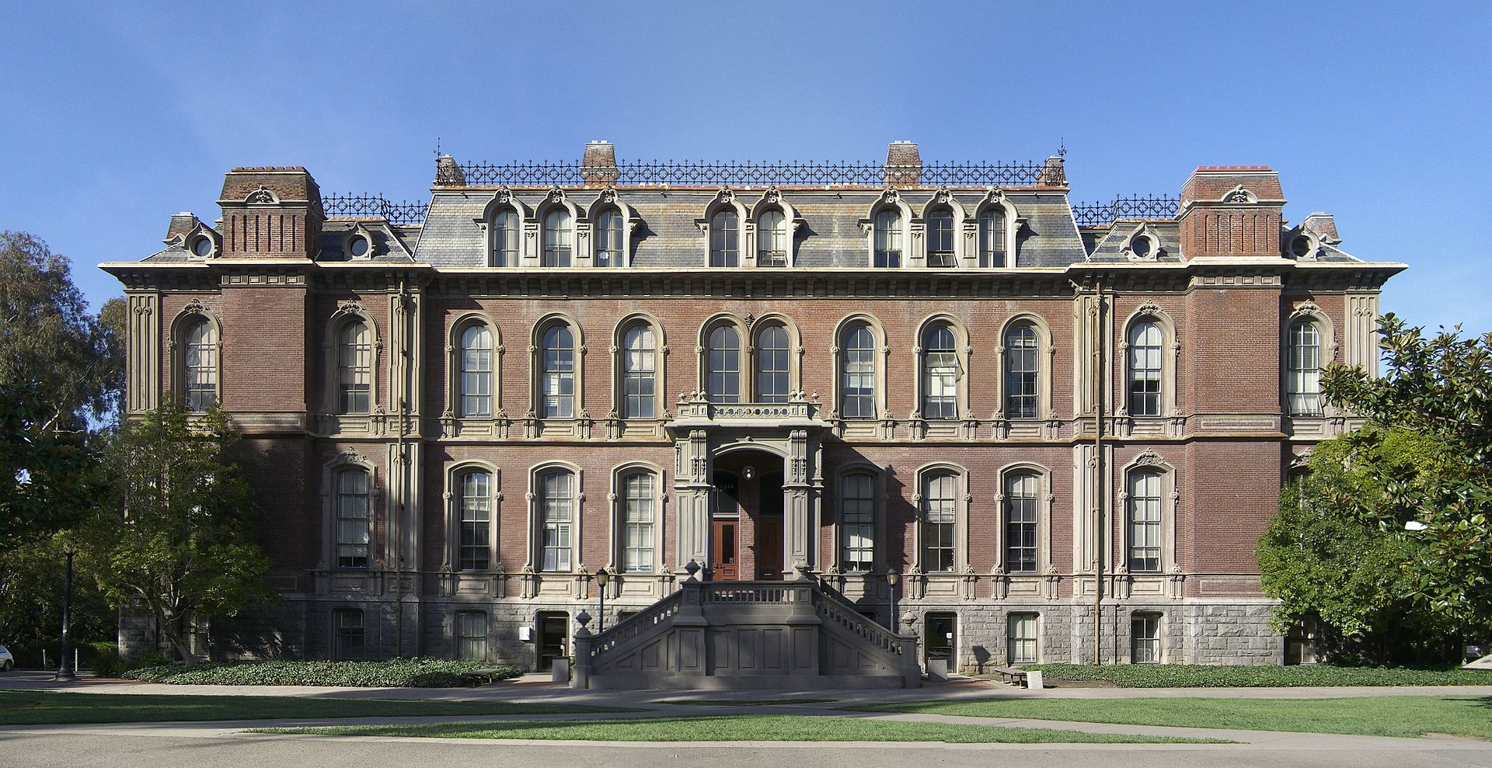
What is a Land Grant University?
Every state has a Land Grant University (LGU). They are called LGUs because the Federal Government granted (federally controlled) land to each state. The states could then use that land to establish so called "land-grant" colleges.
Trivia? Which US President established the Land Grant System?
Abe Lincoln in 1862
Woodrow Wilson in 1918 (post WWI)
Franklin D Roosevelt in 1933 (post great depression)
South Hall is the only remaining building of the original UC Berkeley campus.

Slide 8
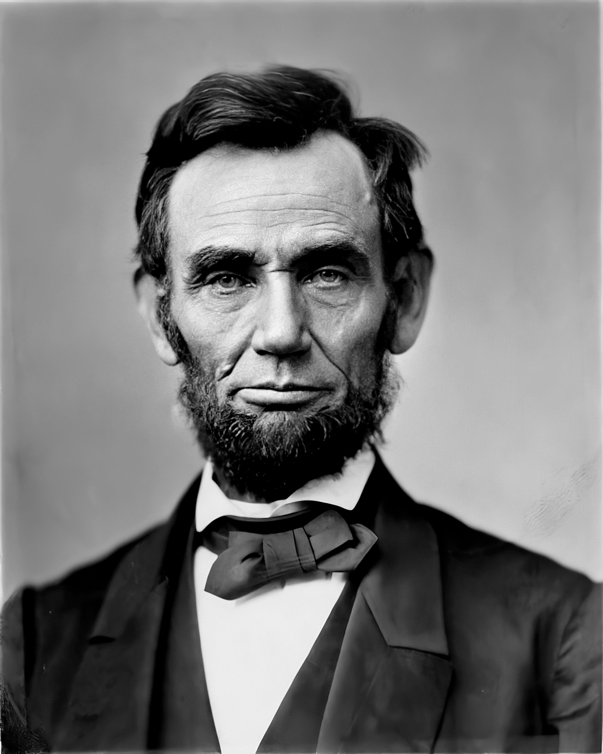
Answer: Abraham Lincoln
So the system was established way back in 1862.
The following table shows the series of Federal acts passed to build support for LGUs since 1862.
Look for when Cooperative Extension was started. What was the rural population at that time?

Slide 9
Act | Year | Rural pop’n (%) | Why significant
Morrill Act | 1862 | 80
Hatch Act | 1887 | 67
Morrill Act | 1890 | 65
Smith Lever | 1914 | 52
Equity in Educational .. Act | 1994 | 23
 | 2019 | 18 (USA) 2-5 (Cal)
Established Land Grant universities
… with the mandate to ensure that ”education be practical and available to the masses.”
Established funding for faculty (AES*)
Forbade racial discrimination - shored up funding
Established Cooperative Extension
Established Tribal Council Universities as federal land-grant institutions
No law - but we evolve to meet changing urban & rural needs
*AES = Agricultural Experiment station

Slide 10
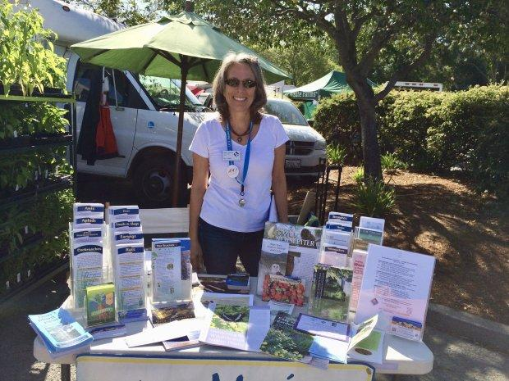
What are the three primary functions of a Land Grant University ?
Research
Build the foundation and understanding for change
Build the foundation for the future
Education
Outreach
Build positive change in communities

Slide 11
Which is the Land Grant University in California?
The University of California System is the Land Grant University
(i.e., all 10 campuses)
Note: It’s a trick question
Why an “A”?
signifies the beginning of wisdom.
Why the star & rays?
symbolize the discovery and dissemination of knowledge.
And UC ANR (Cooperative Extension) is the mandated arm to disseminate knowledge.

Slide 12
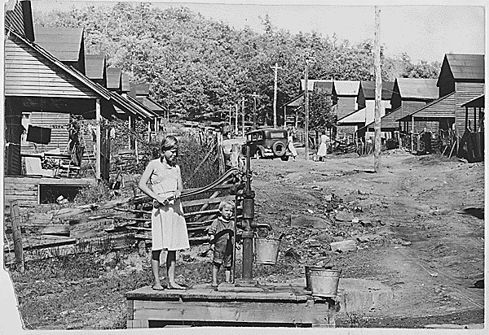
What were some of the first programs in Cooperative Extension (1914)?
Youth (4-H) & Nutrition were among the first!
Did you know…
Youth programs (4-H) were established early to get “new” information into households.

Slide 13
If We Are Cooperative Extension, then Why Are We Called UC ANR?
2
pikrepo.com

Slide 14
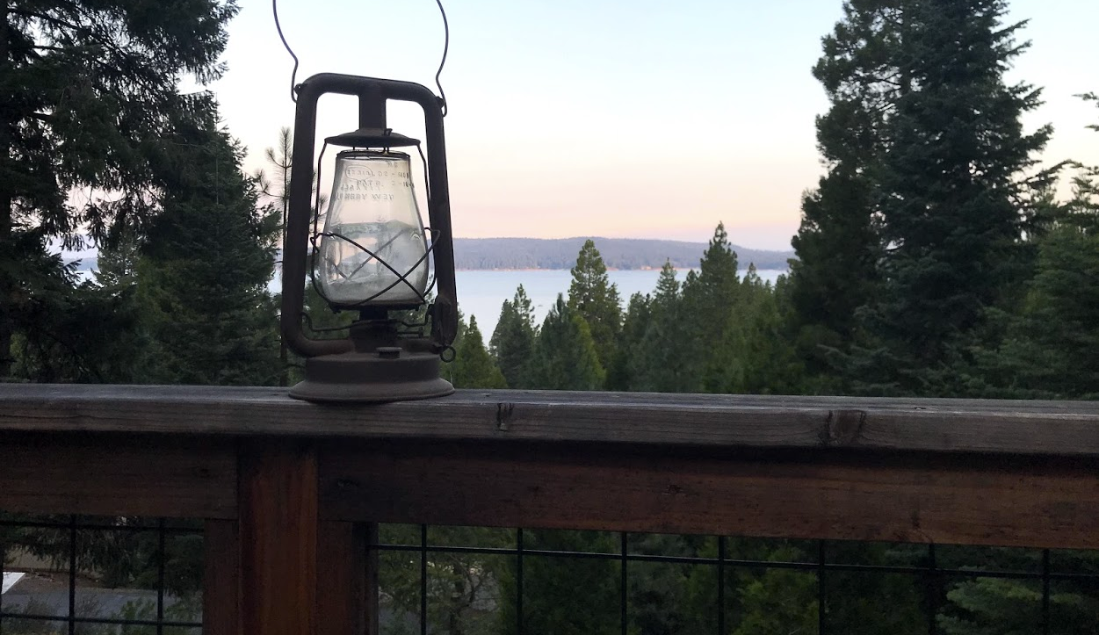
UC ANR or Cooperative Extension?
In essence, UC ANR is Cooperative Extension.
In most states, the program is known as Cooperative Extension (CE) and the CE program sits on the single Land Grant campus. However, in California, with multiple campuses, we sit in the office of the UC President and the name became UC Agriculture and Natural Resources (UC ANR) noting that...
UC ANR sits as a separate entity across the system’s campuses
UC ANR entails two programs
Cooperative Extension (which operates throughout the state) and
The Agricultural Experiment Station (Federal funds that support research faculty on various UC campuses)

Slide 15
Remember
Our Goal:
Positively impact the lives of all Californians
Photo by Thomas Morse on Unsplash

Slide 16
Resources
3
pikrepo.com

Slide 17
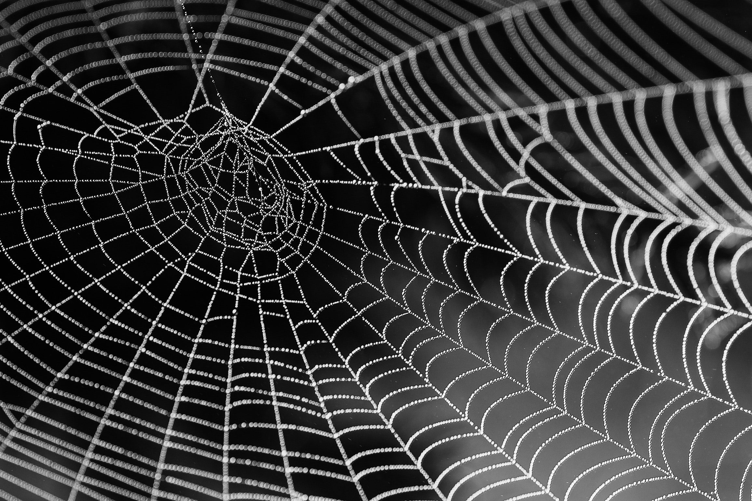
Where Do I Learn More?
Obviously, we have only just scratched the surface. There is much more to learn.
Find more resources at:
UC ANR Learning & Development
UCANR.edu

Slide 18
You’re done!
But … you can link here to learn about what “we” do and how it makes a difference.
© UC ANR. 2020. Contributors. This modules was developed with input from Mark Bell (lead), Wendy Powers, Mark Lagrimini, Chris Greer, Steven Worker, Linda Forbes, Anne Megaro, Kathy Eftakhari, Edited by Kathryn Stein.

