Slide 1
UCPath June 2023 Release Webinar Agenda
UCPath June 2023 Release Project List
PeopleSoft Upgrade
Highlight of changes
Global Search
Lived Name in UCPath
Purpose and Updates in UCPath
How to Update Your Name
How to Find People (Demo)
Directory updates and other UCANR-related Roll Out
Resources and Questions

Slide 2
UCPath June 2023 Release Project List
Going live the evening on June 19th, 2023 for all projects
Projects included in this release include:
PeopleSoft Upgrade (Transactors)
Yearly upgrade that helps us stay current on PeopleSoft HCM platform
MuleSoft Re-platform and Upgrade (Web Services) (Transactors)
Upgrade MuleSoft campus and secured SOAP APIs
Lived Name (All)
Implementation of the Gender Recognition Lived Name Policy for UCPath
Replace PayPath (Transactors)
Implement Fluid Job data as part of the phase 1 for the implementation
Funding Validation Web Service Redesign (GL Transactors)
Use effective dates can be configured for validations
Ability to configure I-370 message size for each location

Slide 3
PeopleSoft Upgrade: Overview
The Annual UCPath Upgrade (PUM 44) will deploy a new user interface in Fluid with the following changes:
Fluid Banner
New icons in the Fluid Banner
Quick Access, Back button
Homepages
New homepage selector and new color scheme
Menu Breadcrumbs
New breadcrumbs for Navigation
Global Search
Expanded and muted search bars
New Menu search functionality
Suggestions Search and Recently Visited
New Search content (Search for Person and Job)

Slide 4
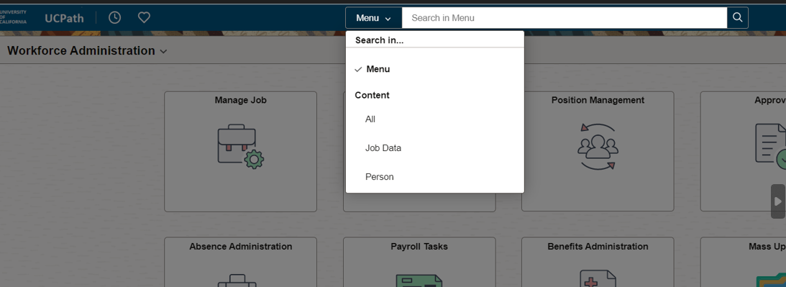
PeopleSoft Upgrade: Global Search
Global Search searches the UCPath system for specified Homepages, tiles or pages anywhere in the system. Results are limited based on your security profile.
Based on the selection, you can find specific people, pages, and data.
Notes:
Keyword Search: Search suggestions are displayed immediately
As you type, suggestions are updated. Clicking on any suggestion navigates directly to that item.

Slide 5
Lived Name: Purpose and Updates in UCPath
Employees can opt to display a chosen name (other than their legal name)
UC policy group decided to use the term “Name” to differentiate from Legal Name in place of Preferred OR Lived Name
Legal Name is still required for some university business but will be displayed sparingly, such as in reviewing paychecks, benefits, retirement, I-9, and anywhere the legal name associates with outside systems.

Slide 6
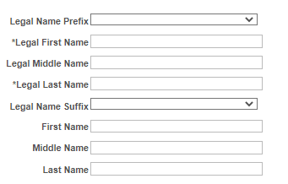
UCPath Legal and Lived Name Label Definitions
Legal Name
This label represents legal name. You can search by first, last, or full legal name in this search field. You will also see search fields and search results for Legal First Name and Legal Last Name.
Name
This label represents lived name and will be most often used. You can search by first, last, or full lived name in this search field. You will also see search fields and search results for First Name and Last Name. These are also lived name fields.

Slide 7
UCPath: Where Legal Name Remains
Review Paycheck and Review Paycheck Summary
Review Self Service Paycheck
View W-2/W-2c Forms
Search/Match (Search Person)
Three searches have BOTH Name and Legal Name Fields
Job Data
Workforce Job Summary
Personal Information

Slide 8
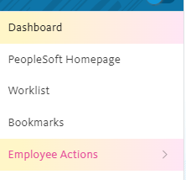
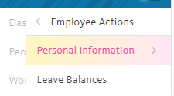
How to Update Your Name in UCPath
How to Update Name (Name and Legal Name)
To make the change, sign into your UCPath account and select Employee Actions > Personal Information > Personal Information Summary.

Slide 9
How to Update Your Name in UCPath cont’d
As the prompt says, Legal and Name cannot be updated simultaneously. Name changes are immediate but Legal has more steps
Name on Social Security card must match new Legal Name
Proof to HR
Goes through UCPath for verification

Slide 10
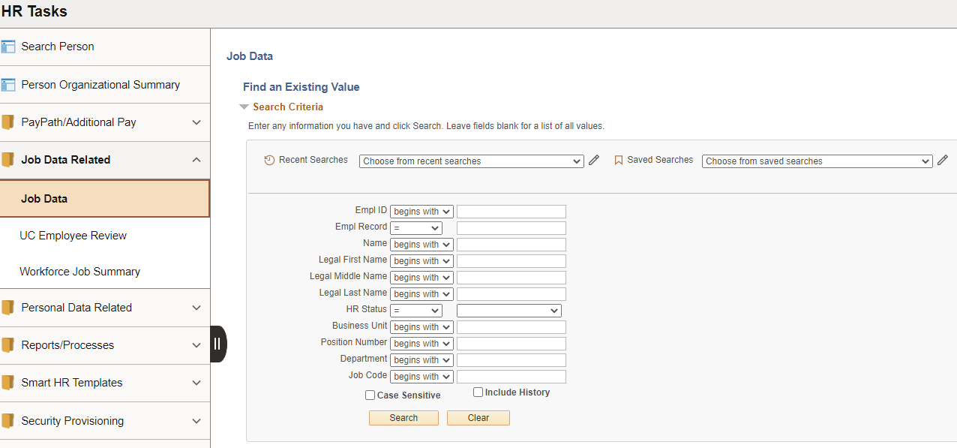
How to Find People by EMPLID
Please make sure to use EMPLID where possible. EMPLID is also available via ANR Portal
Always validate that job information to ensure you got the right person

Slide 11
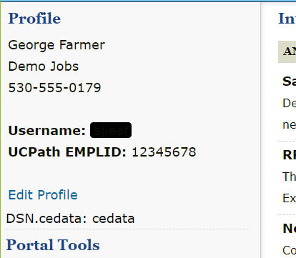
Where can employees find their EMPLID?
In UCPath In ANR Portal

Slide 12
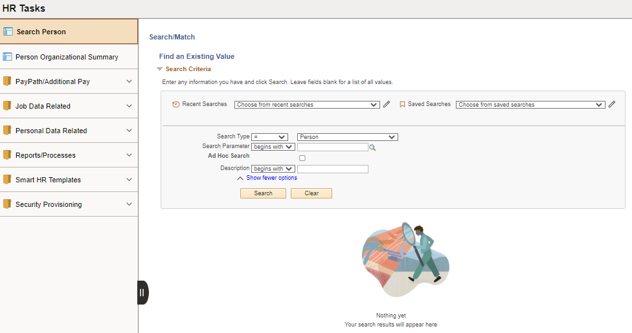
How to Find People Without EMPLID for HR Prepare for Hire
Select Search Type as Person
Click Search
Click on Person Search
Search Criteria Page

Slide 13
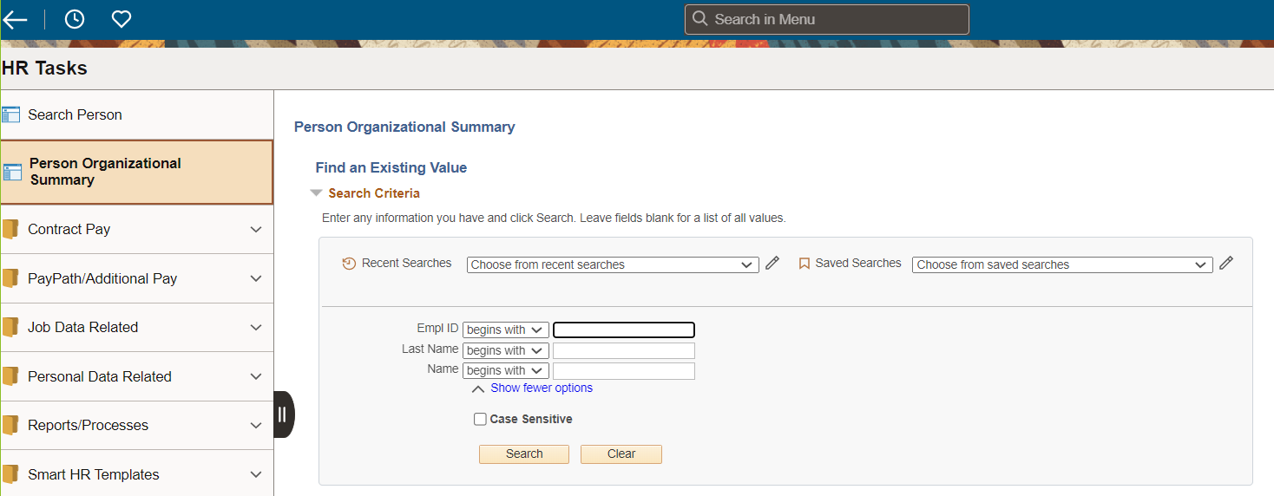
How to Find People Without EMPLID for Other Use Cases
Use the Person Org Summary to find employees if ensure of their EMPLID
Search by Name as results will not show Legal Names

Slide 14
Lived Name Updates in UCPath: Other Information
Testing to make sure lived names get populated into the UC ANR Directory
UC ANR Directory will be updated in order to ensure one source of entry for name fields for employees
Other UC ANR Gender Recognition and Lived Name implementation items to be shared later this year
UCPath Help materials will be updated to reflect changes
Links will be provided on the UCPath website
Notes:
Most of our primary systems are dependent on UCPath. Some databases, such as our volunteers of 4-H and Master Gardeners and CA Naturalists, are in progress separately, as well as forms. Other forms from federal, state, or sponsored programs, we have no authority to update. We anticipate sensitivity training as well.

Slide 15
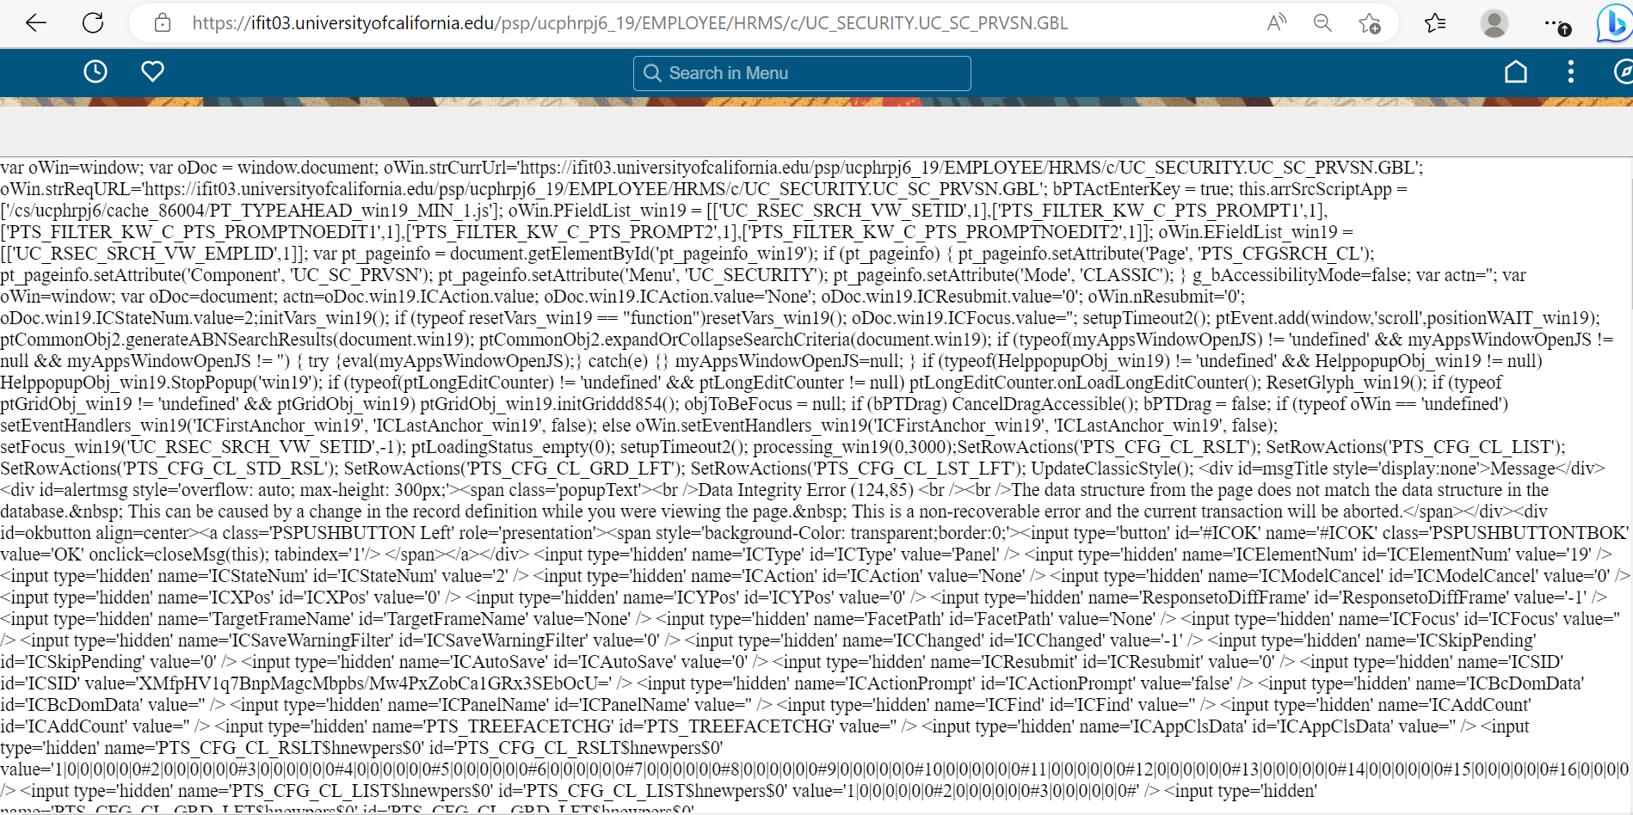
XML Issue
Intermittent error messages will display. UCPath is working on a fix with Oracle

Slide 16
Appendix: UCPath Page Labels for Lived Name
Expected Labels for UCPath Pages

Slide 17
Absence Management Pages
Workforce Administration Homepage

Slide 18
Page Name | Page Navigation (Fluid) | Label
Administer Extended Absence | Main Menu > PeopleSoft Homepage > Absence Administration > Extended Absence > Administer Extended Absence | Name
Extended Absence Trans History | Main Menu > PeopleSoft Homepage > Absence Administration > Extended Absence > Extended Absence Trans History | Name
Request Extended Absence | Main Menu > PeopleSoft Homepage > Absence Administration > Extended Absence > Request Extended Absence | Name
Manage Accruals | Main Menu > PeopleSoft Homepage > Absence Administration > Manage Accruals/Balances > Manage Accruals | Name
Manage Accrual Transactions | Main Menu > PeopleSoft Homepage > Absence Administration > Manage Accruals/Balances > Manage Accrual Transactions | Name
Admin - Review Absence Balance | Main Menu > PeopleSoft Homepage > Absence Administration > Manage Accruals/Balances > Admin - Review Absence Balance | Name
Absence Event | Main Menu > PeopleSoft Homepage > Absence Administration > Extended Absence > Absence Event | Name
Career & Benefits Elig Hrs INQ | Main Menu > PeopleSoft Homepage > Absence Administration > Manage Accruals/Balances > Career & Benefits Elig Hrs INQ | Name

Slide 19
Payroll Pages
Workforce Administration Homepage

Slide 20
Page Name | Page Navigation (Fluid) | Label
General Deduction Entry Update | Main Menu > PeopleSoft Homepage > Payroll Tasks > Deductions > General Deduction Entry Update | Legal Name
Review Paycheck | Main Menu > PeopleSoft Homepage > Payroll Tasks > Paycheck > Review Paycheck | Legal Name
Review Paycheck Summary | Main Menu > PeopleSoft Homepage > Payroll Tasks > Paycheck > Review Paycheck Summary | Legal Name
Self Service Transaction Links | Main Menu > PeopleSoft Homepage > Payroll Tasks > Payroll Transactions > Self Service Transaction Links | Name
Update Employee Tax Data | Main Menu > PeopleSoft Homepage > Payroll Tasks > Employee Payroll Information > Update Employee Tax Data | Name

Slide 21
Benefits Pages
Workforce Administration Homepage

Slide 22
Page Name | Page Navigation (Fluid) | Label
ACA Employee Eligibility | Main Menu > PeopleSoft Homepage > Benefits Administration > ACA/Benefits Eligibility > ACA Employee Eligibility | Name
Arrears/Frequency Override | Main Menu > PeopleSoft Homepage > Benefits Administration > Benefit Enrollment > Arrears/Frequency Override | Name
Assign to Benefit Program | Main Menu > PeopleSoft Homepage > Benefits Administration > Benefit Enrollment > Assign to Benefit Program | Name
Benefits Summary | Main Menu > PeopleSoft Homepage > Benefits Administration > Review Employee/Dependent Info > Benefits Summary | Name
Disability Benefits | Main Menu > PeopleSoft Homepage > Benefits Administration > Benefit Enrollment > Disability Benefits | Name
Health Benefits | Main Menu > PeopleSoft Homepage > Benefits Administration > Benefit Enrollment > Health Plan Enrollment | Name
Life and AD/D Benefits | Main Menu > PeopleSoft Homepage > Benefits Administration > Benefit Enrollment > Life and AD/D Plan Enrollment | Name
Retirement Plans | Main Menu > PeopleSoft Homepage > Benefits Administration > Benefit Enrollment > Retirement Plans | Name

Slide 23
Page Name | Page Navigation (Fluid) | Label
Simple Benefits | Main Menu > PeopleSoft Homepage > Benefits Administration > Benefit Enrollment > Simple Benefits | Name
Spending Accounts | Main Menu > PeopleSoft Homepage > Benefits Administration > Benefit Enrollment > Spending Accounts | Name
Update Dependent/Beneficiary | Main Menu > PeopleSoft Homepage > Benefits Administration > Review Employee/Dependent Info > Update Dependent/Beneficiary | Name
Savings Management | Main Menu > PeopleSoft Homepage > Benefits Administration > Benefit Enrollment > Benefits Savings Management | Name
Savings Plans | Main Menu > PeopleSoft Homepage > Benefits Administration > Benefit Enrollment > Savings Plans | Name

Slide 24
Employee Self-Service Pages
UCPath Online Portal

Slide 25
Page Name | Page Navigation (Fluid) | Label
Direct Deposit | Main Menu > Employee Actions > Income and Taxes > Direct Deposit | Name
View Paycheck* | Main Menu > Employee Actions > Income and Taxes > View Paycheck | Name
CA State - W4 | Main Menu > Employee Actions > Income and Taxes > CA State - W4 | Legal Name
Federal Witholding | Main Menu > Employee Actions > Income and Taxes > Federal Witholding | Legal Name
Life Event/Benefits Changes | Main Menu > Employee Actions > Health and Welfare > Life Events/Benefits Changes | Name
Enroll in Benefits | Main Menu > Employee Actions > Health and Welfare > Benefits Enrollment | Name
Disability | Main Menu > Employee Actions > Personal Information > Disability | Name
Email Addresses | Main Menu > Employee Actions > Personal Information > Email Addresses | Name
Emergency Contact | Main Menu > Employee Actions > Personal Information > Emergency Contacts | Name
Employee Disclosure | Main Menu > Employee Actions > Personal Information > Employee Disclosures | Name

Slide 26
Page Name | Page Navigation (Fluid) | Label
Ethnic Groups | Main Menu > Employee Actions > Personal Information > Ethnic Groups | Name
Gender Identity | Main Menu > Employee Actions > Personal Information > Gender Identity | Name
Home and Mailing Address | Main Menu > Employee Actions > Personal Information > Home and Mailing Address | Name
Veteran Status | Main Menu > Employee Actions > Personal Information > Veteran Status | Name
My Current Profile | Main Menu > Employee Actions > Learning and Development > My Current Profile | Name
Name Change | Main Menu > Employee Actions > Personal Information > Name Change | Name
Patent Acknowledgment | Main Menu > Employee Actions > Personal Information > Patent Acknowledgment | Name
Patent Amendment | Main Menu > Employee Actions > Personal Information > My Patent Amendment | Name
Personal Information Summary | Main Menu > Employee Actions > Personal Information > Personal Information Summary | Name
Phone Numbers | Main Menu > Employee Actions > Personal Information > Phone Numbers | Name

Slide 27
Page Name | Page Navigation (Fluid) | Label
Add Dependent | Main Menu > Employee Actions > Personal Information > Personal Information Summary | Legal Name
Leave Balances | Main Menu > Employee Actions > Leave Balances | Name

Slide 28
Manager Self-Service Pages
UCPath Online Portal

Slide 29
Page Name | Page Navigation (Fluid) | Label
My Historical Profile | Main Menu > Manager Actions > My Historical Profile | Name
Current Team Profiles | Main Menu > Manager Actions > Current Team Profiles | Name
View Compensation History | Main Menu > Manager Actions > View Compensation History | Name
View Employee Information | Main Menu > Manager Actions > View Employee Information | Name
View Employee Absence Balance | Main Menu > Manager Actions > View Employee Absence Balance | Name

Slide 30
Workforce Administration Pages
Workforce Administration Homepage

Slide 31
Page Name | Page Navigation (Fluid) | Label
Activities | Main Menu > PeopleSoft Homepage > HR Tasks > Personal Data Related > Activities | Name
Admin Verification of Employmnt | Main Menu > PeopleSoft Homepage > HR Tasks > Personal Data Related > Admin Verification of Employment | Legal Name
Emergency Contact | Main Menu > PeopleSoft Homepage > HR Tasks > Personal Data Related > Emergency Contact | Name
Gender Identity | Main Menu > PeopleSoft Homepage > HR Tasks > Personal Data Related > Gender Identity | Name
Identification Data | Main Menu > PeopleSoft Homepage > HR Tasks > Personal Data Related > Identification Data | Name
Job Data | Main Menu > PeopleSoft Homepage > HR Tasks > Job Data Related > Job Data | Both
Maintain POI Relationship | Main Menu > PeopleSoft Homepage > Person of Interest > Maintain POI Relationship | Name
Maintain Teleworkers | Main Menu > PeopleSoft Homepage > HR Tasks > Job Data Related > Maintain Teleworkers | Name
Modify a Person | Main Menu > PeopleSoft Homepage > HR Tasks > Personal Data Related > Modify a Person | Both
PayPath Actions | Main Menu > PeopleSoft Homepage > HR Tasks > PayPath & Additional Pay > PayPath Actions | Name

Slide 32
Page Name | Page Navigation (Fluid) | Label
Person Checklist | Main Menu > PeopleSoft Homepage > HR Tasks > Personal Data Related > Person Checklist | Name
Person of Interest - Add | Main Menu > PeopleSoft Homepage > Person of Interest > Person of Interest - Add | Name
Person Organizational Summary | Main Menu > PeopleSoft Homepage > HR Tasks > Person Organizational Summary | Name
Person Profiles | Main Menu > PeopleSoft Homepage > HR Tasks > Personal Data Related > Person Profiles | Name
Search for People (Search/Match) | Main Menu > PeopleSoft Homepage > HR Tasks > Search for People (Search/Match) | Legal Name
Security Clearance | Main Menu > PeopleSoft Homepage > HR Tasks > Personal Data Related > Security Clearance | Name
Smart HR Transaction Status | Main Menu > PeopleSoft Homepage > HR Tasks > Template Based Hire > Smart HR Transaction Status | Name
SS Smart HR Transactions | Main Menu > PeopleSoft Homepage > HR Tasks > Template Based Hire > SS Smart HR Transactions | Name
Transaction Status | Main Menu > PeopleSoft Homepage > HR Tasks > Template Based Hire > Transaction Status | Name
UC Employee Experience Admin | Main Menu > PeopleSoft Homepage > Experience Based Pay > Enter Experience Folder > UC Employee Experience Admin | Name

Slide 33
Page Name | Page Navigation (Fluid) | Label
UC Employee Experience Page | Main Menu > PeopleSoft Homepage > Experience Based Pay > Enter Experience Folder > UC Employee Experience Page | Name
UC Employee Review | Main Menu > PeopleSoft Homepage > HR Tasks > Job Data Related > UC Employee Review | Name
UC External System IDs | Main Menu > PeopleSoft Homepage > HR Tasks > Personal Data Related > UC External System IDs | Name
UC Patent Inquiry | Main Menu > PeopleSoft Homepage > HR Tasks > Personal Data Related > UC Patent Inquiry | Name
Update Contract Pay NA | Main Menu > PeopleSoft Homepage > HR Tasks > Contract Pay > Update Contract Pay NA | Name
Workforce Job Summary | Main Menu > PeopleSoft Homepage > HR Tasks > Job Data Related > Workforce Job Summary | Both

Slide 34
General Ledger Pages
General Ledger Administration Homepage

Slide 35
Page Name | Page Navigation (Fluid) | Label
Funding Entry | Main Menu > PeopleSoft Homepage > General Ledger Administration Homepage > General Ledger Tasks > Funding > Funding Entry | Name
Funding Entry Inquiry | Main Menu > PeopleSoft Homepage > General Ledger Administration Homepage > General Ledger Tasks > Funding > Funding Entry Inquiry | Name
Process Direct Retro | Main Menu > PeopleSoft Homepage > General Ledger Administration Homepage > General Ledger Tasks > Direct Retro > Process Direct Retro | Name
Review Retro Distribution | Main Menu > PeopleSoft Homepage > General Ledger Administration Homepage > General Ledger Tasks > Direct Retro > Review Retro Distribution | Name
Process Benefits Cost Transfer | Main Menu > PeopleSoft Homepage > General Ledger Administration Homepage > General Ledger Tasks > Benefits Cost Transfer > Process Benefit Cost Transfer | Name
Review Benefits Cost Transfer | Main Menu > PeopleSoft Homepage > General Ledger Administration Homepage > General Ledger Tasks > Benefits Cost Transfer > Review Benefit Cost Transfer | Name

Slide 36
TAM
Recruiting Administration Homepage

Slide 37
Page Name | Page Navigation (Fluid) | Label
Administer Referrals | Main Menu > PeopleSoft Homepage > Recruiting Administration Homepage > Recruiting Administration > Employee Referrals > Administer Referrals | Name
Applicant Data | Main Menu > PeopleSoft Homepage > Recruiting Administration Homepage > Recruiting Activities > Search Applicants > Click on applicant > Applicant Data tab | Name
Applicant Lists | Main Menu > PeopleSoft Homepage > Recruiting Administration Homepage > Recruiting Activities > Search Applicant Lists | Name
Browse Applicants | Main Menu > PeopleSoft Homepage > Recruiting Administration Homepage > Recruiting Activities > Browse > Browse Applicants | Name
Browse Job Openings | Main Menu > PeopleSoft Homepage > Recruiting Administration Homepage > Recruiting Activities > Browse > Browse Job Openings | Name
Create Applicant | Main Menu > PeopleSoft Homepage > Recruiting Administration Homepage > Recruiting Activities > Create > Create Applicant | Both

Slide 38
Page Name | Page Navigation (Fluid) | Label
Create Job Opening | Main Menu > PeopleSoft Homepage > Recruiting Administration Homepage > Recruiting Activities > Create > Create Job Opening | Name
Manage Applicant | Main Menu > PeopleSoft Homepage > Recruiting Administration Homepage > Recruiting Activities > Search > Search Applicants > Click on applicant > Manage Applicant | Name
Manage Job Opening | Main Menu > PeopleSoft Homepage > Recruiting Administration Homepage > Recruiting Activities > Search > Search Job Openings > Click on job opening > Manage Job Opening | Name
Merge Applicants | Main Menu > PeopleSoft Homepage > Recruiting Administration Homepage > Recruiting Activities > Search > Search Job Openings > Click on job opening > Manage Job Opening > On applicant, click on Other Actions > Applicant Actions > Merge Applicant | Name
My Applicants | Main Menu > PeopleSoft Homepage > Recruiting Administration Homepage > Recruiting Activities > Search > Search Job Openings > Click on job opening > Manage Job Opening > Applicants tab | Name
Offer Letter Templates | Main Menu > PeopleSoft Homepage > Recruiting Administration Homepage > Recruiting Activities > Search > Search Job Openings > Click on job opening > On applicant, click on Other Actions > Recruiting Actions > Prepare Job Offer > Offer Letter section > Letter dropdown | Name

Slide 39
Page Name | Page Navigation (Fluid) | Label
Pending Approvals | Main Menu > PeopleSoft Homepage > Recruiting Administration Homepage > Pending Approvals > Pending Approvals | Name
Print Application | Main Menu > PeopleSoft Homepage > Recruiting Administration Homepage > Recruiting Activities > Search Applicants > Click on applicant > Applicant Activity tab > Print icon in Applicant Activity section | Name
Search Applicants | Main Menu > PeopleSoft Homepage > Recruiting Administration Homepage > Recruiting Activities > Search > Search Applicants | Name
Search Applications | Main Menu > PeopleSoft Homepage > Recruiting Administration Homepage > Recruiting Activities > Search > Search Applications | Name
Search Job Opening | Main Menu > PeopleSoft Homepage > Recruiting Administration Homepage > Recruiting Activities > Search > Search Job Opening | Name
Hiring Teams | Main Menu > PeopleSoft Homepage > Recruiting Administration Homepage > Recruiting Administration > Administration > Hiring Teams | Name

Slide 40
ePerformance
Performance Administration Homepage

Slide 41
Page Name | Page Navigation (Fluid) | Label
Cancel Performance Documents | Main Menu > PeopleSoft Homepage > Performance Administration Homepage > Performance Documents > Administrative Tasks > Cancel Performance Documents | Name
Delete Performance Documents | Main Menu > PeopleSoft Homepage > Performance Administration Homepage > Performance Documents > Administrative Tasks > Delete Performance Documents | Name
View Performance Documents | Main Menu > PeopleSoft Homepage > Performance Administration Homepage > Performance Documents > View Performance Documents | Name
Reopen Performance Documents | Main Menu > PeopleSoft Homepage > Performance Administration Homepage > Performance Documents > Administrative Tasks > Reopen Performance Documents | Name
Transfer Performance Documents | Main Menu > PeopleSoft Homepage > Performance Administration Homepage > Performance Documents > Administrative Tasks > Transfer Performance Documents | Name
Approve Documents | Main Menu > PeopleSoft Homepage > Performance Administration Homepage > Approvals > Administrative Tasks > Approve Documents | Name
Create Performance Documents | Main Menu > PeopleSoft Homepage > Performance Administration Homepage > Performance Documents > Create Performance Documents | Name
Change Document Date | Main Menu > PeopleSoft Homepage > Performance Administration Homepage > Performance Documents > Administrative Tasks > Change Document Dates | Name

