Slide 1
IOE Quarterly Call
April 16, 2024
Hosted by:
Amanda Linares

Slide 2


Access the recording & slides
Find the webinar recording and this slide deck on the IOE Website

Slide 3

Agenda
Announcements & Reminders
IOE Timelines
FY 24​ Progress
FY 25 IOE & EATS
Q & A

Slide 4

Announcements & Reminders

Slide 5
EATS Survey Administration Training
When: Tuesday, July 16th at 10am
Where: https://tinyurl.com/EATSTraining
What: Review IOE requirements, Preview the FY 25 tool & administration protocol

Slide 6
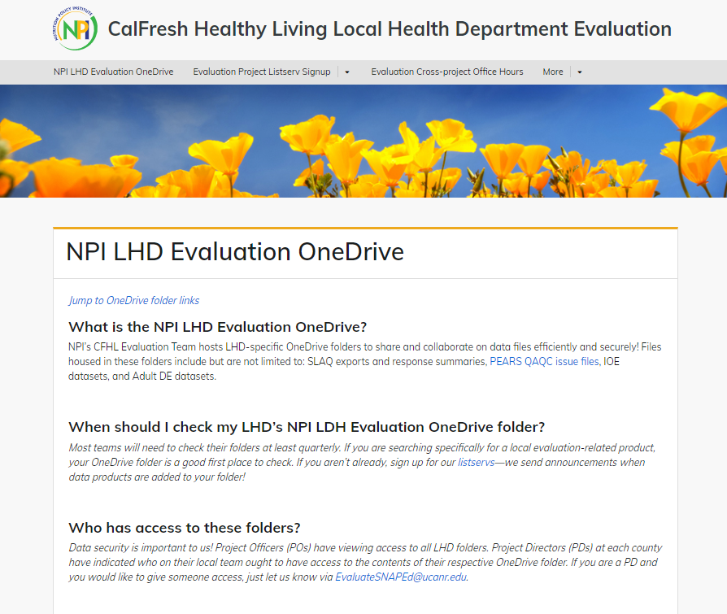
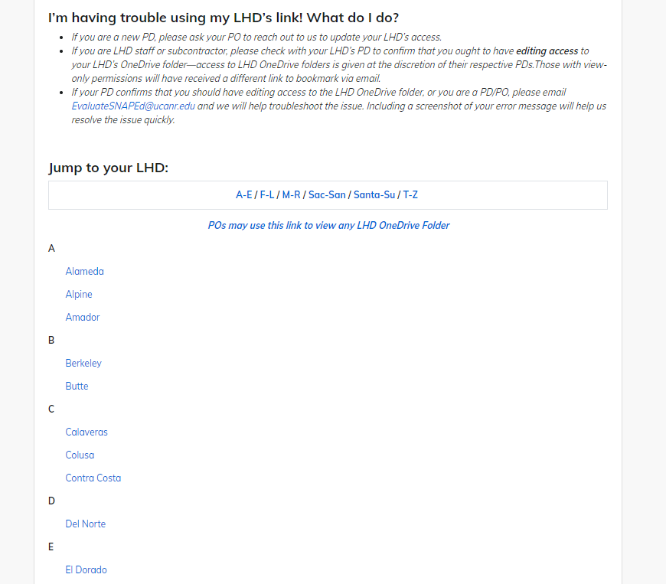
LHD Evaluation OneDrive Folders

Slide 7
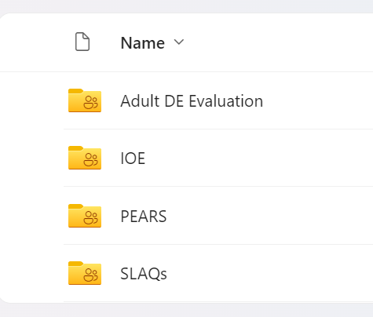
LHD Evaluation OneDrive Folders
https://ucanr.edu/sites/LHDEvaluation/NPI_LHD_Evaluation_OneDrive/
If you are unable to access:
Existing users: Email EvaluateSNAPEd@ucanr.edu for access
New users: Obtain PD approval, then email EvaluateSNAPEd@ucanr.edu for access

Slide 8

IOE Timelines

Slide 9
Important Dates: FY 24 IOE
Weekly: Online EATS closes Fridays at 4pm and reopens Mondays at 4pm
Holiday: Memorial Day survey closure Tuesday, May 28th
End of Year: Online EATS will close, all surveys and all Planning Worksheets due Friday, June 28th
HARD CLOSURE!

Slide 10
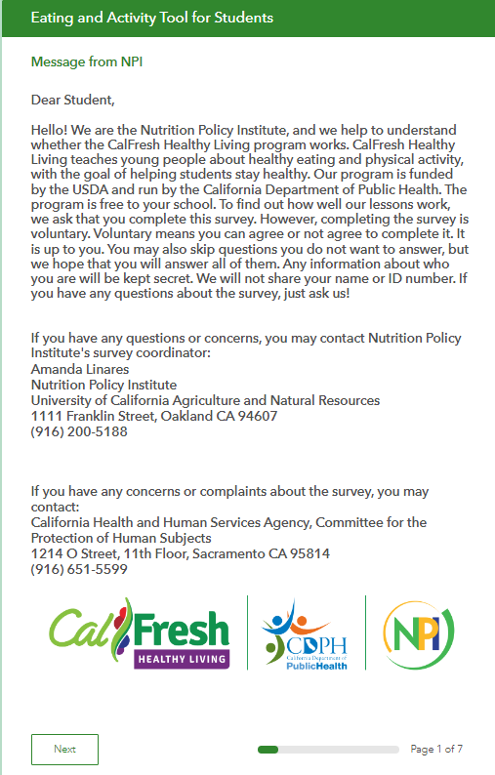
Paper Survey Data Entry
If you need to enter paper surveys when the online survey is closed, you can reach out to schedule a time for data entry.

Slide 11

IOE Timeline
Today
FY 24 process
Mar.–June
Engage school(s) for next FY
Plan intervention
June–Aug.
Identify classrooms/teachers
Train evaluators*
Complete Planning Worksheet
Aug.–Oct.
Turn in Planning Worksheets/get links
Pre-test students
Sep.–May
Conduct intervention (timeline variable)
Apr.–June
Post-test students
Update Planning Worksheet
Turn in all deliverables by June 28th
Today
FY 25 process
* IOE lead and survey administrators (especially classroom teachers and school/district staff!)

Slide 12

1:1s
Don’t hesitate to reach out for a 1:1 call!
  IOE
  Adult DE Eval
  Learn SLAQs

Slide 13

FY 24 Progress

Slide 14
FY 24 Data Collection
27 LHDs reporting (pre)
98 schools (pre, 97% of expected and 142% of goal)
6,196 pre-tests and 180 post-tests

Slide 15
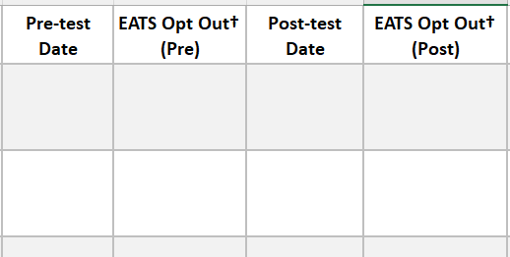
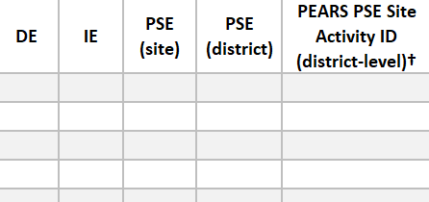
Completing FY 24: Deliverables
Administer post-tests
  Enter paper surveys into S123
  Can switch method!
Update Planning Worksheet
  Add pre/post dates and parent/student opt outs
  PEARS PSE Site Activity ID for district-level PSE work
Send me the completed Worksheet by June 28th

Slide 16
Completing FY 24: PEARS
Program activities → Custom Data & Evaluation
PSE site activities → Custom Data
Indirect activities → Custom data

Slide 17

FY 24 Data & Data Products
Hub → OneDrive dashboards
Currently TBD on what the data product will be but know we will aim to have them to you in August.

Slide 18

FY 25 IOE
& EATS

Slide 19
FY 25 IOE: Minimum Intervention
Clarification on minimum intervention
Minimum intervention:
Series-based DE (3+ lessons)
School or afterschool sites
4th-12th grades

Slide 20
Alternative Interventions
Flexibility = advantageous for dose design!
Though series-based DE is the minimum intervention that would require your LHD to participate in IOE, we are open to evaluation in sites with alternative interventions:
Ex. 1: No DE, i.e., PSE(s) or PSE/IE
Ex. 2: DE < 3 lessons and PSE(s) and/or IE

Slide 21
Alternative Intervention Considerations
School/afterschool and grade level requirements still apply
Is the intervention robust enough to affect behavior?
If there is no DE, are you able to engage students/teachers for evaluation?
Inform me of your plans via the updated Planning Worksheet and email

Slide 22
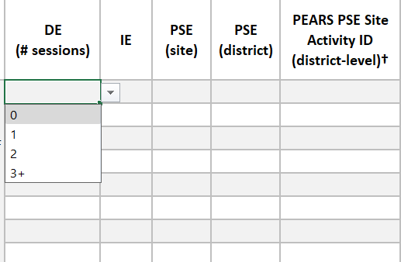
Updated FY 25 Planning Worksheet
Rather than yes/no, identify the number of sessions of DE: 0, 1, 2, 3+
Updated version is on the website now!
For FY 25 only!

Slide 23
FY 25 EATS Modifications
No major changes
Slight wording change to improve readability
Removal of diet soda question
Possible addition of Middle Eastern or North African
Continue with S123, custom links, paper options, Spanish/English, parent opt out form

Slide 24

Questions?

