Slide 1
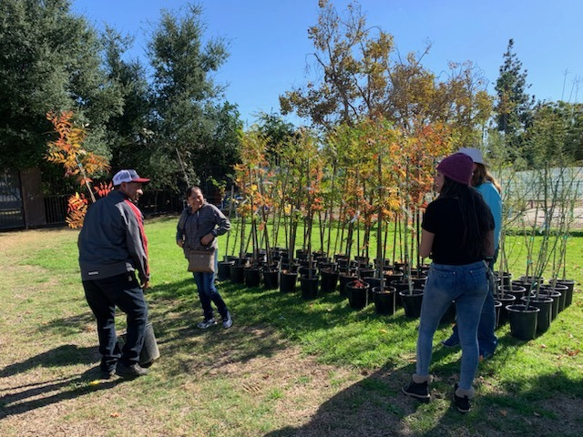
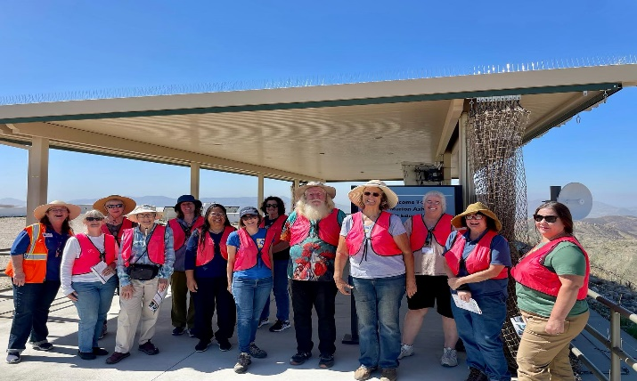
Practical. Connected. Trusted.
UC Cooperative Extension San Bernardino County
“UC ANR offers local expertise with a practical mindset and applied research. They are people who can look directly at a problem and work together with the community and campus-based experts on a solution”
– Don Bransford
President, Bransford Farms
UCCE delivers $20 in program extension for every
$1 of County investment
Strengthening Local Communities
UCCE San Bernardino brings vigorous UC research in agriculture, natural resources, nutrition, and youth development to improve local communities and lives of San Bernardino County residents. By working and living among those we serve, we expand UC’s reach to engage all people and communities, bringing practical, science-based solutions for everyday problems. Forming partnerships with public, private and tribal entities, we enhance stewardship, problem-solving, and community education.
Developing a Qualified Workforce
UC ANR’s programs equip youth for college, successful careers, and to be engaged in their communities. They empower workers and growers to use cutting-edge research to advance innovation. UC ANR helps develop a qualified workforce and promotes healthy communities to increase opportunities to ensure a robust and thriving economy.
The Year in Volunteers
Each year, UCCE volunteers donate their time to extend proven solutions. They help make San Bernardino County residents and communities more sustainable, protect our natural resources, and empower us to be healthy, successful, and productive.
471
Volunteers
13,157
Volunteer Hours
$467,869
Value of Volunteer Service Hours

Slide 2
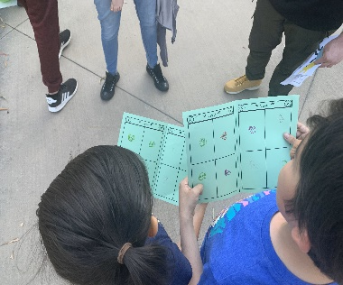
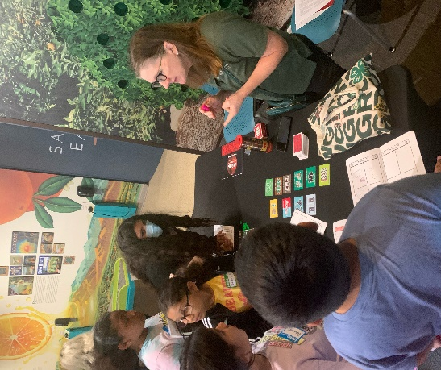
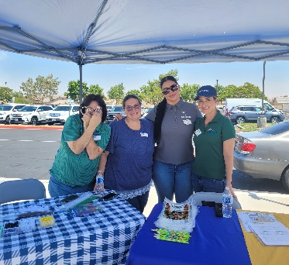
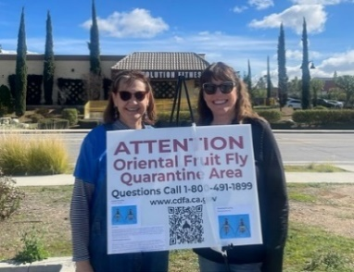
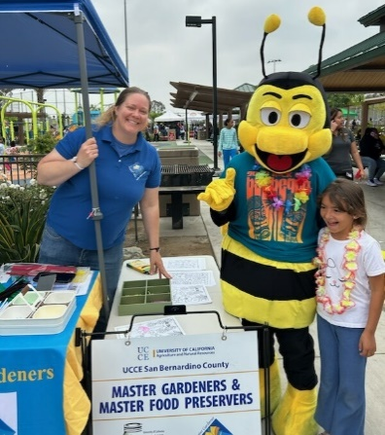
4-H Youth Development Program
4-H empowers young people with skills to lead for a lifetime
236 adult and youth volunteers
562 schools throughout the county received
STEAM activities, events, and training in partnership
with SBCSS Expanded Learning.
4-H youth
4$×$
more likely to give back to their community
Photo Caption
Photo Caption
Food and Nutrition
Over 2,900 adults and youth attended food and nutrition workshops (EFNEP-Expanded Food and Nutrition Program) improving their health by being educated on their diet, physical activity, food safety, and food management.
UCCE Delivered Nutrition, Gardening and Food Preservation classes increasing
access to healthy food and food safety practices to San Bernardino communities.
Studies have shown that
for every $1 invested
in EFNEP, more than $8
is saved in current and
future healthcare costs.
Caption
Small Farms/Urban Agriculture Program
More than 50 farmers received over $750,000 in grants to mitigate the climate impact on crops.
Conducted 38 in-person workshops on specialty crop production, pest management, marketing, food safety, urban soil toxicity and management, organic farming and cover crops.
Hosted 30 virtual workshops on organic production.
Urban Agriculture/Small Farm extended research-based information to over 350 San Bernardino residents and 120 growers on sustainable crop production cycles, soil health, conservation and irrigation scheduling and integrated pest management to traditional and organic growers.
Photo Caption
UC Master Gardener 185 volunteers 11,565 volunteer hours $367,767 in Community Services
UC Master Food Preserver 51 volunteers
2,025 volunteer hours
$60,650 in Community Services
Provided free workshops on food safety and preservation, answered MG helpline inquiries from the public, staffed Farmers Markets and public service booths, and wrote weekly newspaper columns that have reached over 35,000 county residents.
Environmental Horticulture and Natural Resources Program
Conducted applied research on climate-resilient drought landscape trees that reached over 1,800 end-users and provided free trees and tree care information to residents of low-shade neighborhoods.
Conducted applied research and education regarding important land management practices that reduce populations of the invasive garlic mustard.
Caption
Caption
15,616 professionals and residents attended UCCE education events to increase their knowledge and capacity to protect natural environments from climate change, wildfire, invasive weeds and forest pests, and improve sustainability.
FOLLOW US: @HANDLE @HANDLE @HANDLE
Rita Clemons, Area Director
UC Agriculture and Natural Resources
https://cesanbernardino.ucanr.edu/
2024

