Slide 1
This template should be used and modified to fit your county's needs and to highlight the best of your county's programming. Modify the document and replace sections based on what's relevant to you, your partners and stakeholders.
Instructions:
Update content with data and information relevant to your county. Photos and items in red font or highlight should always be updated with data and information relevant to your county. Other text can be changed to highlight your county's programming.
Delete content not relevant to your county. Replace with photos, quotes, stories, or other program data/information from your county. For example, if your county does not have EFNEP, you can replace that section with a story from the Condition Change Impact Stories compilation by searching your county’s name or Advisors assigned to your county.
Add photos with photo captions. Using local photos is recommended, to best tell your local story. Photo file size: for high quality printing these need to be @ 300 dpi. Further ANR guidance on photos: UC ANR Photo Guidelines Photographic Style, includes information on tips for taking/using your own photos, media release forms, and how to access the UC curated library of production-quality images if you want to use them.
Resize photos and text boxes to adequately fill white space.
Follow the UC ANR Communications Toolkit for fonts and colors: https://ucanr.edu/sites/communicationstoolkit/Branding/Visual_Style_Guide/Fonts_and_colors/
Upload/Save a copy of your final draft to the 2023 County Reports Google Drive folder so that PPE can also post it on our webpage. Please login to my.ucdavis.edu before clicking on this link to the folder: https://drive.google.com/drive/folders/1wYPJ7AOJmZTrbK5N7jy7wMr1nPiSlWRb?usp=drive_link (copy-paste the link into your browser if clicking doesn’t work).
Note: You can collect your own county-level data. County-level metrics for FY2023 data have also been provided via the “County Report templates” found on the Google Drive folder: https://drive.google.com/drive/folders/1v5A89_167qLWs3tsWlIf9-wSkS16bdL5?usp=sharing

Slide 2
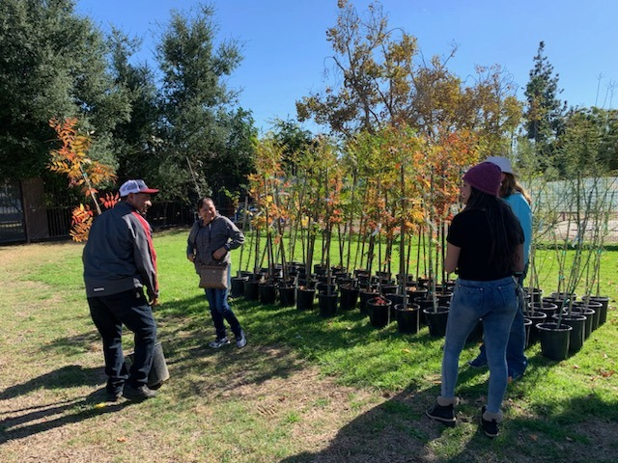
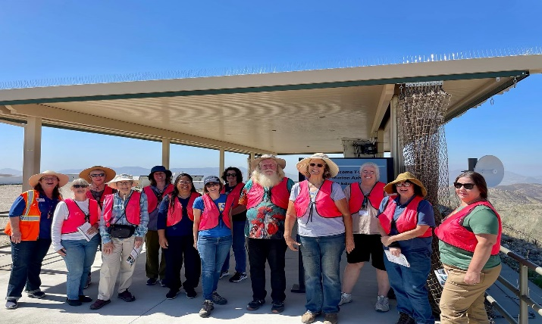
Practical. Connected. Trusted.
UC Cooperative Extension in County
“UC ANR offers local expertise with a practical mindset and applied research. They are people who can look directly at a problem and work together with the community and campus-based experts on a solution”
– Don Bransford
President, Bransford Farms
Academics and Staff
# Academic Advisors
# Program Staff
Our Clientele
Growers
Families
Land stewards
Research and Extension
Empowerment Community Sustainability
Food and Nutrition
EFNEP
Master Food Preserver
Restoring and Protecting Natural Resources
Agriculture
Serving Farmers and Growers
For every $1 invested in agricultural research and extension, there is a return of $20 to the community
Alston, Anderson et al (2010)
Strengthening Local Communities
UCCE San Bernardino brings vigorous UC research in agriculture, natural resources, nutrition, and youth development to improve local communities and lives of San Bernardino County residents. By working and living among those we serve, we expand UC’s reach to engage all people and communities, bringing practical, science-based solutions for everyday problems. Forming partnerships with public, private and tribal entities, we enhance stewardship, problem-solving, and community education.
Developing a Qualified Workforce
UC ANR’s programs equip youth for college, successful careers, and to be engaged in their communities. They empower workers and growers to use cutting-edge research to advance innovation. UC ANR helps develop a qualified workforce and promotes healthy communities to increase opportunities to ensure a robust and thriving economy.
The Year in Volunteers
Each year, UCCE volunteers donate their time to extend proven solutions. They help make San Bernardino County residents and communities more sustainable, protect our natural resources, and empower us to be healthy, successful, and productive.
#
Volunteers
#
Volunteer Hours
$
Value of Volunteer Service Hours

Slide 3
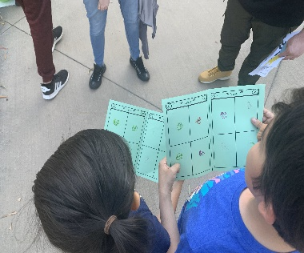
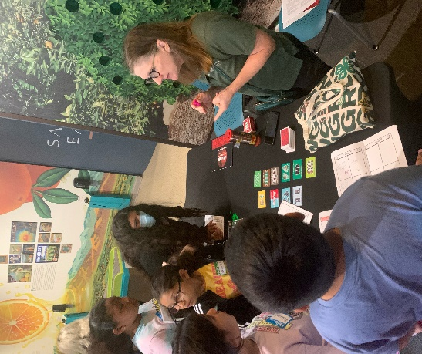
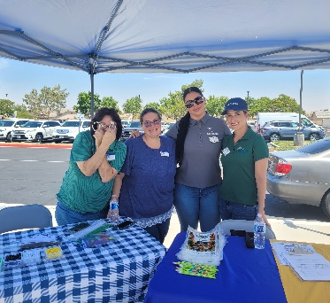
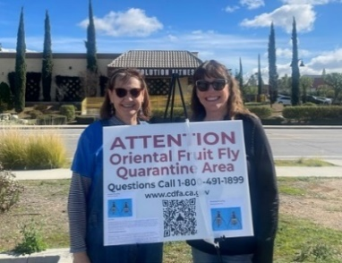
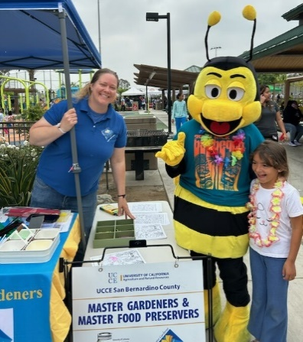
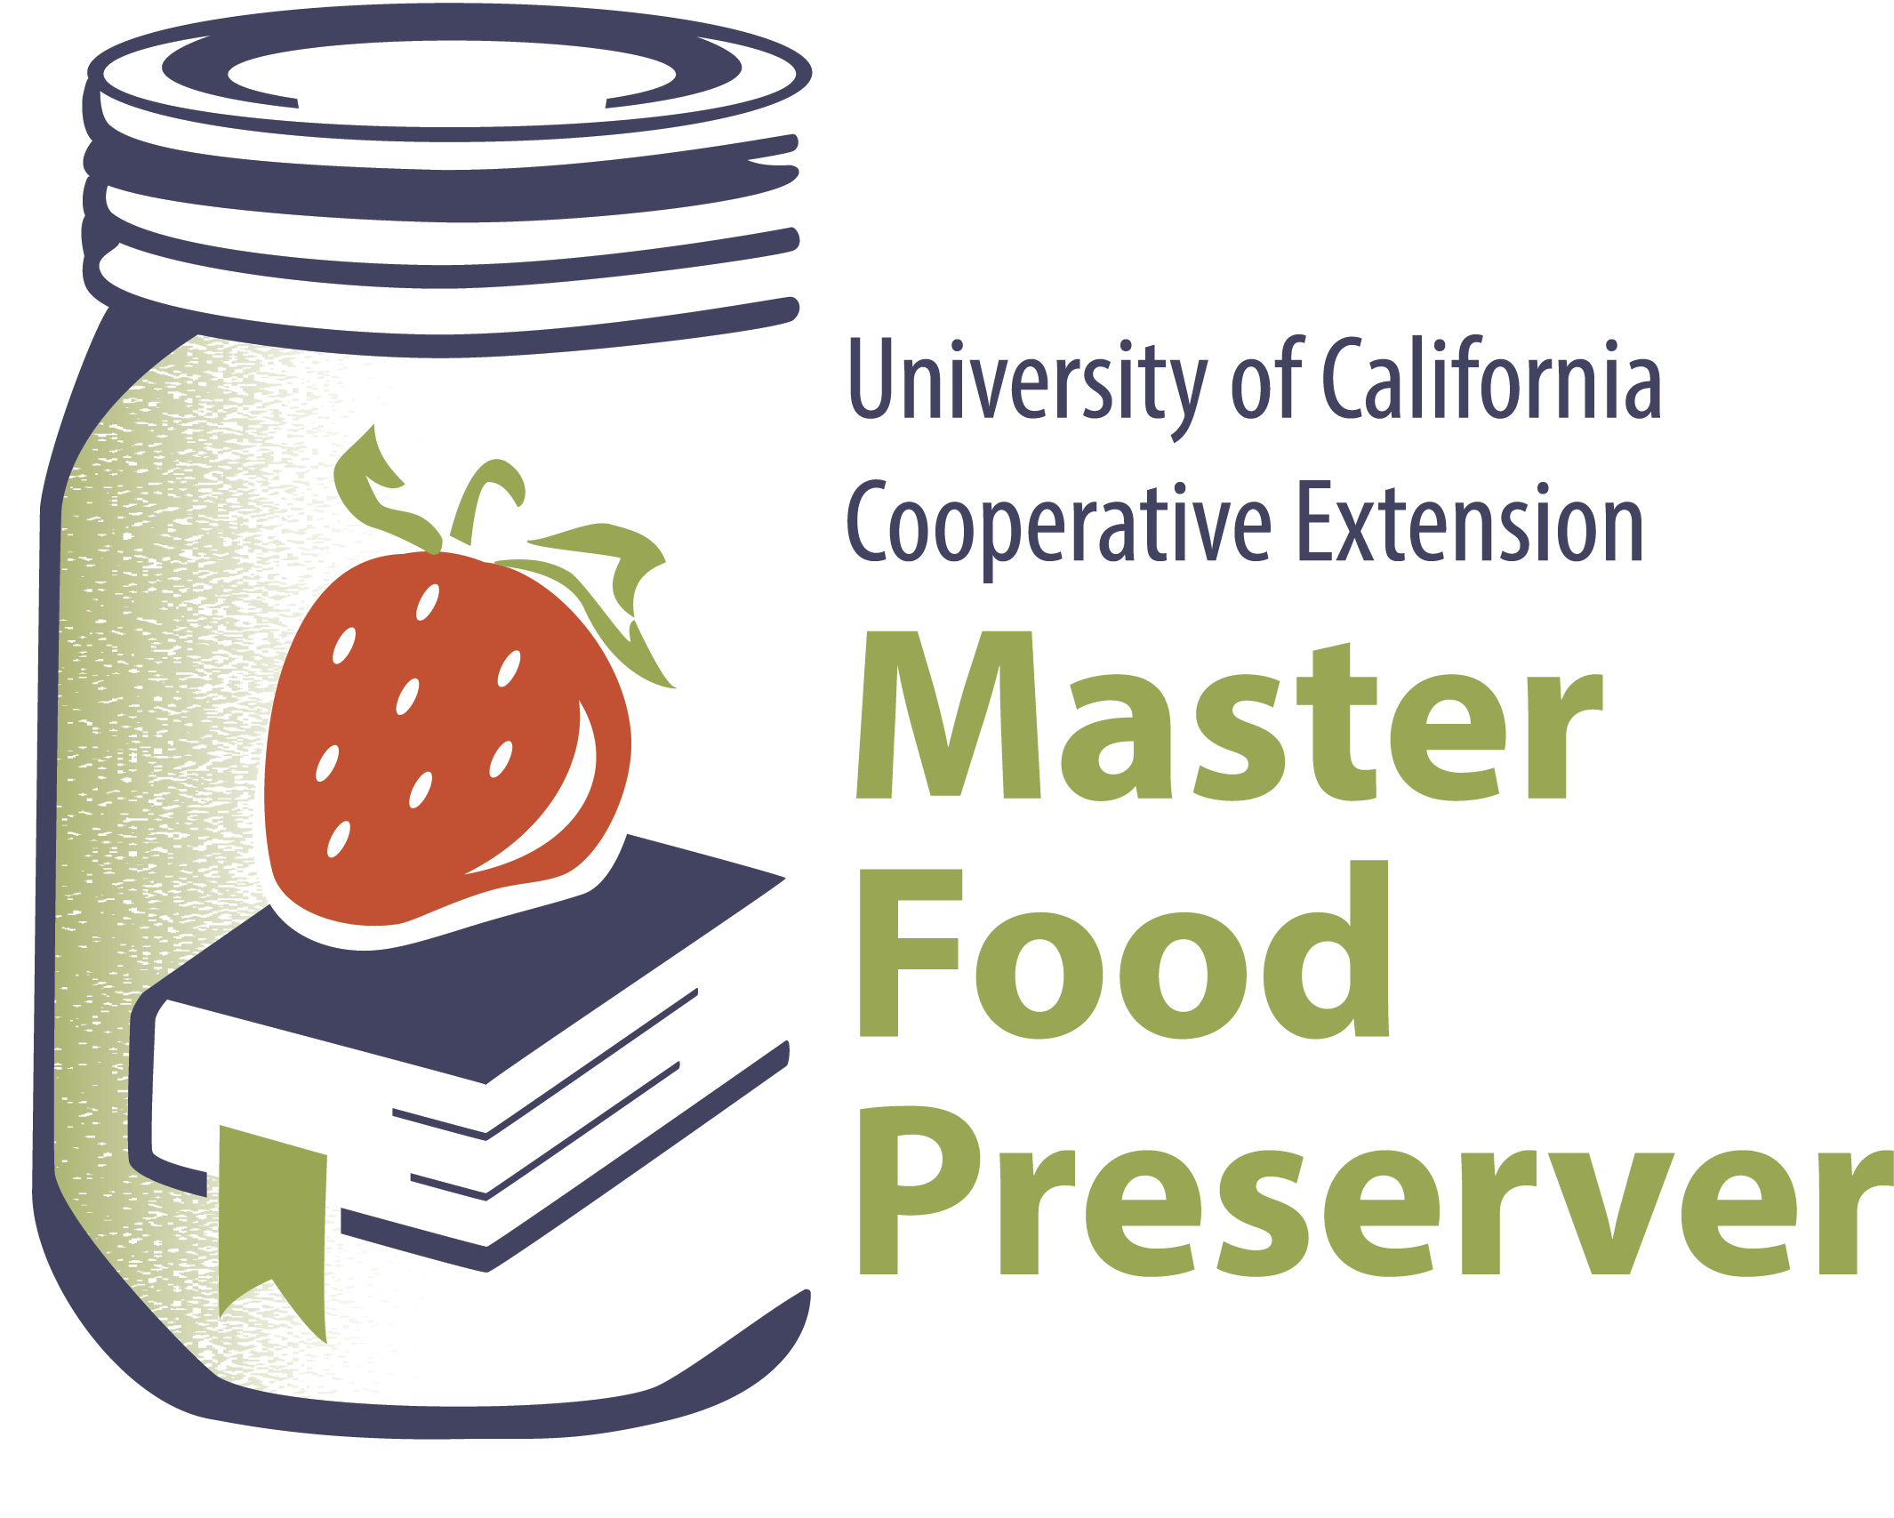
4-H Youth Development Program
4-H empowers young people with skills to lead for a lifetime
X adult and youth volunteers
X schools throughout the county received
STEAM activities, events, and training in partnership
with SBCSS Expanded Learning.
Add optional impact statement
4-H youth
4$×$
more likely to give back to their community
Photo Caption
Photo Caption
Food and Nutrition
Over # adults and youth attended food and nutrition workshops (EFNEP-Expanded Food and Nutrition Program) improving their health by being educated on their diet, physical activity, food safety, and food management.
UCCE Delivered Nutrition, Gardening and Food Preservation classes increasing
access to healthy food and food safety practices to San Bernardino communities.
Add optional impact statement
Studies have shown that for every $1 invested in EFNEP, more than $8 is saved in current and future healthcare costs.
Caption
Small Farms/Urban Agriculture Program
More than 50 farmers received over $750,000 in grants to mitigate the climate impact on crops.
Conducted 38 in-person workshops on specialty crop production, pest management, marketing, food safety, urban soil toxicity and management, organic farming and cover crops.
Hosted 30 virtual workshops on organic production.
Urban Agriculture/Small Farm extended research-based information to over 350 San Bernardino residents and 120 growers on sustainable crop production cycles, soil health, conservation and irrigation scheduling and integrated pest management to traditional and organic growers.
Photo Caption
UC Master Gardener # volunteers #volunteer hours $ in Community Services
UC Master Food Preserver # volunteers
# volunteer hours
$ in Community Services
Provided free workshops on food safety and preservation, answered MG helpline inquiries from the public, staffed Farmers Markets and public service booths, and wrote weekly newspaper columns that have reached over 35,000 county residents. Add optional impact statement
Environmental Horticulture and Natural Resources Program
Conducted applied research on climate-resilient drought landscape trees that reached over 1,800 end-users and provided free trees and tree care information to residents of low-shade neighborhoods.
Conducted applied research and education regarding important land management practices that reduce populations of the invasive garlic mustard.
Caption
Caption
UCCE Advisor-led Meetings, Courses, and Workshops
# professionals and residents attended # UCCE education events to increase their knowledge and capacity to protect natural environments from climate change, wildfire, invasive weeds and forest pests, and improve sustainability.
FOLLOW US: @HANDLE @HANDLE @HANDLE
Rita Clemons, Area Director
UC Agriculture and Natural Resources
https://cesanbernardino.ucanr.edu/
2024

